Slide 1
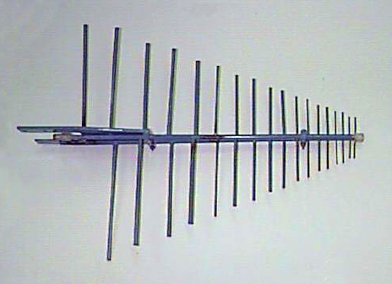
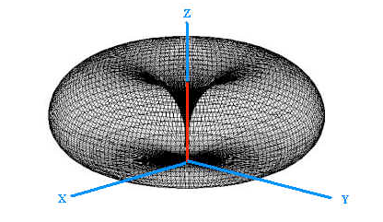
NEAR EAST UNIVERSITY
GRADUATE SCHOOL OF APPLIED SCIENCES
SIMULATIONS ON THE LINEAR DIPOLE ANTENNA:
APPLICATIONS TO YAGI-UDA AND RABBIT EARS ANTENNAS
Master Thesis defense
Prepared by :Talal KHADER
Supervised by : Assoc. Prof. Dr. Sameer IKHDAIR

Slide 2
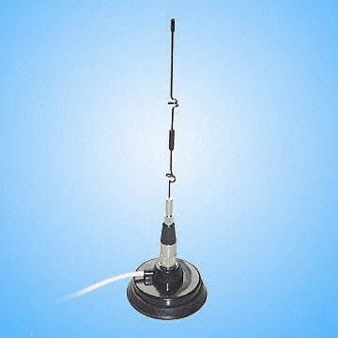
ABSTRACT
A dipole antenna is an antenna with a center- fed driven element for transmitting or receiving radio frequency energy. These antennas are the simplest practical antennas from a theoretical point of view. Dipole antennas are commonly used for broadcasting, cellular phones, and wireless communications due to their omnidirective property.
Antenna design is interactive. So, changing one dimension in each formula result in the need to change other dimensions or parameters which will take much time and calculations, Instead of formulas, the antenna design programs use interactive algorithms that automatically make all the other changes simple and easy.

Slide 3
AIM OF THE WORK
This thesis attempts to construct and analyze different types of dipole antennas such as half wave dipole antenna and rabbit ears (V) antenna.
These examples illustrate both the simplicity and power of the software such as PCAAD, MMANA, EZNEC and MATLAB, through the construction and simulation of these antenna structures.
As a practical application to dipole antennas, Yagi-Uda antenna is considered as one of the most important type of dipole antennas where, different number of elements are constructed and simulated to analyze its characteristics.
An implementation of Yagi-Uda antenna is designed and simulated in accordance with the broadcasting channels of Bayrak Radyo ve Televizyon Kurumu (BRTK) in Turkish Republic of Northern Cyprus (TRNC).

Slide 4
TABLE OF CONTENTS
1- INTRODUCTION.
2- CH1 : ANTENNA PARAMETERS.
3- CH2 : THE THEORY OF DIPOLE ANTENNAS AND YAGI-UDA
ANTENNA.
4- CH3 : MODELING METHODS AND SOFTWARE FOR ANTENNAS.
5- CH4 : SOME APPLICATIONS TO LINEAR DIPOLE ANTENNA
6- CONCLUSION AND FUTURE WORK

Slide 5
INTRODUCTION
An antenna is an electrical conductor or system of conductors
Transmission - radiates electromagnetic energy into space
Reception - collects electromagnetic energy from space
In two-way communication, the same antenna can be used for transmission and reception.
An antenna is a circuit element that provides a transition form a guided wave on a transmission line to a free space wave and it provides for the collection of electromagnetic energy.
In transmit systems the RF signal is generated, amplified, modulated and applied to the antenna.
In receive systems the antenna collects electromagnetic waves that are “cutting” through the antenna and induce alternating currents that are used by the receiver

Slide 6
HISTORY OF ANTENNA
The history of the antenna is a relatively young one. Started in 1842, when Joseph Henry used vertical wires on the roof of his house to detect lightning flashes. Later on, in 1864, James Clerk Maxwell presented the equations that form the basis for antenna technology and microwave engineering. In 1885, Thomas Edison patented a communications system that utilized top-loaded, vertical antennas for telegraphy. Two years later, Heinrich Hertz introduced a Hertzian dipole to experimentally validate Maxwell’s equation in regard that electromagnetic waves propagate through the air. Guglielmo Marconi, in 1898, developed radio commercially and pioneering transcontinental communications.
In 19th century, antennas have been used for lot of applications. The need for radar during the major wars of the 20th century sparked the creation of large reflectors, lenses, dipole and waveguide slot arrays. The antenna has been an essential component of the television set since the 1930’s.

Slide 7
ANTENNA PARAMETERS Table 1.1 Electromagnetic Spectrum and Some Applications

Slide 8
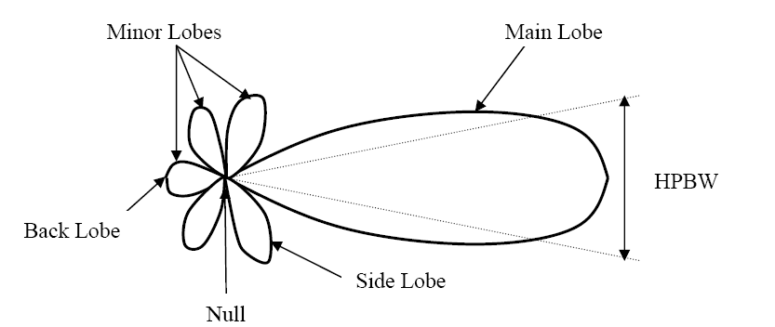
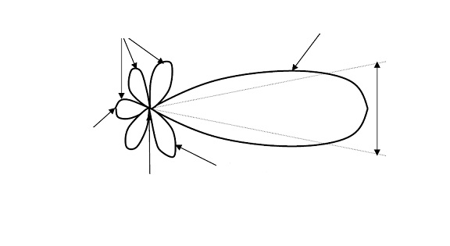
Radiation Pattern

Slide 9
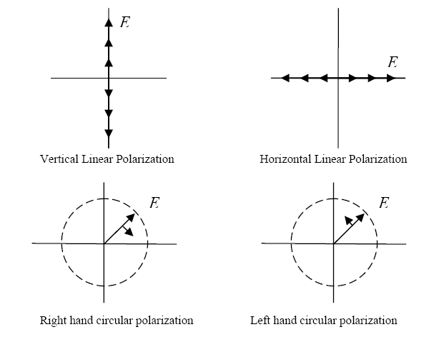
Polarization

Slide 10
Gain and Directivity AND ANTENNA EFFICIENCY
The term gain refers to the antenna’s effective radiated power compared to the effective radiated power of some reference antenna.
● When the isotopic model is used, the gain will be stated in dBi (meaning gain in dB over isotopic)
In antennas, power gain in one direction is at the expense of losses in others
Directivity is the gain calculated assuming a lossless antenna.
The antenna efficie ncy is a parameter which takes into account the amount of losses at the terminals of the antenna within the structure of the antenna. The types of losses are given as follows:
1- Reflections because of mismatch between the transmitter and the antenna.
2- losses (conduction and dielectric) .

Slide 12
Impedance
Impedance is the relationship between voltage and current at any point in an alternating current circuit.
The impedance of an antenna is equal to the ratio of the voltage to the current at the point on the antenna where the feed is connected (feed point).

Slide 13
DIPOLE ANTENNAS
Wire antennas are the most familiar antennas because they are seen virtually everywhere. There are various shapes of wire antennas such as a straight wire (dipole), loop and helix antenna. Dipole antennas have been widely used since the early days of radio communication.
The 1/2 wave Dipole Antenna is one of the simplest antenna designs.

Slide 15
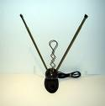
rabbit ears (V) antenna
The most common dipole antenna is the rabbit ears (V) type used with televisions. While theoretically the dipole elements should be along the same line, rabbit ears are adjustable in length and angle. Larger dipoles are sometimes hung in a V shape with the center near the radio equipment on the ground or the ends on the ground with the center supported. Shorter dipoles can be hung vertically. Some have a dial also used to clarify the picture. In each house we can see this type of antenna

Slide 16
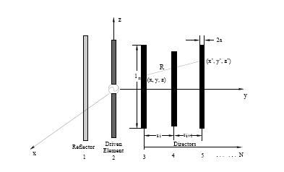
Yagi- Uda Antenna
The Yagi-Uda antenna was invented in 1926 by Shintaro Uda with the collaboration of Hidetsugu Yagi in Tohoku University, Sendai, Japan.
The Yagi-Uda was first widely used during (WW II) for airborne radar sets, because of its simplicity and directionality.

Slide 17
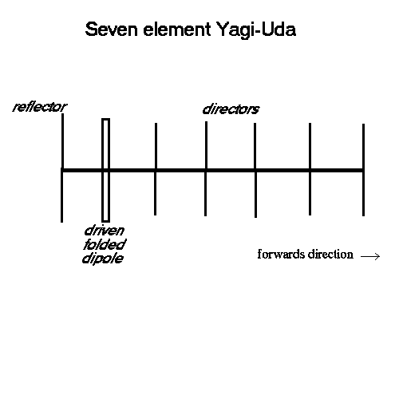

Slide 18
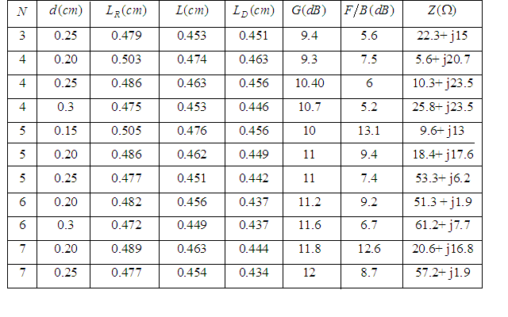
Table 2.2 Characteristics of Equally Spaced Yagi-Uda Antennas

Slide 20
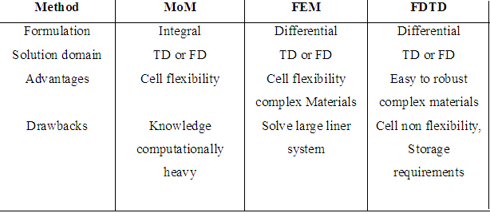
Table 3.1 Main Features of the Most Commonly Used by EM Simulation Techniques

Slide 21
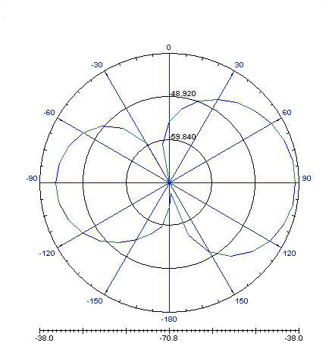
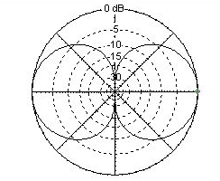
Figure 3.5 EM simulators for Radiation Pattern with Half Wave Dipole Antenna
(a) (b)
.
Figure 3.5 presents the radiation pattern of the half wave dipole antenna using different software that use different methods, where (a) is the output of the gain from High Frequency Structure Simulator (HFSS) which uses FEM method and (b) is an EZNEC software which uses MoM method.

Slide 22
Company | Software Name | Method of Analysis | Domain of Analysis | Price
Agilent | HFSS | FEM | Frequency | Unknown *
Zeland | IE3-D | FEM | Frequency | $14.800
Remco | XFDTD | FTDT | Time | Unknown *
Antenna Design Associates | PCAAD | MoM | Frequency | $490.00
Computer Simulation Technology | CST | MoM | Frequency | $17.000
Antenna Software W7EL | EZNEC Pro 5 | MoM | Frequency | $650.00
MMANA | MMANA | MoM | Frequency | FREE

Slide 23
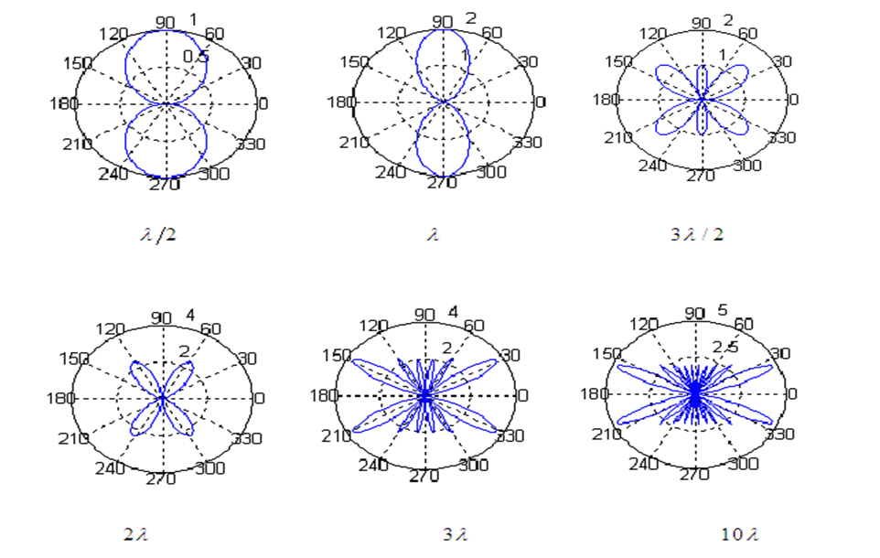
MATLAB Simulations

Slide 24
MMANA Simulations for Half Wave Dipole Antenna
Table 4.2 Gain, Resistance, and Reactance as a Function of Dipole Length in Free Space.
Length (l) | Gain (dBi) | Resistance (Ω) | Reactance (Ω)
0.1 | 1.77 | 1.969 | -3655
0.2 | 1.81 | 8.181 | -1729
0.3 | 1.89 | 20.705 | -934
0.4 | 2 | 40.67 | -409.5
0.5 | 2.15 | 76.88 | 44.02
0.6 | 2.35 | 145.6 | 526.7
0.7 | 2.61 | 298 | 1159
0.8 | 2.94 | 757.4 | 2231
0.9 | 3.36 | 3447 | 4539
1 | 3.87 | 6374 | -5440
1.5 | 3.53 | 110 | 49.65

Slide 25
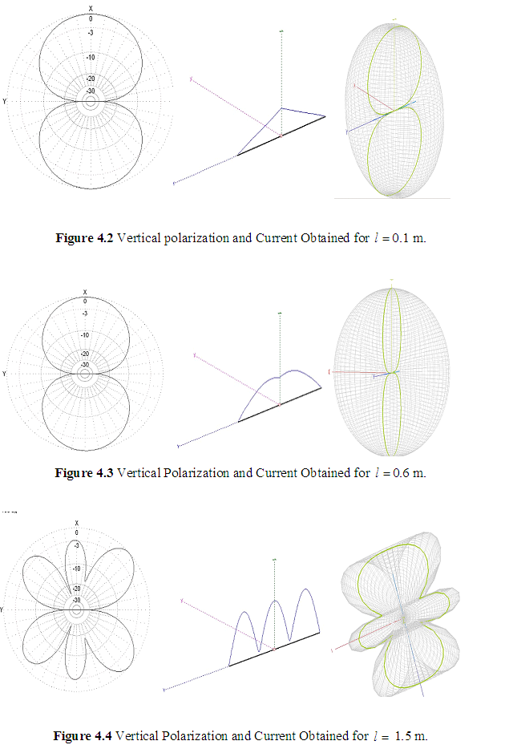
1.5 m.

Slide 26
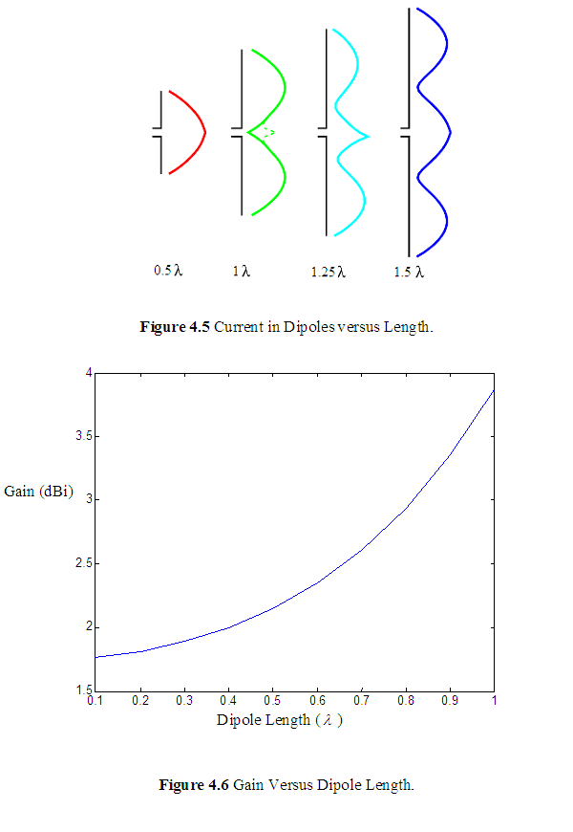
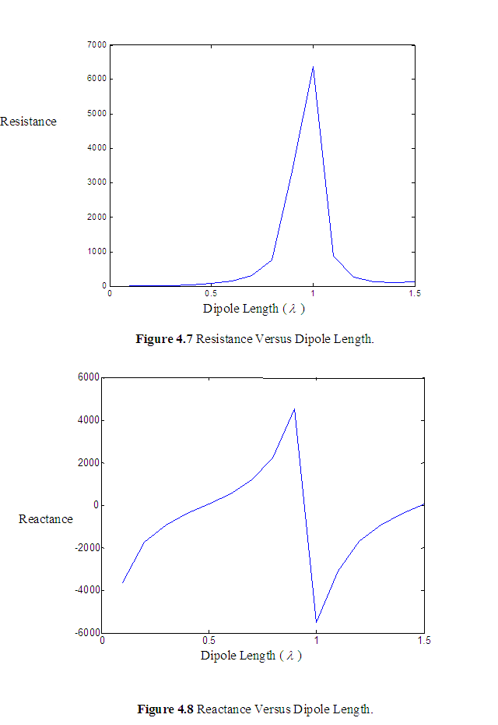
Dipole Length (
Dipole Length (
Figure 4.8 Reactance Versus Dipole Length.

Slide 27
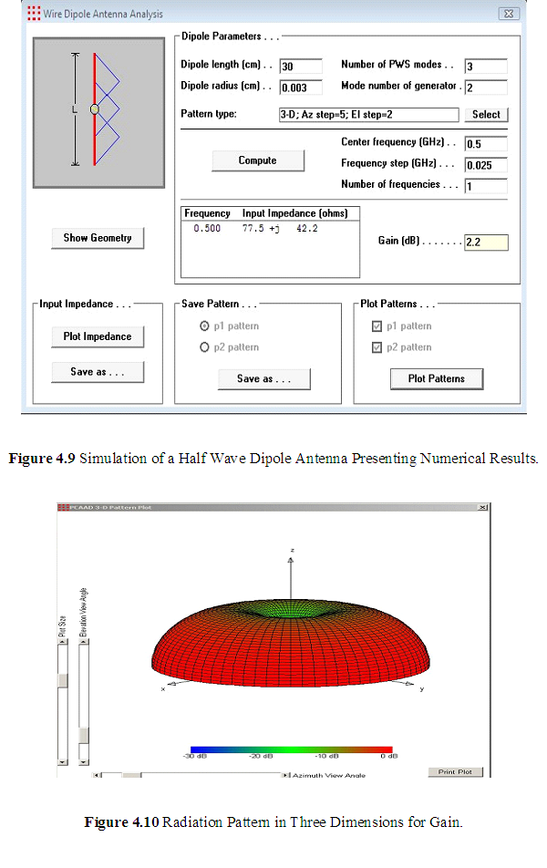
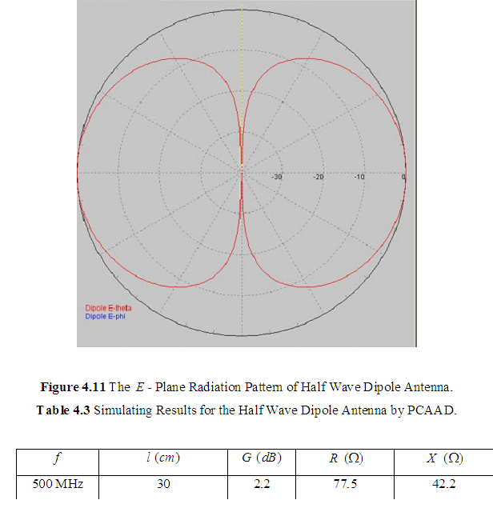
PCAAD Simulations for Half Wave Dipole Antenna

Slide 28
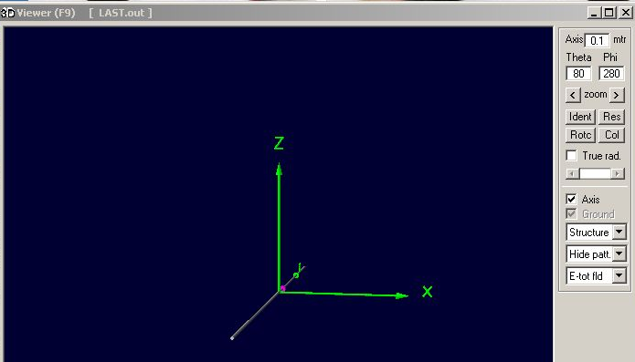
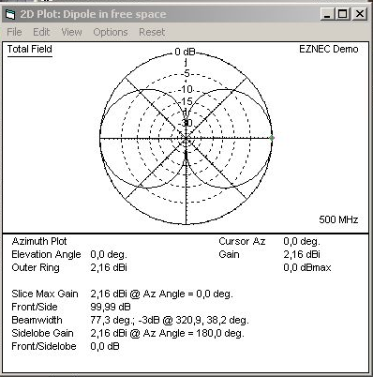
EZNEC and 4NEC2 Simulations for Half Wave Dipole Antenna
Figure 4.13 A Plot for the Simulated Structure by EZNEC and 4NEC2
Figure 4.12 Structure of the Half Wave Dipole Antenna.

Slide 29
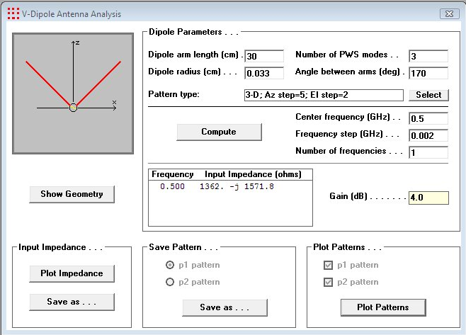
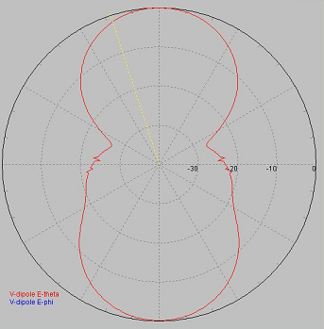
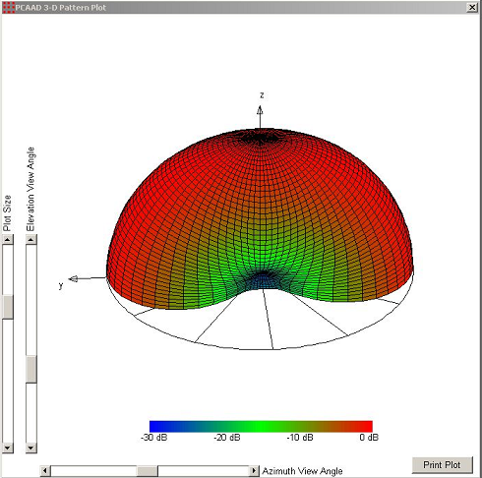
PCAAD Simulations to Rabbit Ears (V) Antenna
.

Slide 30
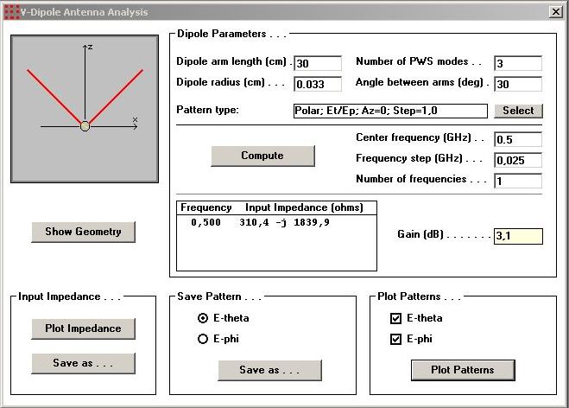
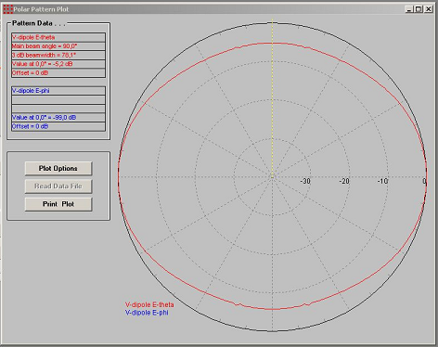
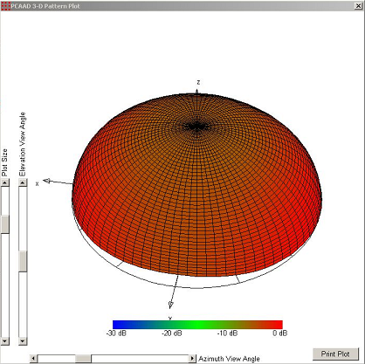

Slide 31
Table 4.5 The Gain of the Rabbit Ears (V) Antenna using Different Angles and Lengths.
(cm) | (Degree)
30 | 170 | 4
30 | 30 | 3.1
20 | 170 | 2.5
20 | 30 | 1
15 | 170 | 2.2
15 | 70 | 1.6
10 | 170 | 1.9

Slide 32
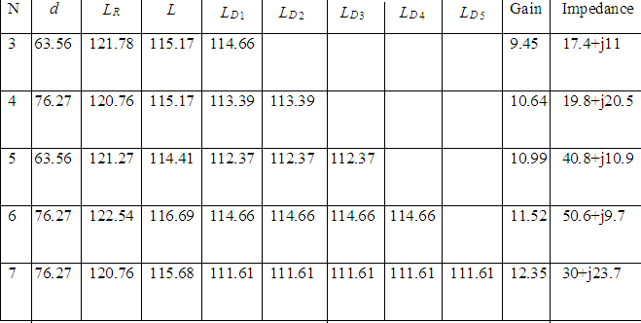
PCAAD Simulations of Yagi-Uda Antenna
Table 4.6 Various Parameters for Yagi-Uda Antenna.

Slide 33
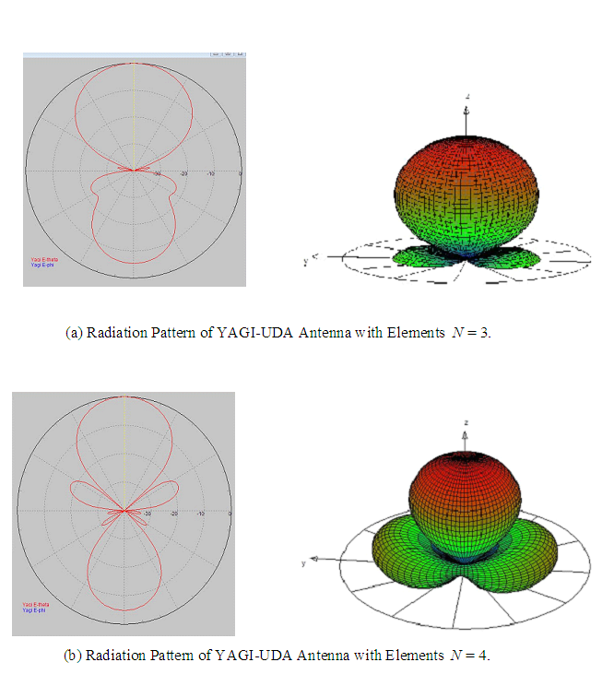
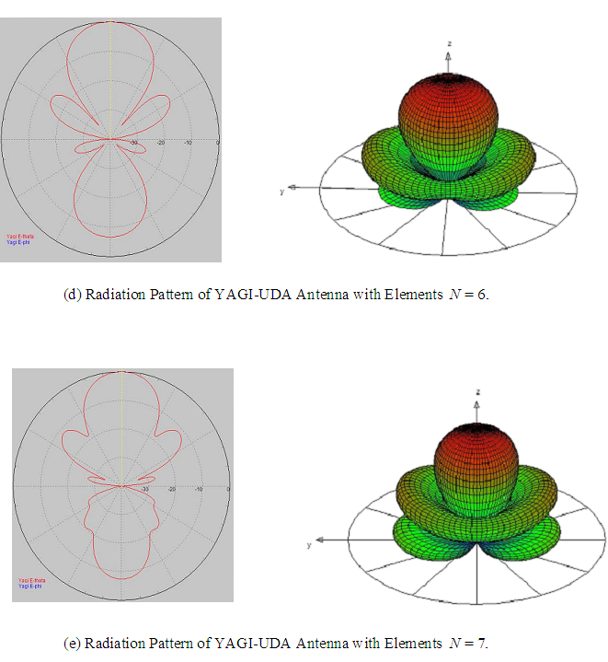

Slide 34
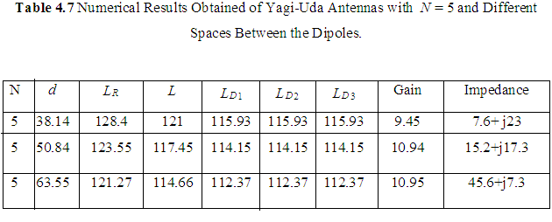

Slide 35
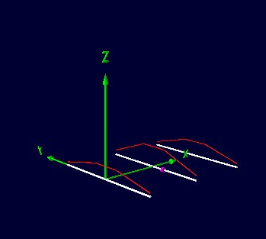
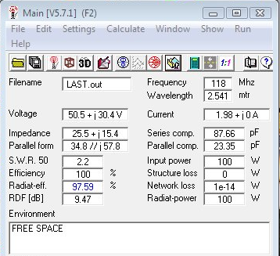
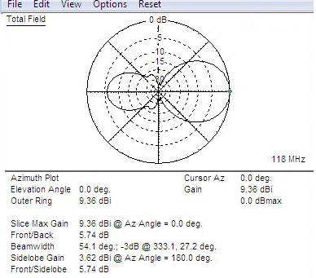
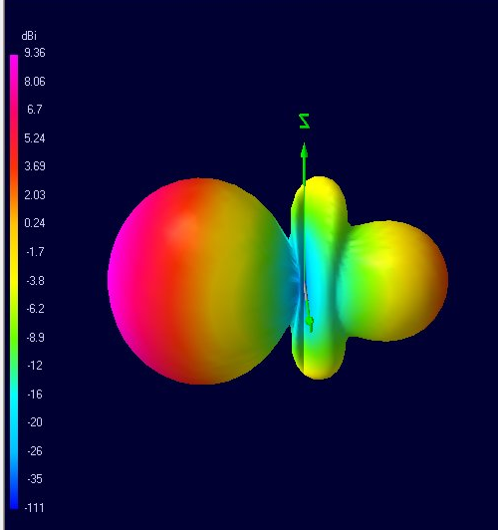
EZNEC and 4NEC2 Simulations of Yagi-Uda Antenna
Figure 4.20 Results for Gain, Impedance, Structure and Radiation Pattern, Respectively, Obtained for
N= 3 Elements of Yagi-Uda Antenna.

Slide 36
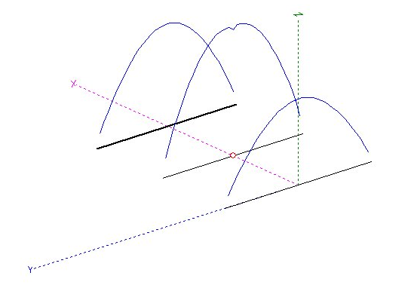
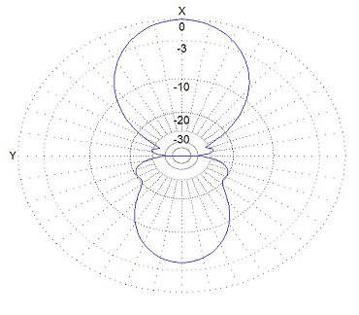
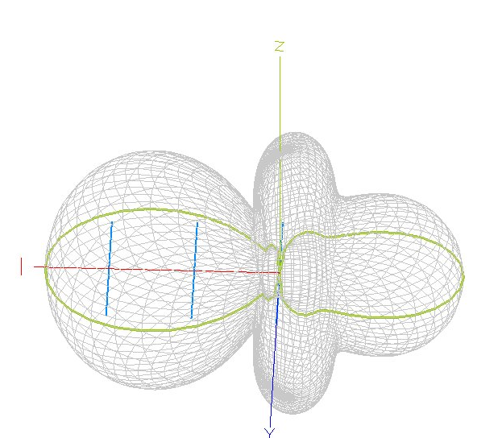
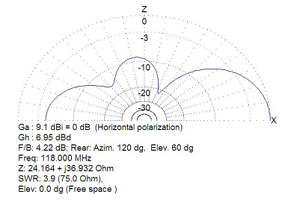
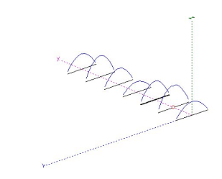
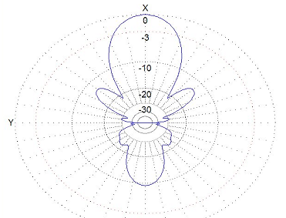
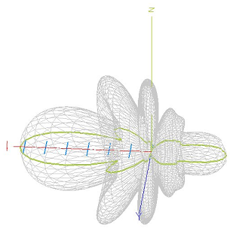
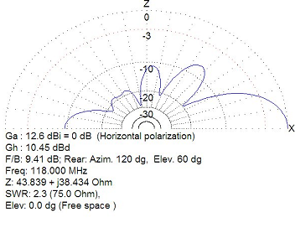
MMANA Simulations of Yagi-Uda Antenna
Simulated Results for Vertical Polarization, Horizontal Polarization, Current Distribution and 3D of Radiation Pattern Obtained for =3 Elements Using Yagi-Uda Antenna
Simulated Results for Vertical Polarization, Horizontal Polarization, Current Distribution and 3D of Radiation Pattern Obtained for =7 Elements Using Yagi-Uda Antenna.

Slide 37
Table 4.10 Commonly Used Frequencies in RRTK TV .
Region 1 (EAST) | Location: Sinandağı
Channel | TV. Channel
VHF 08 | TRT1
UHF 21 | BRT1
UHF 50 | BRT2
Region 2 (WEST) | Location: Selvilitepe
VHF 11 | TRT1
UHF 41 | TRT2
UHF 44 | BRT1
UHF 33 | BRT2

Slide 38
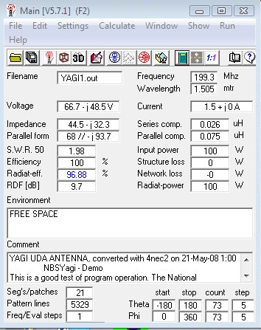
Implementation of Yagi-Uda Antenna

Slide 39
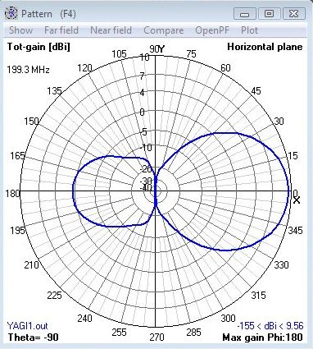
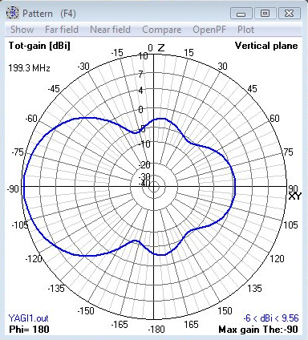
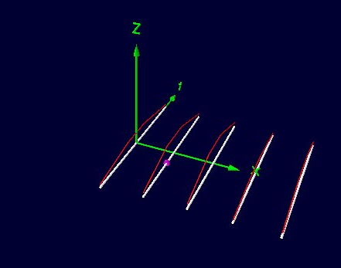
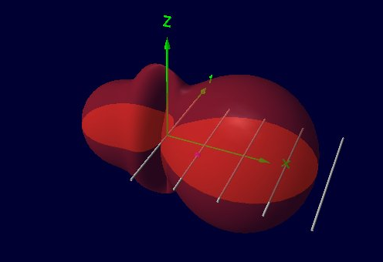

Slide 40
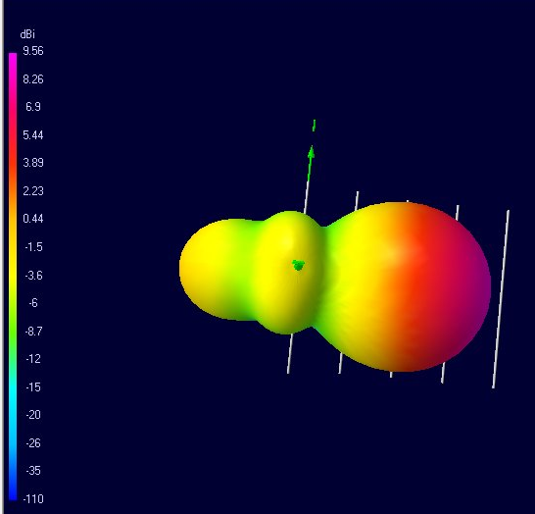
Figure 4.24 Simulated Results for Vertical Polarization, Horizontal Polarization, Current Distribution and 3D of Radiation Pattern Obtained for N 5 Elements for Yagi-Uda Antenna Designed

Slide 41
CONCLUSION
1-The length of the dipole increase, the lobes will increase. This would affect on the performance of the antenna.
2-MMANA software was simulated to investigate the dependence of grain and feed point impedance on the length of a dipole in free space. According to the results, dipole gain increases when the length of the dipole increases, the resonance occurs at slightly less than one-half wavelength and radiation resistance is about 75 Ω. The half-wave dipole has a single current peak, while the 1.5 dipole has three current peaks, each acting as a source of radiation, so that interference can be expected, dipoles longer than one wavelength exhibited unwanted side lobes, while shorter ones are not. Due to that the half wave dipoles are popular because they are relatively easy to match to standard 50 Ω or 75 Ω coaxial cables as they do not contain side lobes.
3-The Rabbit ears antenna was simulated by using different angles and length. The results showed that adjusting the length of each leg would make the antenna resonant on different frequencies. Adjusting the angle between the two "ears" is found to affect the radiation pattern. Making a smaller angle makes the antenna behaving more like an isotropic radiator, i.e., it receives signals all around with almost no attenuation. Once the angle is increased, the pattern becomes a straight dipole, having deep nulls at each end

Slide 42
CONCLUSION
4-Frequency increases wavelength decreases, Gain is inversely proportional to wavelength,
so as frequency increases gain also increases. Furthermore, the gain is directly proportional to
Area of the aperture, so as the area of the antenna increases gain also increases. Noting that
gain is inversely proportional to beam width. As side lobe level increases, the signals will be
spitted in the unwanted direction and signal strength at the required direction will be less.
5-In Yagi-Uda the more directors, the more focused the gain is in the direction of the directors which lead to incensement in the amount of gain and decrease the bandwidth of the radiation patterns
6-Same numbers of elements were used and the spaces were changed. This change has affected on the characters of the antenna, the spaces between the directors increase, the gain also increases.
7-The mechanical and environment side were not considered in the simulations for the implemented antenna, but the main parameters to be used in calculating the gain, input impedance and efficiency were given. According to the theoretical point of view this type of antenna has a good performance.

Slide 43
FUTURE WORK
Various types of antennas would be also simulated such as horn antenna, helical antenna
or possibly the more developed antennas such as smart antennas.
Computer software were used to design the implemented antenna, this type of antenna
can be done in real life, so practical and experimental methods can be used for these
types of antenna, or other types.

