Slide 1
Chapter 1
Why Study Money, Banking, and Financial Markets?

Slide 2
Why Study Financial Markets?
1. Channel funds from savers to investors, thereby promoting economic efficiency
2. Affect personal wealth and behavior of business firms
Why Study Banking and Financial Institutions?
1. Financial Intermediation
Helps get funds from savers to investors
2. Banks and Money Supply
Crucial role in creation of money
3. Financial Innovation
Why Study Money and Monetary Policy?
1. Influence on business cycles, inflation, and interest rates

Slide 3
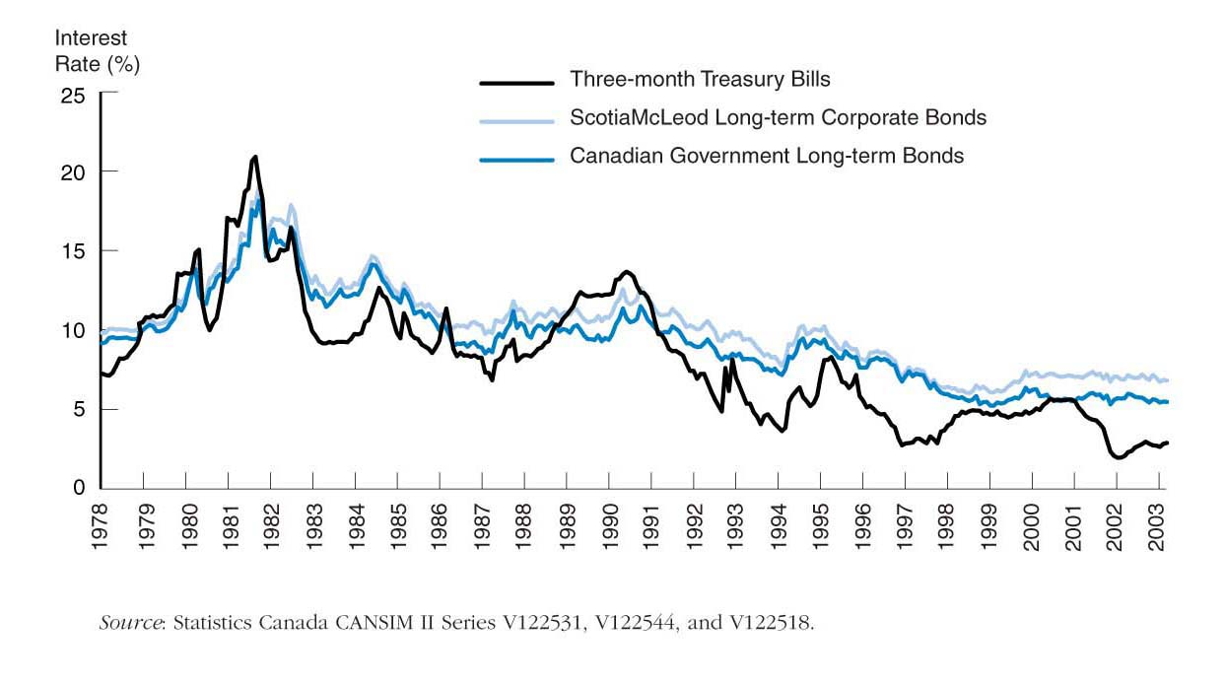
Bond Market

Slide 4
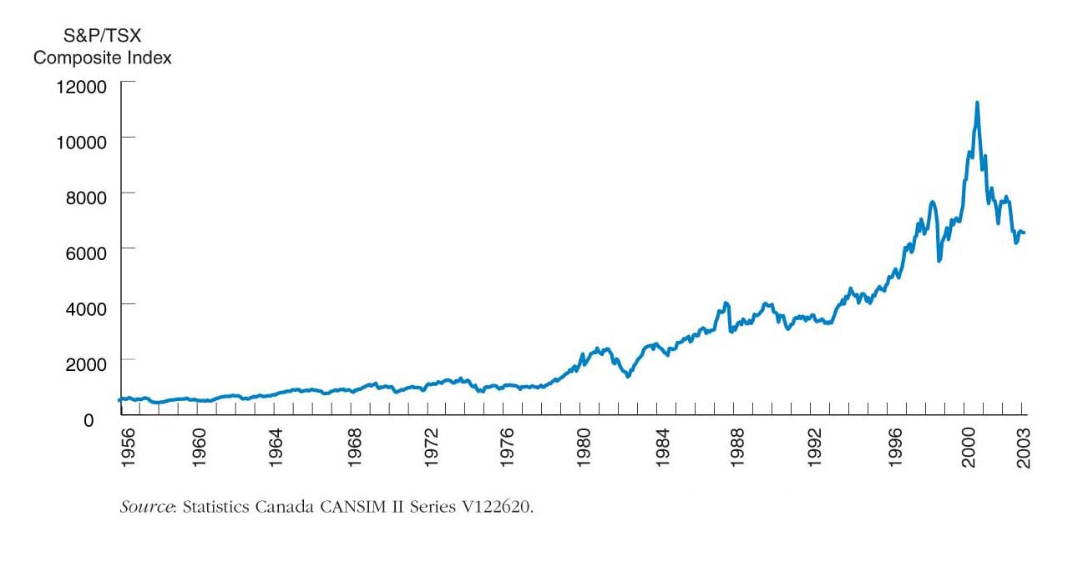
Stock Market

Slide 5
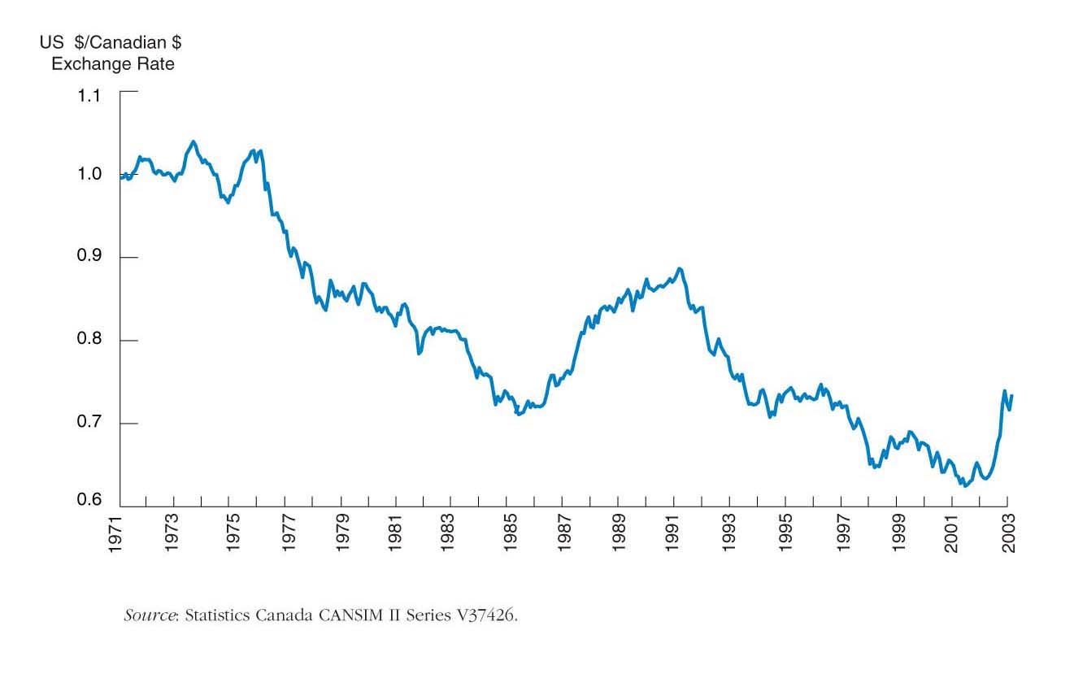
Foreign Exchange Market

Slide 6
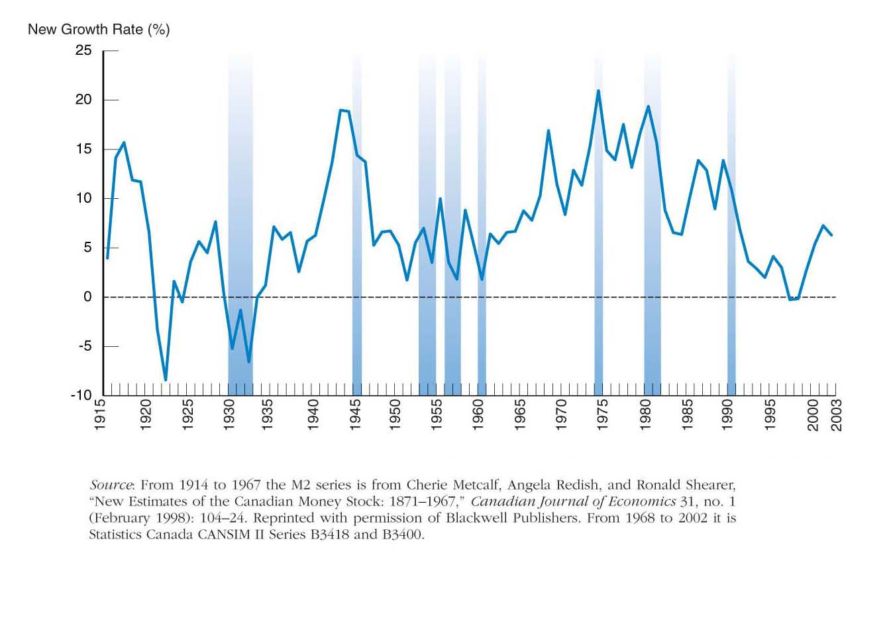
Money and Business Cycles

Slide 7
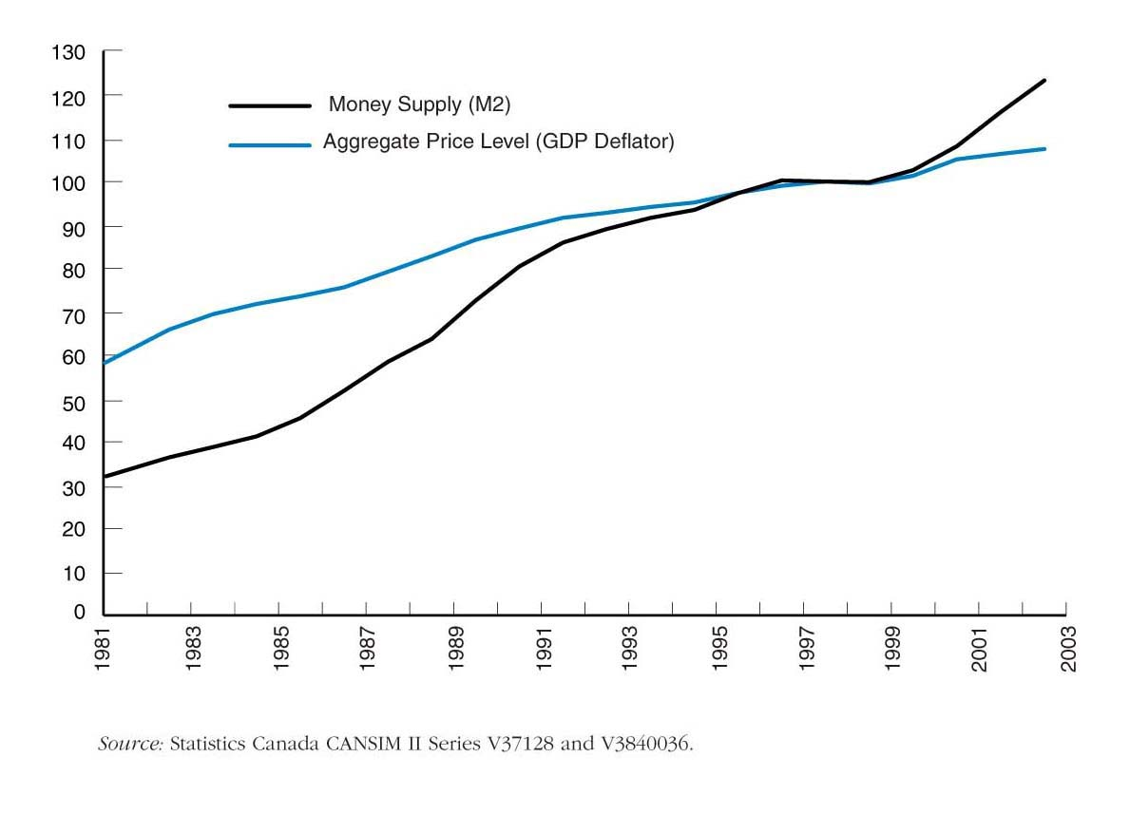
Money and the Price Level

Slide 8
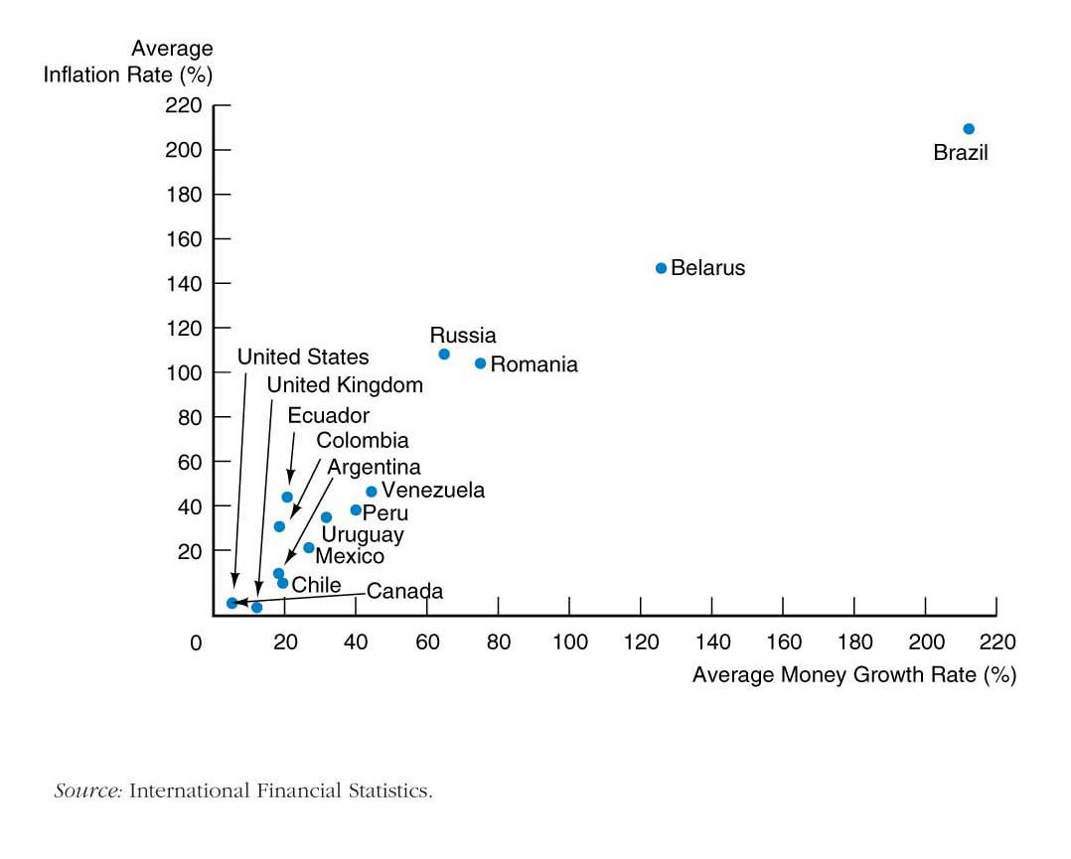
Money Growth and Inflation

Slide 9
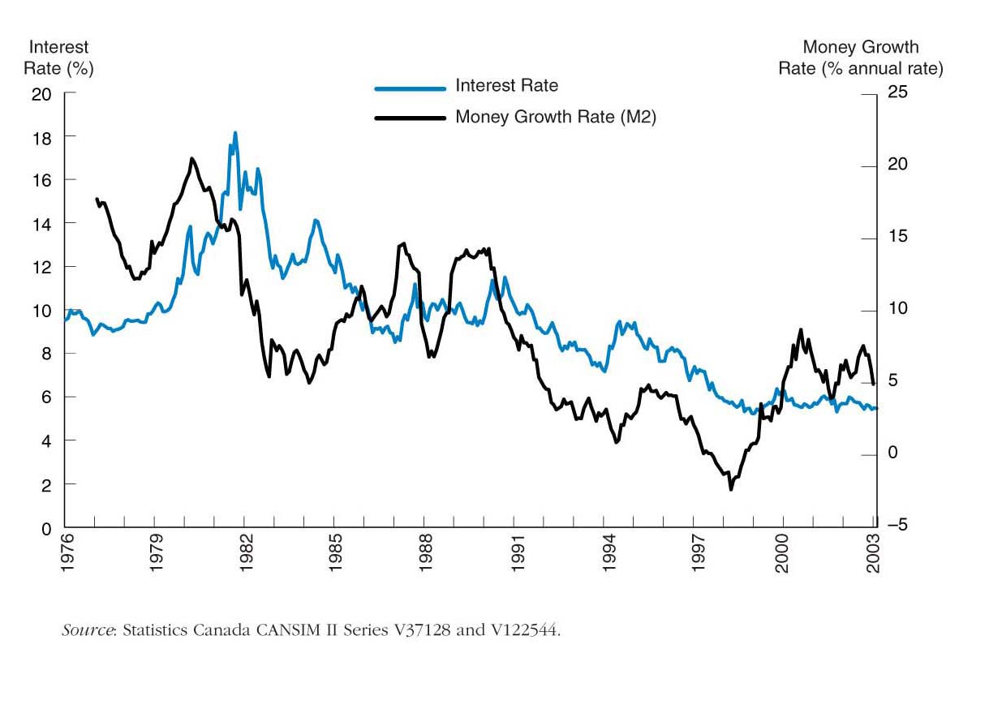
Money Growth and Interest Rates

Slide 10
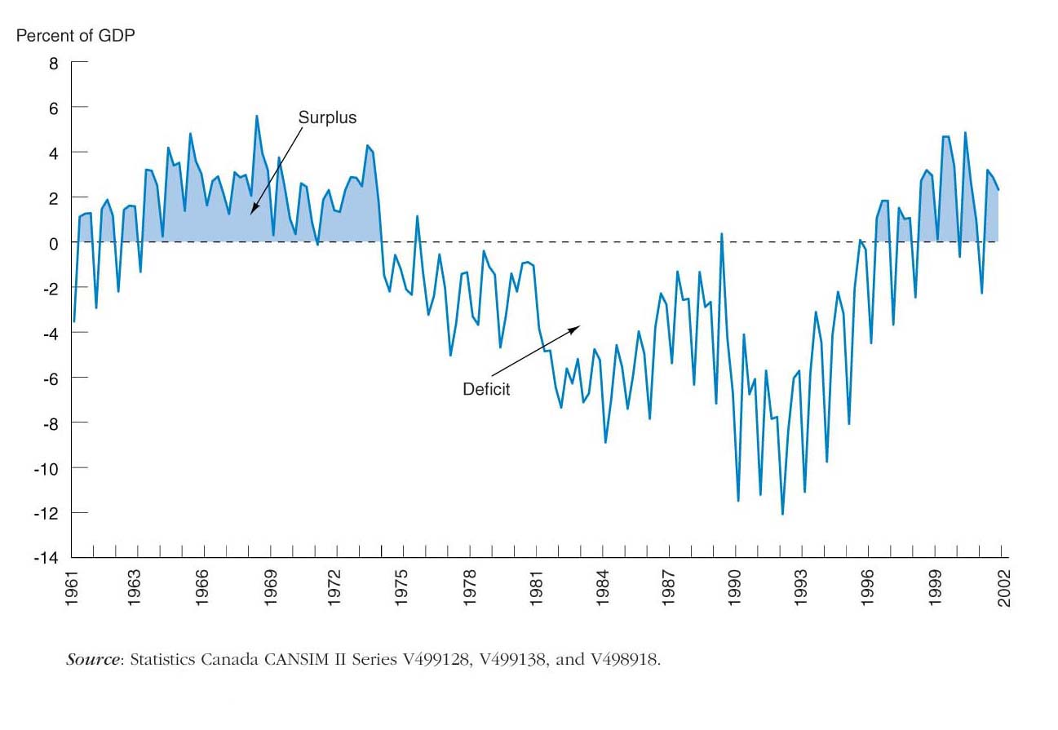
Fiscal Policy and Monetary Policy

Slide 11
How We Study Money and Banking
Basic Analytic Framework
1. Simplified approach to the demand for assets
2. Concept of equilibrium
3. Basic supply and demand approach to understand behavior in financial markets
4. Search for profits
5. Transactions cost and asymmetric information approach to financial structure
6. Aggregate supply and demand analysis
Features
1. Case studies
2. Applications
3. Special-interest boxes
4. Following the Financial News boxes
5. Reading the financial pages
6. Web Exercises and URLs
© 2005 Pearson Education Canada Inc.

Slide 12
Appendix: Definitions
Aggregate Output
Gross Domestic Product (GDP) = Value of all final goods and services produced in domestic economy during year
Aggregate Income
Total income of factors of production (land, capital, labor) during year
Distinction Between Nominal and Real
Nominal = values measured using current prices
Real = quantities, measured with constant prices
Aggregate Price Level
nominal GDP
GDP Deflator =
real GDP
$10 trillion
GDP Deflator = = 1.11
$9 trillion
Consumer Price Index (CPI) price of “basket” of goods and services

Slide 13
Appendix: Definitions
Growth Rates and the Inflation Rate

