Slide 1
Chapter 23
The Keynesian Framework and the ISLM Model
© 2005 Pearson Education Canada Inc.

Slide 2
Determination of Output
Keynesian ISLM Model assumes price level is fixed
Aggregate Demand
Y^{ad} = C + I + G + NX
Equilibrium
Y = Y^{ad}
Consumption Function
C = a + (mpc × Y_{D})
Investment
1. Fixed investment
2. Inventory investment
Only planned investment is included in Y^{ad}
© 2005 Pearson Education Canada Inc.

Slide 3
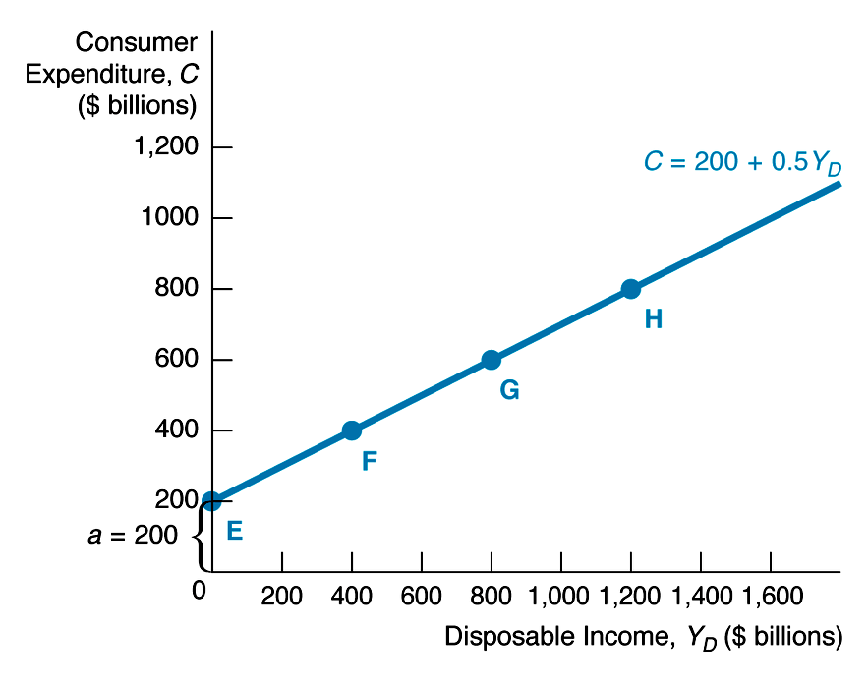
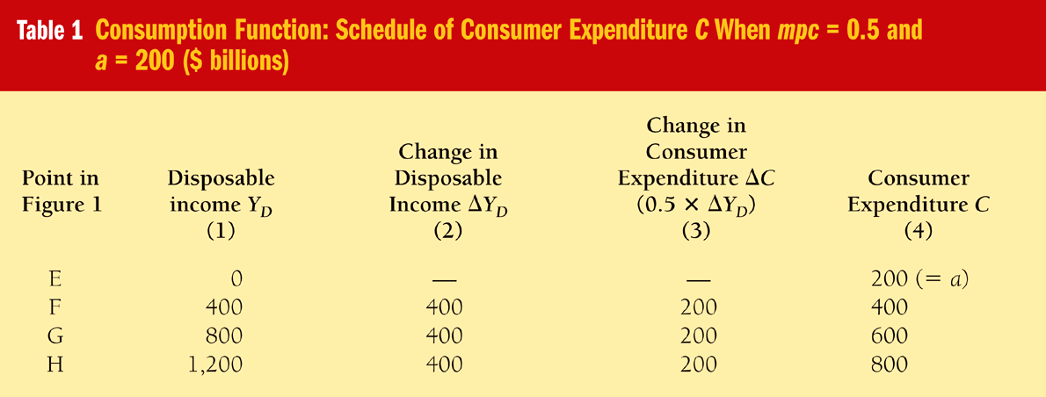
Consumption Function
© 2005 Pearson Education Canada Inc.

Slide 4
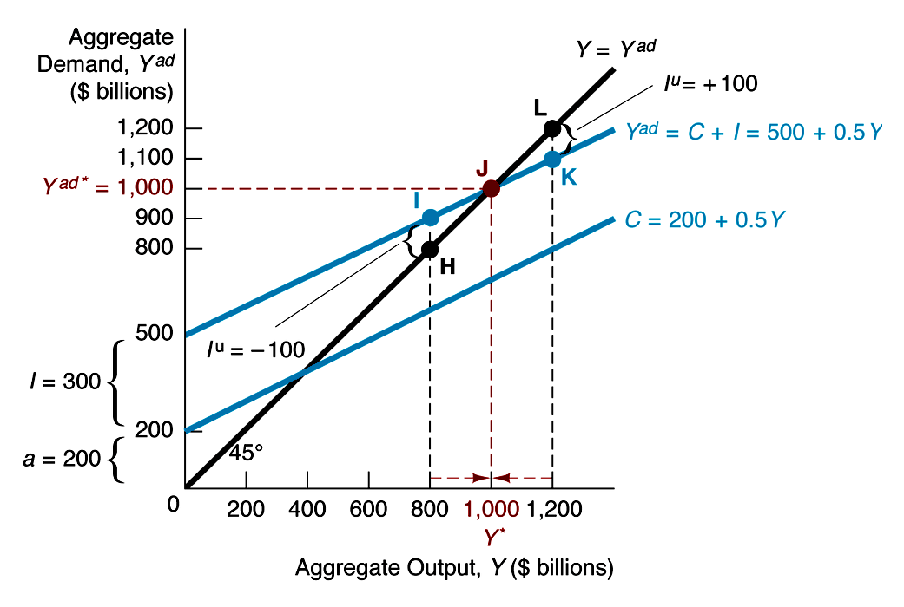
Keynesian Cross Diagram
Assume G = 0, NX = 0, T = 0
Y^{ad} = C + I = 200 + .5Y + 300 = 500 + .5Y
Equilibrium:
1. When Y > Y*, I^{u} > 0 ⇒ Y ↓ to Y*
2. When Y < Y*, I^{u} < 0 ⇒ Y ↑ to Y*

Slide 5
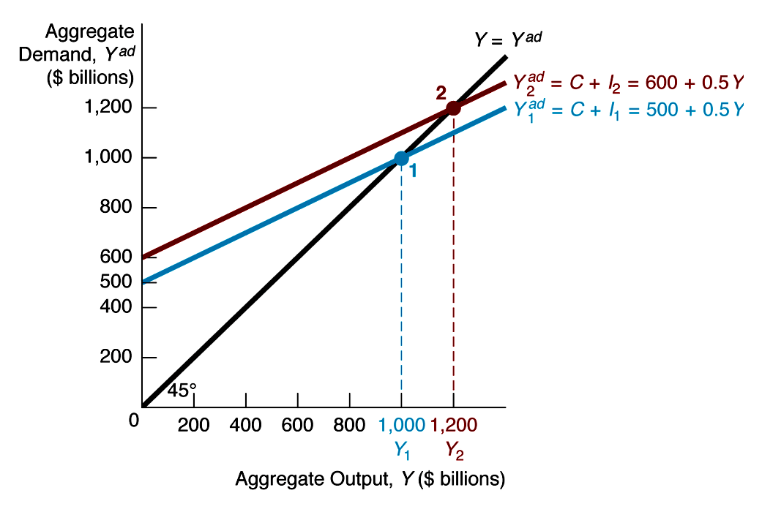
Expenditure Multiplier

Slide 6
Analysis of Figure 3: Expenditure Multiplier
ΔI = + 100 ⇒ ΔY/ΔI = 200/100 = 2
1
Y = (a + I) ×
1 – mpc
A = a + I = autonomous spending
Conclusions:
1. Expenditure multiplier = ΔY/ΔA = 1/(1 – mpc) whether change in A is due to change in a or I
2. Animal spirits change A

Slide 7
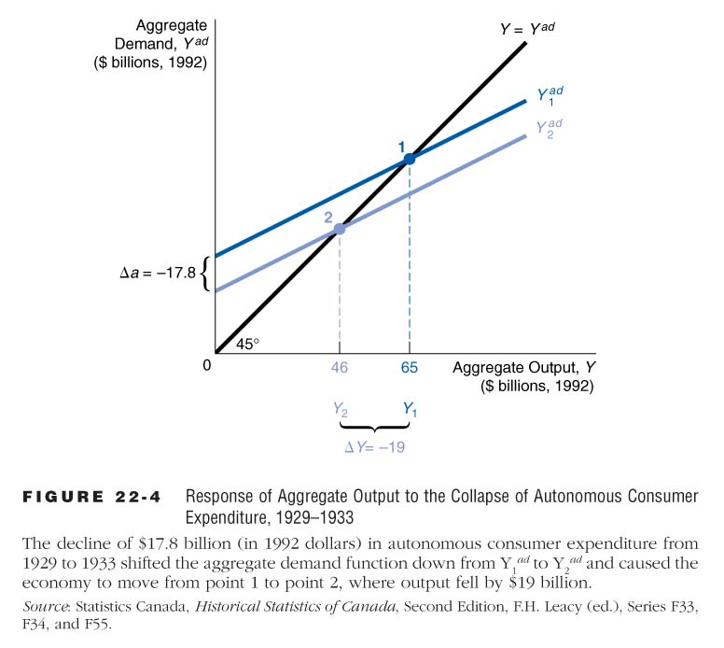
The Great Depression and the Collapse of Investment

Slide 8
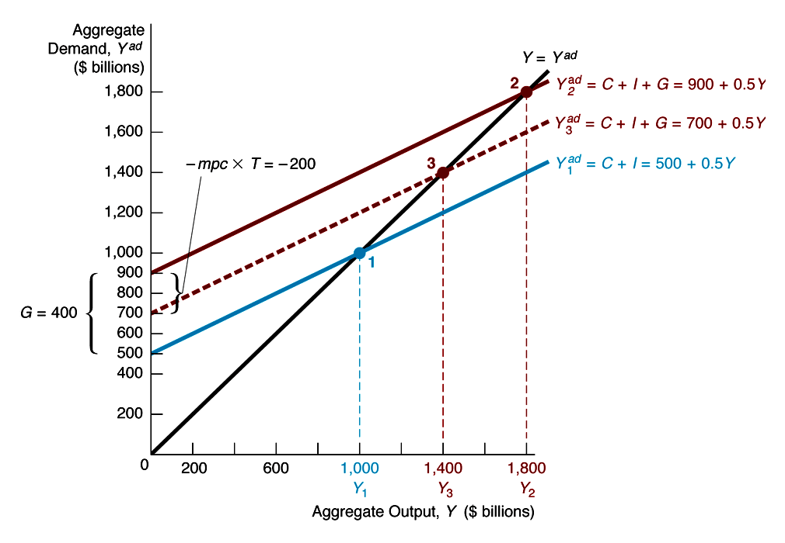
Role of Government

Slide 9
Analysis of Figure 23-5: Role of Government
ΔG = + 400, Δ T = + 400
1. With no G and T, Y^{d} = C + I = 500 + mpc × Y = 500 + .5Y, Y₁ = 1000
2. With G, Y= C + I + G = 900 + .5Y, Y₂ = 1800
3. With G and T, Y^{d} = 900 + mpc × Y – mpc × T = 700 + .5Y, Y₃ = 1400
Conclusions:
1. G ↑ Y ↑; T ↑ Y ↓
2. ΔG = ΔT = + 400, Y ↑ 400

Slide 10
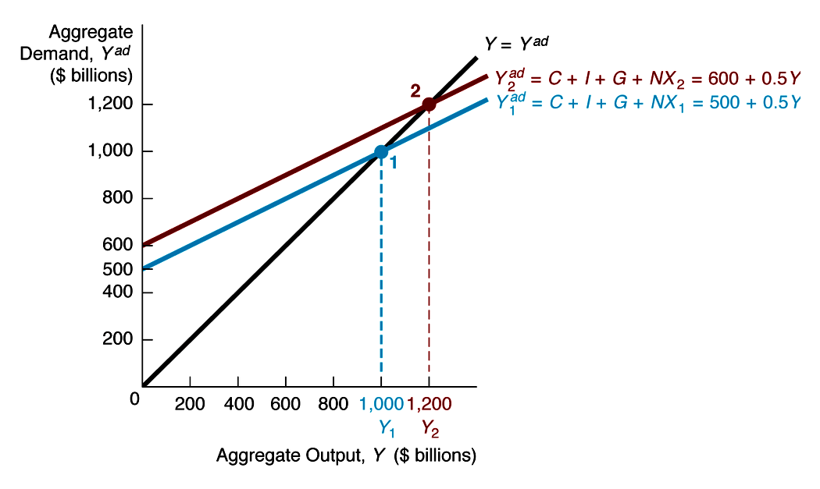
Role of International Trade
ΔNX = +100,
ΔY/ΔNX = 200/100 = 2 = 1/(1 – mpc) = 1/(1 – .5)

Slide 11
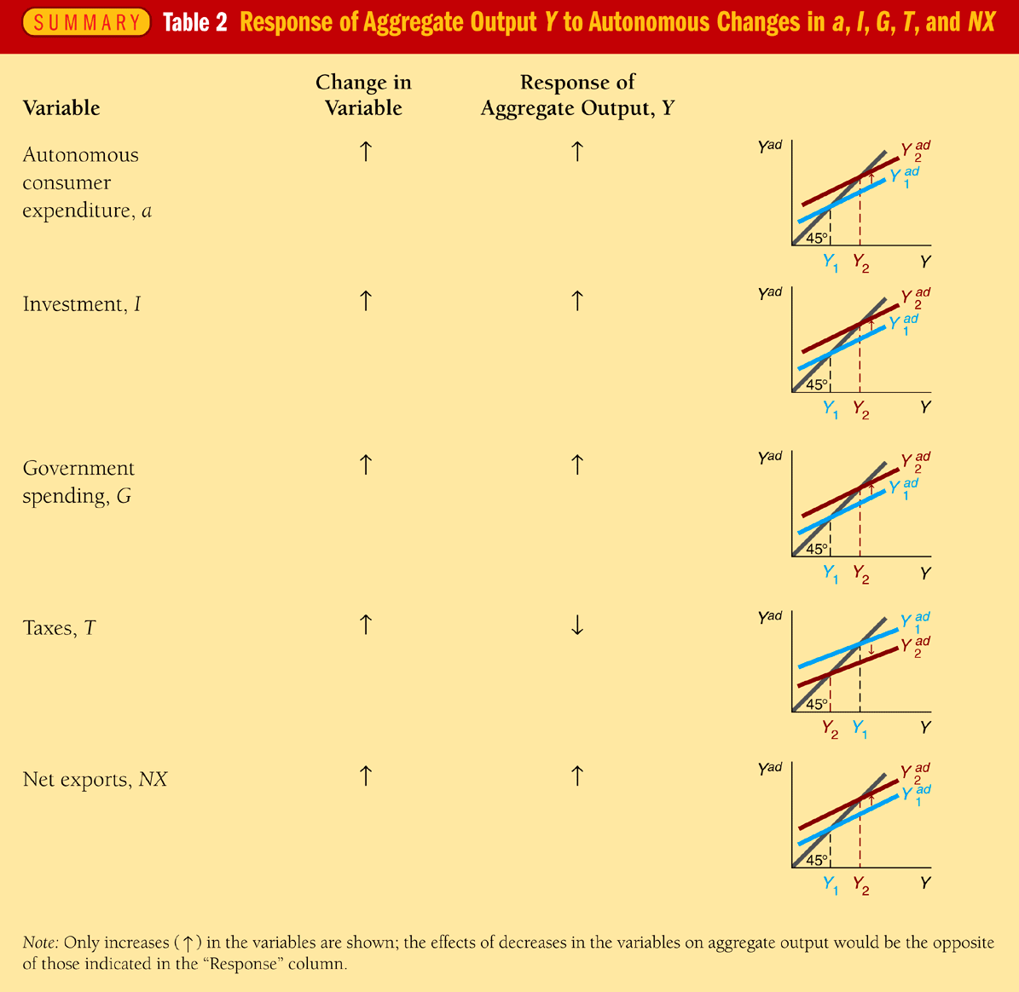
Summary: Factors that Affect Y

Slide 12
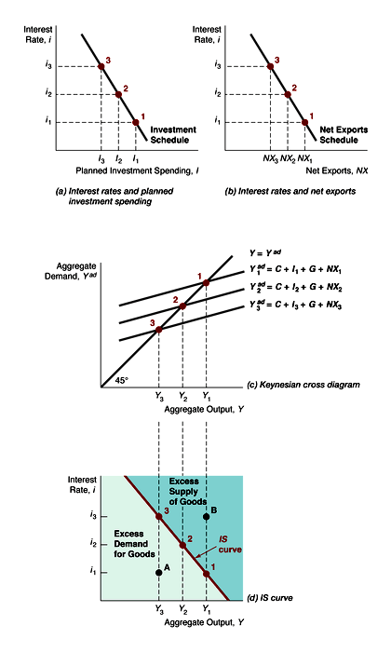
IS Curve
IS curve
1. i ↑ I ↓ NX ↓, Y^{ad} ↓, Y ↓
Points 1, 2, 3 in figure
2. Right of IS: Y > Y^{ad} ⇒ Y ↓ to IS
Left of IS: Y < Y^{ad} ⇒ Y ↑ to IS
© 2005 Pearson Education Canada Inc.

Slide 13
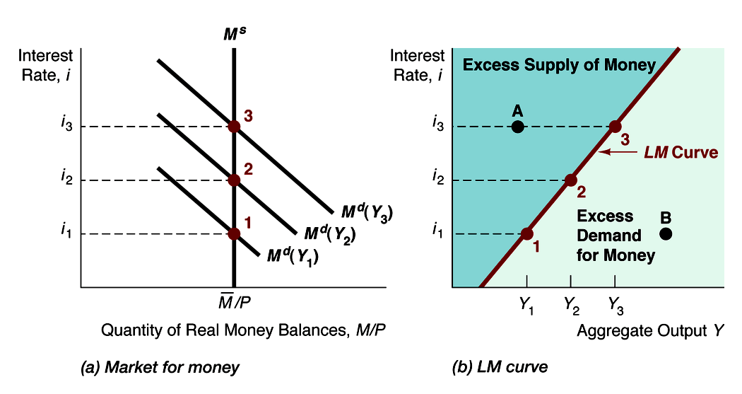
LM Curve
LM curve
1. Y ↑, M^{d} ↑, i ↑ Points 1, 2, 3 in figure
2. Right of LM: excess M^{d}, i ↑ to LM Left of LM : excess M^{s}, i ↓ to LM
© 2005 Pearson Education Canada Inc.

Slide 14
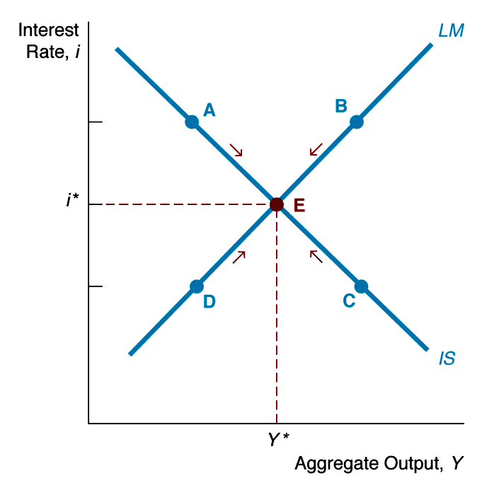
ISLM Model
Point E, equilibrium where Y = Y^{ad} (IS) and M^{d} = M ^{s} (LM )
At other points like A, B, C, D, one of two markets is not in equilibrium and arrows mark movement towards point E

