Slide 1
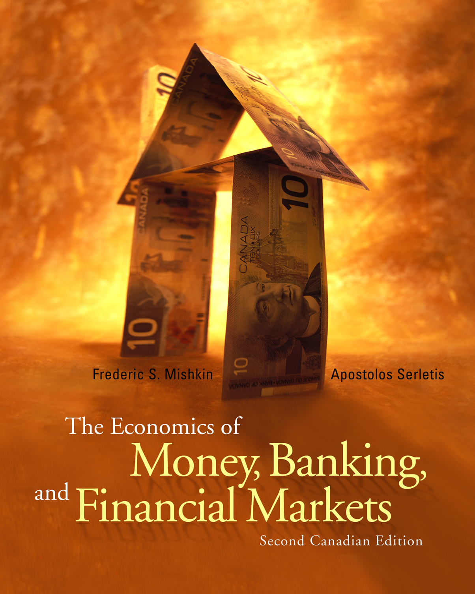
Chapter 28
Rational Expectations: Implications for Policy
© 2005 Pearson Education Canada Inc.

Slide 2
Lucas Critique
Lucas challenges usefulness of econometric models for policy evaluation
1. Critique follows from RE implication that change in way variable moves, changes way expectations are formed
2. Policy change, changes relationship between expectations and past behavior
3. Estimated relationships in econometric model change
4. Therefore, can’t be used to evaluate change in policy
Example: Evaluate effect on long rate from Bank policy raising short-term i permanently, if in past changes in i quickly reversed
1. Estimated term structure relationship indicates only small change in long rate
2. Once realize short i ↑ permanently, average future short rates ↑ a lot, long rate ↑ a lot
3. Another implication of Lucas analysis: expectations about policy influences response to policy

Slide 3
New Classical Model
Assumptions:
1. Rational expectations
2. Wages and prices completely flexible, adjust fully to changes in expected price level
Implications:
1. Policy ineffectiveness proposition: anticipated policy has no effect on business cycle
2. Effects of policy are uncertain because depend on expectations
3. No beneficial effect from activist policy: supports nonactivism
© 2005 Pearson Education Canada Inc.

Slide 4
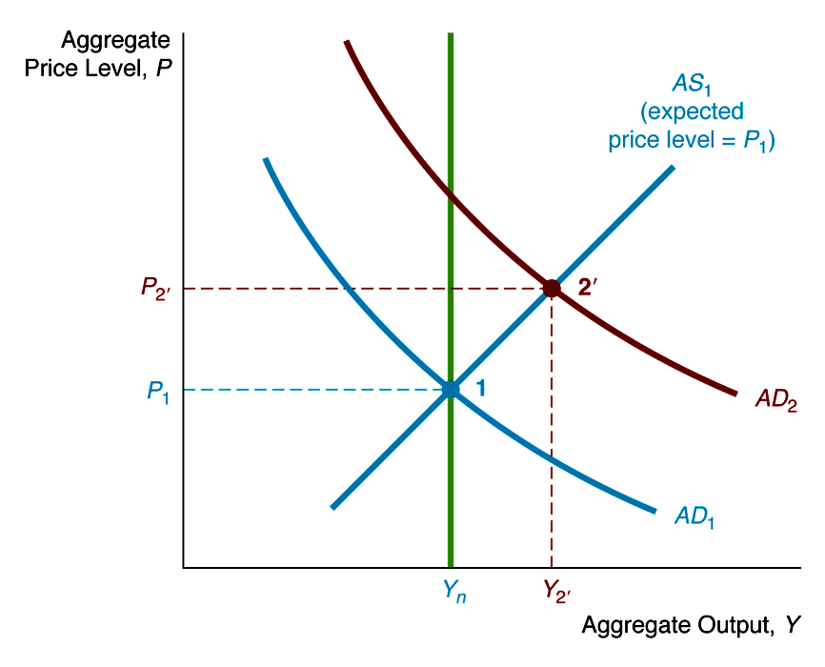
Response to Unanticipated Policy in New Classical Model
1. M ↑, AD shifts right to AD₂
2. Because M ↑ unanticipated, expected price level unchanged and AS stays at AS₁
3. Go to 2': Y ↑, P ↑

Slide 5
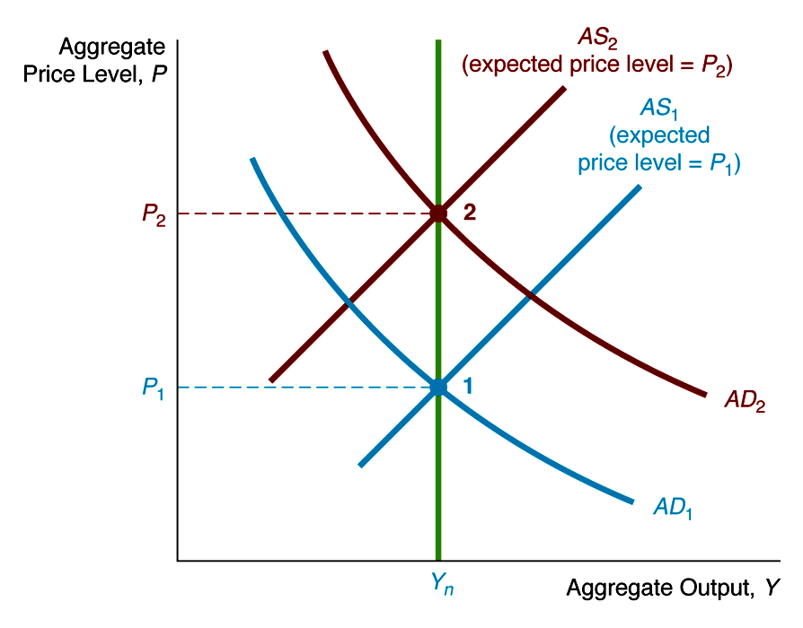
Response to Anticipated Policy in New Classical Model
1. M ↑, AD shifts right to AD₂
2. M ↑ anticipated, expected price level ↑ to P₂, AS shifts in to AS₂
3. Go to 2: Y unchanged, P ↑ by more

Slide 6
New Keynesian Model
Assumptions:
1. Rational expectations
2. Wages and prices have rigidity: don’t adjust fully to changes in expected price level
Implications:
1. Unanticipated policy has larger effect on Y than anticipated policy
2. Policy ineffectiveness does not hold:
Anticipated policy does affect Y
3. Does not rule out beneficial effect from activist policy
4. However, effects of policy are affected by expectations: designing policy is tough
© 2005 Pearson Education Canada Inc.

Slide 7
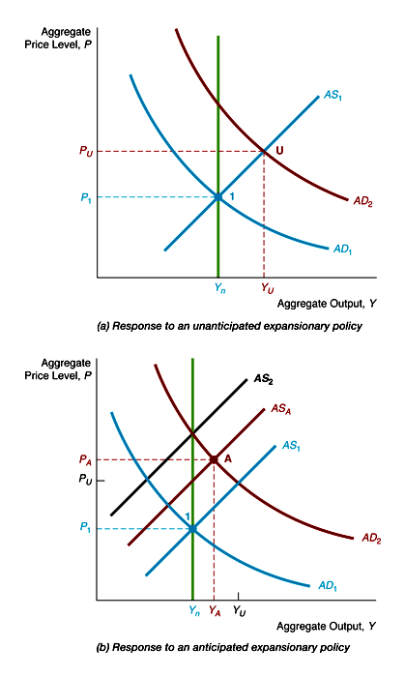
Response to Expansionary Policy in New Keynesian Model
1. M ↑, AD shifts out to AD₂
2. Panel (a): M ↑ unanticipated, AS stays at AS_{1;}; go to U, Y ↑ P ↑
3. Panel (b): M ↑ anticipated, AS shifts to AS_{A} (not all the way to AS₂); go to A, Y ↑ by less than in panel (a), P ↑ by more

Slide 8
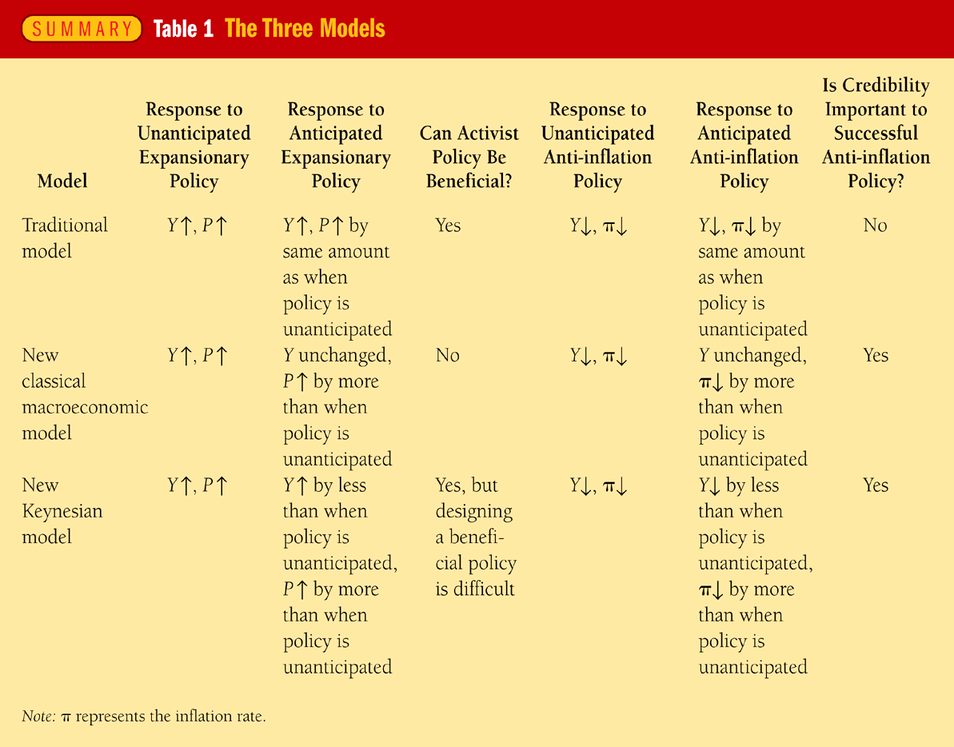
Summary: The Three Models
© 2005 Pearson Education Canada Inc.

Slide 9
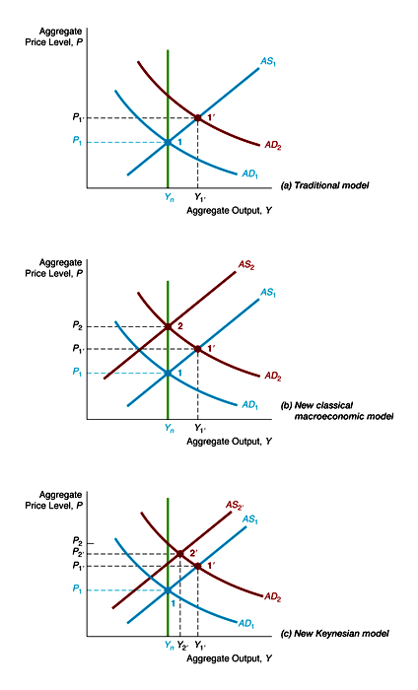
Response to Expansionary Policy in the Three Models

Slide 10
Analysis of Figure 28-5: Response to Expansionary Policy in the Three Models
M ↑, AD shifts out to AD₂
Traditional Model (a)
1. AS stays at AS₁ whether M ↑ anticipated or not; go to 1', Y ↑ P ↑
New Classical Model (b)
1. M ↑ unanticipated, AS stays at AS₁; go to 1', Y ↑, P ↑
2. M ↑ anticipated, AS to AS₂; go to 2, Y unchanged, P ↑ by more
New Keynesian Model (c)
1. M ↑ unanticipated, AS stays at AS₁; go to 1', Y ↑ P ↑
2. M ↑ anticipated, AS to AS₂; go to 2', Y ↑ by less, P ↑ by more

Slide 11
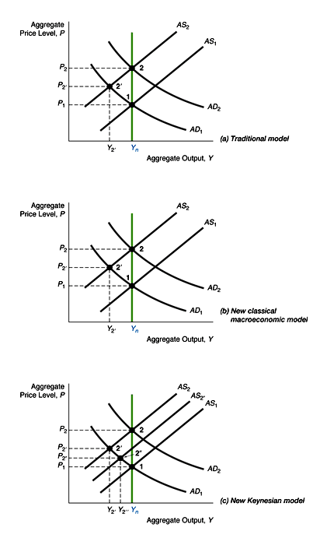
Anti-Inflation Policy in the Three Models
© 2005 Pearson Education Canada Inc.

Slide 12
Analysis of Figure 28-6: Anti-Inflation Policy in the Three Models
1. Ongoing π, so moving from AD₁ to AD₂, AS₁ to AS₂, point 1 to 2
2. Anti-π policy, AD kept at AD₁
Traditional Model (a)
1. AS to AS₂ whether policy anticipated or not; go to 2', Y ↓, π ↓
New Classical Model (b)
1. Unanticipated: AS to AS₂; go to 2', Y ↓, π ↓
2. Anticipated: AS stays at AS₁; stay at 1, Y unchanged, π ↓ to zero
New Keynesian Model (c)
1. Unanticipated: AS to AS₂; go to 2', Y ↓, π ↓
2. Anticipated: AS to AS_{2''}; go to 2'', Y ↓ by less, π ↓ by more

Slide 13
Credibility and the Reagan Deficits
Reagan deficits may have made 1981–82 recession worse after Fed anti-π policy
Analysis with Figure 28-6
1. Anti-π policy kept AD at AD₁
2. Fed’s anti-π policy less credible, so AS kept rising to AS₂
3. Go to 2' in panels (b) and (c); Y ↓ by more than if anti-π policy credible
Impact of Rational Expectations Revolution
1. More aware of importance of expectations and credibility
2. Lucas critique has caused most economists to doubt use of conventional econometric models for policy evaluation
3. Since effect of policy depends on expectations, economists less activist
4. Policy effectiveness proposition not widely accepted, most economists take intermediate position that activist policy could be beneficial but is tough to design

