Slide 1
CUSTOMER RELATIONSHIP MANAGEMENT
by: Berk TUNCALI

Slide 2
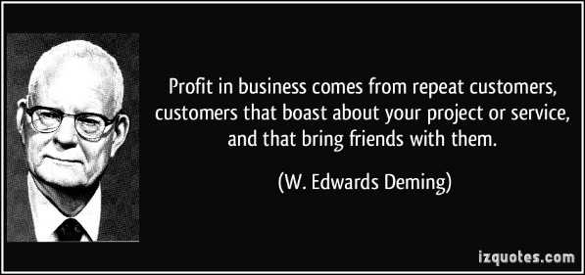

Slide 3
A short video about CRM…..
https://www.youtube.com/watch?v=N35SicxQvsI

Slide 4
What is CRM?
Customer relationship management refers to the practices, strategies and technologies that companies use to manage, record and evaluate customer interactions in order to drive sales growth by deepening and enriching relationships with their customers.

Slide 5
Some famous sayings….
satisfied customer in 10 years will bring 100 more customers to the company
It costs 7 time more to attract a new customer than to serve an old one

Slide 6
What is CRM? Cont.
CRM systems are designed to compile information on customers across different channels. These can be through the face to face contact, company website, telephone conversation, email system, social media or even various marketing campaigns.
CRM systems also store personal information of customers such as name, address, birthdays, purchase history, buying preferences and feedback.

Slide 7
What is CRM? Cont.
The type of data that can be gathered or that is needed to be gathered changes for the sector of each company.
Further analysis can be carried out in order to reveal trends among customers and also data mining techniques can be applied in order to reveal further information from already existing data.

Slide 8
The History of CRM
The CRM industry started in the 1980s with the introduction of database marketing which collected and analysed the information of customers collected by companies.
In the following years, the business world was introduced to a software named ‘‘ACT!’’ to help customize communications with existing and potential customers.
As years went by and new technologies became adopted by companies. A technology called sales force automation combined various features of database marketing, automated them, and combined them with contact management which provided companies with much more useful customer information.

Slide 9
The History of CRM cont.
Large companies like SAP, Oracle and Siebel constantly update and introduce new tools in their CRM packages which make use of the cloud technology and the social media.
CRM solutions continue to gain popularity, largely due to their lower initial cost and easy integration with mobile devices.

Slide 10
The History of CRM cont.
In the new millennia, CRM systems started to speed up even more with the technological advancements and the wide spread of the social media.
CRM started to manage all business relationships that a company has. This way of managing relationships became the common standard across the CRM industry.

Slide 11
Uses of Customer Relationship Management

Slide 12
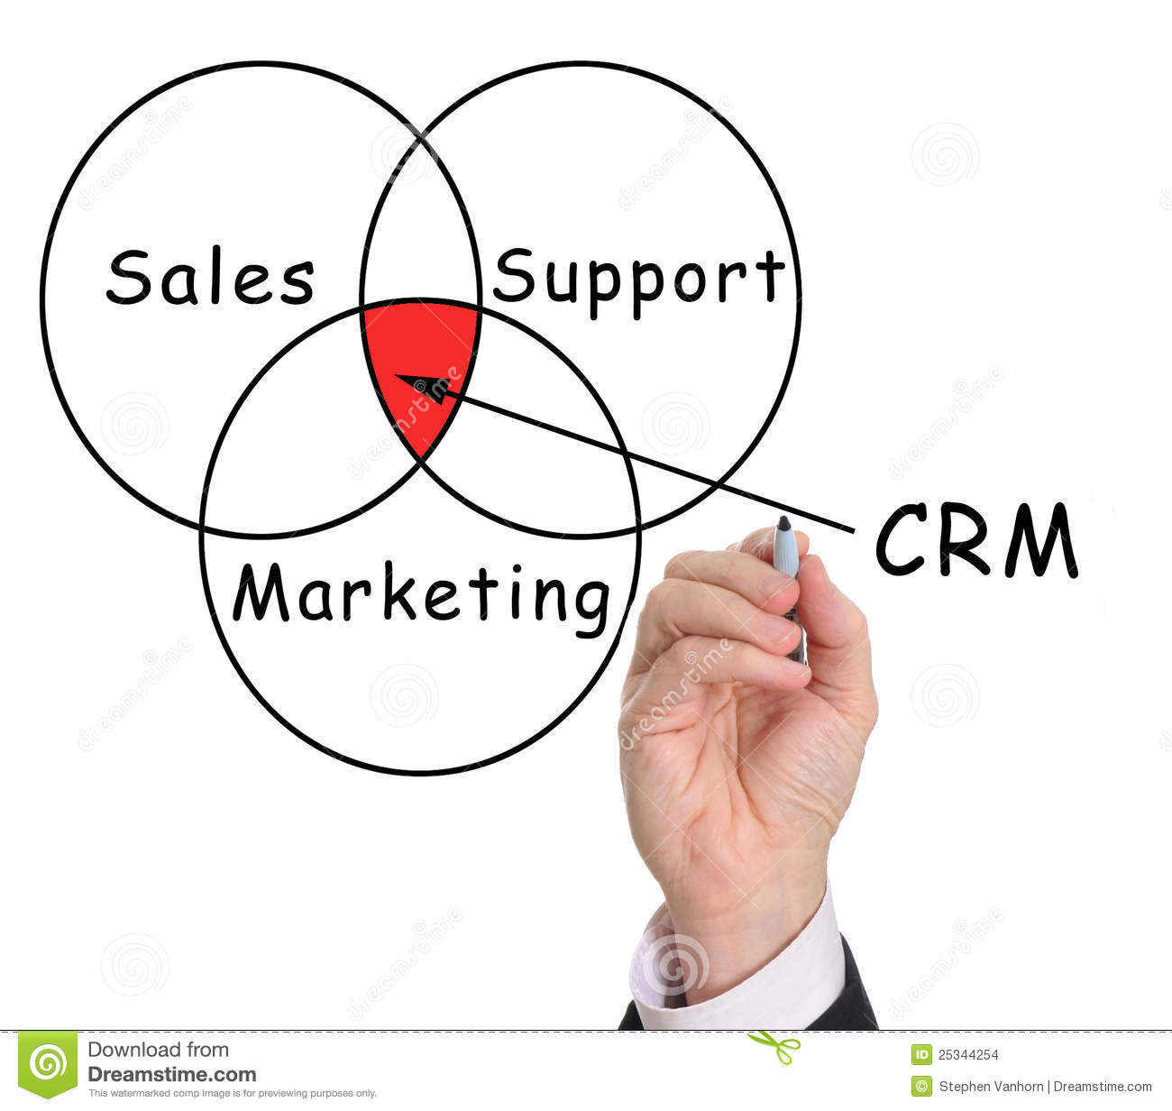
Uses of Customer Relationship Management
Developing and Maintaining Relationships
Track and Measure Marketing Campaigns
Opportunity Management
Sales Force Automation
Manage Relationships
Use of Technology

Slide 13
Uses of Customer Relationship Management
Developing and Maintaining Relationships
Sometimes, the customers want something more than they can purchase and pay for. They would like a good relationship with their company.
Track and Measure Marketing Campaigns
Analysis in relation to marketing campaigns can be carried out which would help with the success of the campaigns. As new data is fed into the CRM software, the response to such campaigns can be measured and adjusted accordingly on the go.

Slide 14
Uses of Customer Relationship Management
Opportunity Management
This use of CRM will help companies better manage unpredictable growth and demand opportunities. Information created by CRM software will help better inform the upper management in the decision making process and also utilize a fitting forecasting model in order to generate realistic sales projections.
Sales Force Automation
This use may implement sales promotion analysis, purchasing habits, order processing and sales trend analysis activities. It brings an automation to the sales force in order to carry out the same tasks in less time hence leaving more time to be in search of new customers.

Slide 15
Uses of Customer Relationship Management
Manage Relationships
The main use of CRM is to be customer oriented and help better manage relationship with customers.
Use of Technology
Companies make full use of technological advancements which brings faster communication and instant up to date data. Faster and better informed decisions become a possibility.

Slide 16
Advantages of CRM
Customer Loyalty
Targeted Communication
Cross Selling and Up Selling More Effectively
Discover New Customers
Efficiency and Time Saving
Fast Access to Customer Information
Competitive Advantage
Better Customer Service

Slide 17
Advantages of CRM
Customer Loyalty
Easier and less costly for companies to satisfy an already existing customer instead of gaining a new one. As a result, loyalty is less costly for companies.
Targeted Communication
Consumers today are in a state of constant overload of information. CRM system will ensure companies to have a good view over the list of customers and prospects and to know where it stands with relationship management, when to contact them again and so on. This will result in improved and more targeted customer communication.

Slide 18
Advantages of CRM
Cross Selling and Up Selling More Effectively
Cross-selling is offering customers complimentary products based on their previous purchases from the company. Up-selling is offering customers premium products in the same category. It helps them to gain a better understanding of customers and anticipate their purchases.
Discover New Customers
CRM systems help companies identify potential customers. Due to records of customer profiles of their existing customer base, businesses can easily come up with strategies to determine the kind of people they should target in order to expand their customer base. CRM data enables companies to correctly identify their target audience and helps focus marketing efforts.

Slide 19
Advantages of CRM
Efficiency and Time Saving
Standardised and automated processes abilities of CRM system will help employees access important information and complete tasks quicker.
Fast Access to Customer Information
Due to technological advancements, the information on the CRM system is constantly updated with up to date data and it can be accessed from any location, from any country and even while traveling through mobile devices and the use of the cloud computing systems.

Slide 20
Advantages of CRM
Competitive Advantage
A company which operate more efficiently and gain more customer insight will have an advantage in competing against its competitors for the same market.
Better Customer Service
Ability to personalize relationships with customers regardless of which employee is servicing them. This ensures the same level of high quality.
CRM also helps companies adjust the level of service to reflect the customer's importance or status. Additionally, better customer service through improved responsiveness and understanding helps in building even more customer loyalty and decreases customer agitation.

Slide 21
Disadvantages of CRM
Not easy to use effectively
Appropriate Selection
Under Utilization

Slide 22
Disadvantages of CRM
Not easy to use effectively
CRM is not easy to put in place. It requires attention and detail in order to prevent mistakes. Effective implementation will require time to set up.
Appropriate Selection
A mistaken choice of a CRM system might result in a more complicated operations for businesses. This is why businesses need to consider in advance what kind of tools would be appropriate to their structure in order to manage relationships with its customers.

Slide 23
Disadvantages of CRM
Under Utilization
In a 2003 report by Gartner, it is estimated that more than $2 billion is spent on CRM software which is not being used. This is a huge amount of cost which could have been used in alternative investments. The same problems exist in CRM system adoption. Many companies do not fully use what the system offers.
Therefore, the amount of gains from such operations stay limited.

Slide 24
Customer Lifetime Value

Slide 25
Customer Lifetime Value
Customer Lifetime Value measures the profit your business makes from any given customer. It is the prediction of the net profit attributed to the entire future relationship with a customer.
It gives an idea about:
How much should be spent on customer service and in retention of customers,
How it allows businesses to realize the amount that should be spent on acquiring new customers,
Who its best customers are,
How to offer products and services tailored for various customer segments,
Types of customers should sales reps spend the most time on.

Slide 26
Customer Lifetime Value
Customer lifetime value is an important concept in that it encourages firms to shift their focus from quarterly profits to the long-term health of their customer relationships.
Customer lifetime value is an important number because it represents an upper limit on spending to acquire new customers.
It has intuitive appeal as a marketing concept, because in theory it represents exactly how much each customer is worth in monetary terms, and therefore exactly how much a marketing department should be willing to spend to acquire each customer, especially in direct response marketing.

Slide 27
Social Customer Relationship Management
Social CRM is a new philosophy and a business strategy, supported by a technology platform, business rules, workflow, processes and social characteristics, designed to engage the customer in a collaborative conversation in order to provide mutually beneficial value in a trusted and transparent business environment.
It's the company's response to the customer's ownership of the conversation.
It is the blend of social media and customer relationship management.
It enhances traditional CRM by listening for and engaging with social media conversations, tracking new leads from social media networks such as Twitter or Facebook and transfer them into their sales channels.
The companies have started to shift its focus from production oriented management into customer oriented management. This means that the companies are recognizing the value of the human connection.

Slide 28
Conclusion
The future of CRM looks very bright indeed.
CRM industry is worth over $100 billion.
Every business need to utilize CRM if they want to remain competitive in their sectors.
CRM should not be viewed as just an office equipment but used as a competitive tool.
There exists many companies who have been around a long time and have become very set in their way of doing tasks. If the upper management of these companies do not recognize the change in dynamics of technology and the power of successful customer relationship management implementation, they will be in a difficult position against competitors who realize the effectiveness of such systems.

