Slide 1
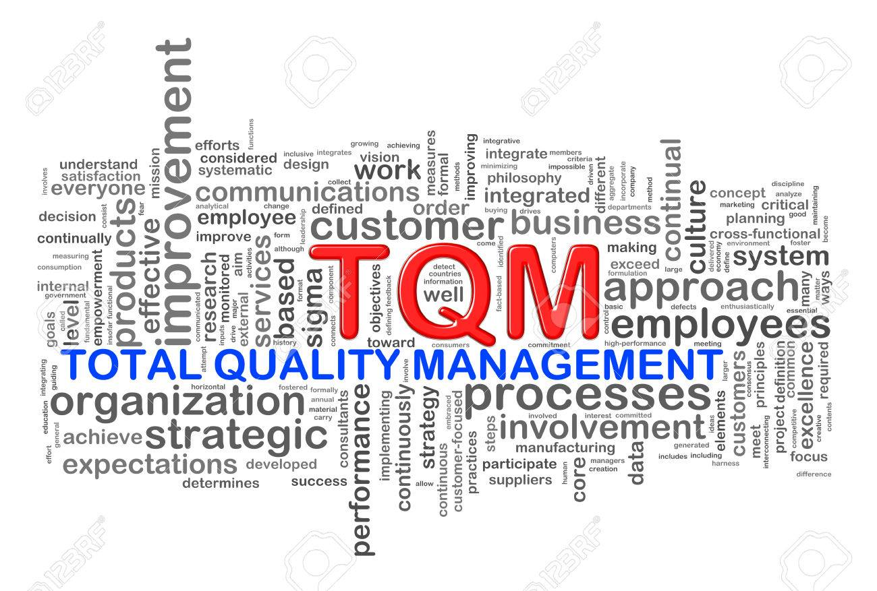
Total Quality Management

Slide 2
What is Quality?
Quality is a relative concept.
Quality is in the eye of the beholder
Perfection
Doing it right at the first time
Eliminating Waste

Slide 3
What is Quality Management?
Management activities and functions involved in determination of quality policy and its implementation through means such as quality planning and quality assurance (including quality control)

Slide 4
Quality Management has a hard side and a soft side.
- Hard side: Statistics,Numbers,etc.
- Soft side: Believes,Emotions,etc.

Slide 5
What is Total Quality Management?
Total quality management exceeds the product quality approach, involves everyone in the organization, and includes its every function; administration, communication,distribution manufacturing,marketing,planning,training,etc.

Slide 6
History of Total Quality Concept

Slide 7
Foundation Principles of TQM
Customer comes first
Employee involvement,education and training
The continuous improvement of systems and processes.

Slide 8
The Seven Basic Tools of Quality
Cause-and-effect diagram: (also called Ishikawa or fishbone diagram) Identifies many possible causes for an effect or problem and sorts ideas into useful categories.
Check sheet: A structured, prepared form for collecting and analyzing data; a generic tool that can be adapted for a wide variety of purposes.
Control charts: Graphs used to study how a process changes over time.
Histogram: The most commonly used graph for showing frequency distributions, or how often each different value in a set of data occurs.
Pareto chart: Shows on a bar graph which factors are more significant.
Scatter diagram: Graphs pairs of numerical data, one variable on each axis, to look for a relationship.
Stratification: A technique that separates data gathered from a variety of sources so that patterns can be seen (some lists replace stratification with flowchart or run chart)

