Slide 1
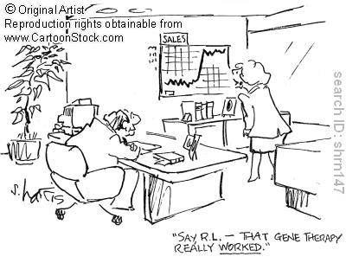
Gene Therapy
Gene Therapy cartoon 10 - search ID shrn157
Gene Therapy cartoon 5 - search ID shrn147
Prof. Dr. Nedime Serakinci
Dept. of Medical Genetics & Medical Biology

Slide 2
Purpose of gene therapy:
Management and correction of human diseases
a. Inherited and acquired disorders
b. cancer
c. AIDS/HIV
Promising advances during the last two decades in recombinant DNA technology.
  Success in treating SCID
  Success in treating some cancers ei. Brain tumour.
(Until recently?) Efficacy in any gene therapy protocol not definitive.
1. Shortcomings in gene transfer vectors.
2. Inadequate understanding of biological interactions of vector and host. (Jesse Gelsinger case).
Notes:
SCID = severe combined immunodeficiency.

Slide 3
Delivering the vector
Efficient gene therapy – gene is placed into a cell and used to produce a protein
Must target the cells that are affected by the disease
A significant number of cells must receive the gene
  Problems in treating neurologic diseases
  May not get infect significant number of cells
DNA must enter the nucleus so it can be transcribed

Slide 4


Delivery of gene therapy vectors
non-viral (synthetic) delivery
viral delivery
adenovirus
retrovirus
HSV
Cationic lipids
poly-L-lysine
polyethylenimine
vector delivery
Plus: efficient transfer
Minus: genetic manipulation
Plus: flexibility
Minus: efficiency of transfer

Slide 5
Gene delivery
Non-viral
  Cationic lipids
  Polymeres
  Targetting proteins
  Calcium phosphate
  Naked DNA
  liposome mediated
Viral
  Retrovirus
  Adenovirus
  Adeno-associated virus
  (AAVs)
  Lentivirus
  Herpes simples virus
  Vaccinia virus
  Baculovirus
  Poliovirus
  Sindbis virus
Mechanical methods:
  Electroporation

Slide 6
Naked DNA
DNA that is not in a vector
Has not be efficient
Membrane of cell may block the DNA from getting in
Enzymes in the cytoplasm may degrade the DNA

Slide 7
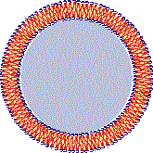
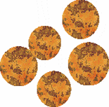
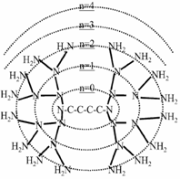
Synthetic (non-viral) Gene Vectors
Linear Polymer
Cationic liposomes
Branched Polymer
Nanoparticles
Fractured dendrimer
PPI Dendrimer
Schatzlein AG, expert reviews in molecular medicine, 2004
Notes:
Two main classes of vectors:
Cationic polymers & cationic lipids
Complex formation requires charge-charge interaction and co-operativity to create stable complexes
Provided through multiple interaction sites and self-aggregation
PPI dendrimers are low molecular weight compounds less than 1/10 MW

Slide 8
Principles of non-viral vectors
Schatzlein AG, Anti-Cancer Drug, 12, 2001,

Slide 9
Intracellular barriers to synthetic gene delivery systems
Schatzlein AG, Anti-Cancer Drug, 12, 2001,

Slide 10
Suicide gene therapy for cancer
Brown MD, Int. J pharmaceutics 229, 2001
Notes:
Suicide gene therapy
2 step protocol requiring initial transfection of the tumor cells and subsequent treatment with a suitable drug.
HSV/TK (timidin kinase)
That activates the nucleotide analog GCV that interferes with DNA synthesis which leads to DNA chain termination and subsequent apoptosis.

Slide 11
Success table of Non-viral methods
Cell lines cultered in vitro | +
Primary cells cultured in vitro
Gene delivery in vivo/ex vivo | +/-
Overall transfection efficiency
Transgene capacity | + (up to 100kb)
Generation of stable transfectants
General safety | +
Cost | +
Time | +

Slide 12
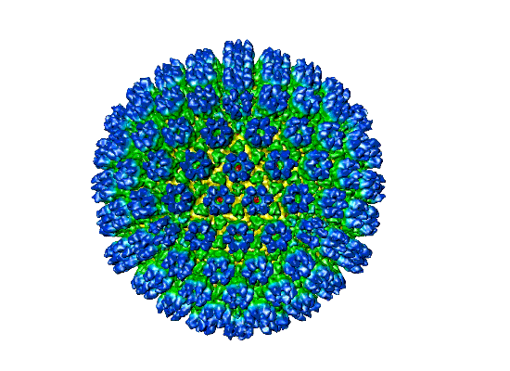
viral gene vectors
  Retrovirus
  Lentivirus
  Adenovirus
  Adeno-associated virus (AAVs)

Slide 13
viral gene vectors
Retrovirus;
Enveloped singel-stranded RNA viruses
Diploid genome about 7-10kb
Four gene regions ; gag, pro, pol and env
Most commonly used retroviral vectors based on Mo-MLV
have varrying cellular tropisms depending on the receptor
binding surface domain of the envelope glycoprotein
  Ecotropic ; strictly murine host range
  Amphotropic ; murine and human host range

Slide 14
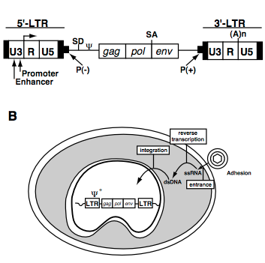
Life cycle of a retrovirus
Retroviruses have diploid genome of about 7-10kb composed of four gene regions gag, pro (core proteins), pol (RT &integrase) and env
Packaging signal
long terminal repeats
After binding to its exstracellular receptor
fuse in to cytoplasm
in the cytoplasm ssRNA
reverstranscribe into ds-DNA proviral genome
preintegration complex
at the nuclear membrane mitosis must occure to provirus to get in
viral integrase can randomly integrate into host genome

Slide 15
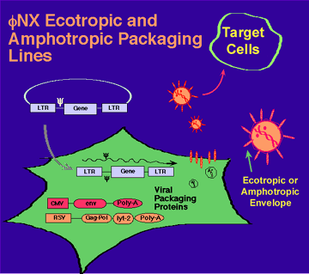
Recombinant retroviralvectors
viral genes have replace with marker or therapeutic gene LTR and Ψ are the only viral sequences
To propagete the recombinat retroviruses;
It is necessary to provide viral genes
This is possible by creating packacing cell lines
That expresses these genes in a stable fashion
With this system it is possible to produce viral titres 10⁵-10⁷ colony forming units/ml

Slide 16
Advantages of retroviral vectors
Ability to stably transduce dividing cells
Inability to express any viral proteins
Ability to achieve long-term transgene expression
Disadvantages of retroviral vectors
The random insertion into the host genome
Possibly cause oncogene activation or
  tumor supresor gene inactivation
Limited insert capacity (8kb)
The low titres
Their inactivation by human complement
The inability to infect non-dividing cells
The potential shut-off of transgene expression over the time
Example; endocrine system cells and hemotopoietic cells

Slide 17
Lentiviruses
Advantages
Complex retroviruses
Ability to infect and express their gene in both mitotic and post mitotic cells (two viron proteins-matrix and Vpr)
Have all the advantages of Mo-MLV-based retroviral vectors
Transgene expression is effective up to 6months
Disadvantages
Question of biosafety
example: Shown to transduce neurons in vivo

Slide 18
Adenovirus vectors
Advantages
Non-enveloped double stranded DNA viruses
Ability to infect and express their genes in vide variety of cell types including dividing and non-dividing cells
No integration into host genome
Relatively larger transgene capacity
Easy manipulation
High titres
Disadvantages
Limited duration of trangene expression
Immuno responce against to rAV in vivo
Generation of AV-neutralising antibodies
Example; have been used to gene transfer into variety of endocrine cells e.g pituitary, pancreatic beta cells and tyroid cells

Slide 19
Adeno-associated vectors
(AAV)
Advantages:
  Belived to be relatively non-immunogenic
  Long trangene expression ( up to 10 months)
Disadvantages
  Complex procedures need to obtain rAAs
  Limited packaging capacity for transgene
  Desperate need for helper virus e.g AV
Example: have been used to treat some endocrine disfuntions in ob/ob mouse

Slide 20
viral vectors and their suitability for different applications
vector | Virion/vector ype | Particle size and titres | advantages | disadvantages
adenovirus | Recombinant+ ”gutless” (dsDNA) | 100nm,10¹⁰-10¹² | dividing+ non-dividing cells Transgene capacity upto 30kb | Immunogenic, instability of transgene expression can be toxic
Lentivirus | Retrovirus(RNA) | 100nm, 10⁶-10⁹ | Can integrate dividing + non-dividing cells | Some risk of activating a proto-oncogene or inactivation a critical gene 7-8kb transgene capacity
AAV | Parvovirus (ssDNA) | 20-30nm, 10¹⁰-10¹³ | Stably retained in dividing+non-dividing cells Low immunogenecity | Limited transgene capacity ∼4,5kb
Retrovirus | RNA | 100nm,10⁷-10¹⁰ | Stable expression of transgene Non-immunogenic | Random insertion into host genome Oncogene activation or inactivation of tumor supressor gene Limited insert capacity (8kb)

Slide 21
Success Comparison of Non-viral methods- viral methods
Cell lines cultered in vitro | +
Primary cells cultured in vitro |  | +
Gene delivery in vivo/ex vivo | +/- | +/-
Overall transfection efficiency |  | +
Transgene capacity | +
Generation of stable transfectants |  | +
General safety | +
Cost | +
Time | +

Slide 22

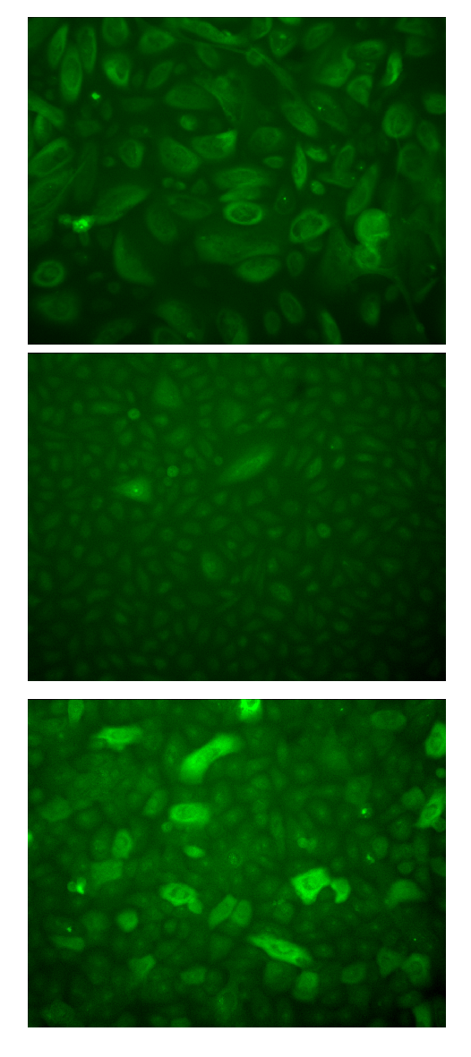
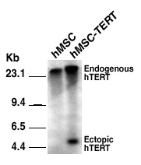
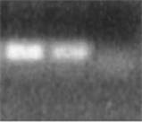
Retroviral transduction with eGFP
Retrovirus with eGFP
Cell of interest
Cell of interest- GFP
Cell of interest- GFP line
Detection of ectopic eGFP
RT-PCR eGFP
eGFP detection with
Fluorescence microscopy
Southern bloting
Cells without insert
expresson eGFP
+-control
kb
With FACS

Slide 23
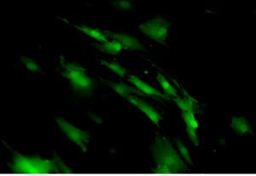
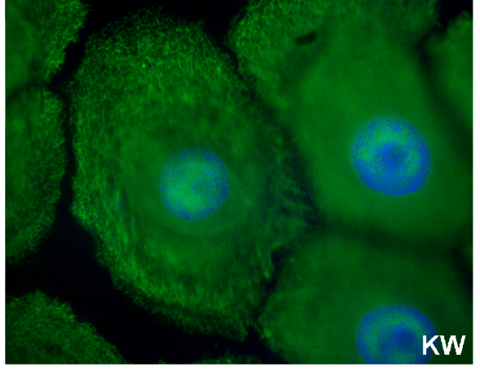
Transcuction of different cells by Retroviral GCsam-EGFP vector
hMSC-eGFP
hKW-eGFP
-K14 immunostaining

Slide 24
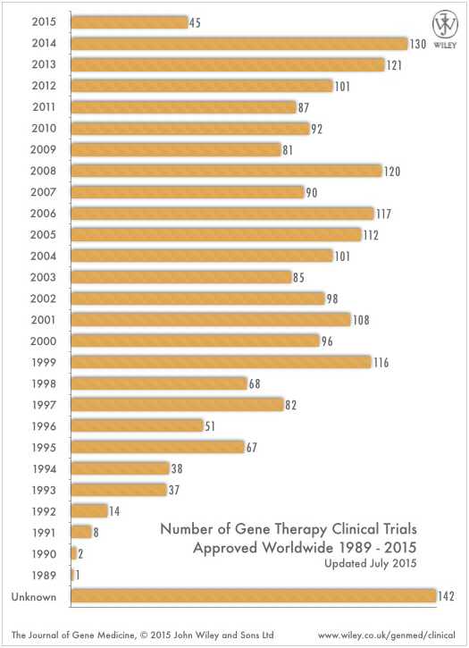
(86)

Slide 25
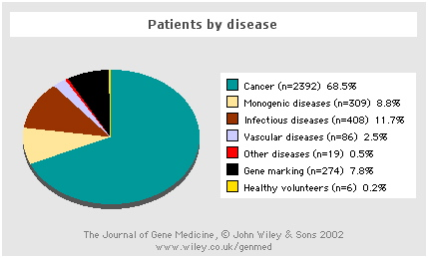
Clinical trial activity: patients by disease

Slide 26
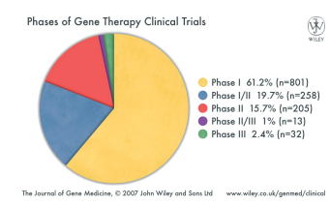
Phase I Early clinical stage Phase I studies are designed to examine the safety of a new medication and understand how it will work in humans by gathering extensive data on how it is absorbed, distributed, metabolized and eliminated from the human body;
Phase I is a trial to determine the best way to give a new treatment and what doses can be safely given; phase 1's involve 20-80 subjects and generate data on toxicity and maximum safe dose, to later allow a properly controlled trial; FDA's review at this point ensures that subjects are not exposed to unreasonable risks; phase I studies generally enroll only healthy persons to evaluate how a new drug behaves in humans, but may enroll Pts with the disease that the new drug seeks to treat
Phase 2 Later clinical stage Phase 2 studies are designed to evaluate the short-term therapeutic effect of a new drug in Pts who suffer from the target disease, and confirm the safety established in phase I trials; phase 2 studies are sometimes placebo-controlled, often double-blinded, enroll a larger number of Pts than in phase 1 and Pt follow up may be for longer periods; phase 2 studies are tailored to specific treatment indications for which the company plans to seek broader approval; where compelling scientific evidence is presented, the FDA expedites review of a company's application for market clearance; expedited review of phase 2 clinical data, and clearance of that early application
Phase 3 Final clinical stage Phase 3 trials are designed to demonstrate the potential advantages of the new therapy over other therapies already on the market; safety and efficacy of the new therapy are studied over a longer period of time and in many more Pts enrolled into the study with less restrictive eligibility criteria; phase 3 studies are intended to help scientists identify rarer side effects of treatment and prepare for a broader application
Phase 4 Post-FDA approval/post-marketing Phase 4 studies involve many thousands of Pts and compare its efficacy with a gold standard; some agents have been withdrawn from the market because they increase the mortality rate in treated Pts

Slide 27
Categories of clinical gene transfer protocols.
1. Inherited/monogenic disorders:
ADA deficiency
Alpha-1 antitrypsin
Chronic granulomatous disease
Cystic fibrosis
Familial hypercholesterolemia
Fanconi Anemia
Gaucher Disease
Hunter syndrome
Parkinsons
2. Infectious Diseases:
HIV
3. Acquired disorders:
peripheral artery disease
Rheumatoid arthritis

Slide 28
Categories of clinical gene transfer protocols.
4. Cancer (by approach):
Antisense
Chemoprotection
Immunotherapy: ex vivo / in vivo
Thymidylate kinase
Tumor suppressor genes

Slide 29
Case study: Jesse Gelsinger
*First documented patient to die from gene therapy treatment. (may have been others).
Disease: liver enzyme deficiency
(ornithine transcarbamylase, OTC) –
controls ammonia metabolism
Vector used to deliver OTC – modified adenovirus
Goal: deliver vector to liver cells and express OTC.
Problem: Very low transfer efficiency (1%), difficult to get
enough functioning OTC expressed to do any good.
Solution: Infect with higher dose of viral particles.
(38 trillion)

Slide 30
Results of follow-up investigation:
3 month investigation by FDA concluded.
  patient enrollment in study despite ineligibility.
  participants misled on safety and toxicity issues.
  loosening of criteria for accepting volunteers.
  informed consent document did not reveal results
    of animal studies.
* Other investigators may not have disclosed important
information on patient deaths in gene therapy trials.
Adenovirus safety: Engineered to prevent viral replication.
  Mutation from replication incompetent to competent?
Shut down of Univ. of Penn. Institute for Human Gene Therapy
Lawsuits

Slide 31
Some successes:
Treatment of Severe Combined ImmunoDeficiency (SCID)
Genetic defects cause decreased T and B cells and NK cells.
Affects 1-75,000 births.
Mostly males (most common form is X-linked)
Types: ADA (adenine deaminase) or Gamma chain (γc).
ADA defect: deoxyadenosine produced in response to DNA degradation. Is converted to deoxynucleotides, which inhibit white blood cell proliferation. ADA converts deoxyadenosine to deoxyinosine.
Gamma chain is linked to IL-2 receptor, required for T-cell maturation from bone stem cells.
Success in treating children observed in Italy, Israel, England, France, and USA.
Bubble boy (SCID) popularized in the 1970s of a young boy in Texas who survived to the age of 12 in a sealed environment.
Phase 1 trial: collect bone marrow, isolate CD34⁺ stem cells, and infect with retroviral vector containing the gene encoding the γ-common chain. Inject two infants with 14-26 million CD34⁺ cells/kg (5- 9 million contained the introduced gene).

Slide 32
successes continued:
Phase I clinical trials results:
Detectable levels of NK and T cells containing the introduced gene were found in the blood within 30 and 60 days, respectively, and their numbers increased progressively until normal levels were reached. After 3 months, the two patients were also able to make antibodies in response to vaccination against diphtheria, tetanus, and pertussis.
10-3-02: France and US (FDA) halted SCID gene therapy due to leukemia-like side effects in one child. Not clear whether this is related to the gene therapy itself.
1/14/03: FDA suspended 30 gene therapy trials using retrovirus vectors due to another case of leukemia.

Slide 33
Strategies for cancer gene therapy
Immunogenic therapy
Mutant gene correction
cell kill
Enzyme prodrug activation
Oncolytic virus

Slide 34
Advantage of cancer gene therapy
gene therapy aims to selectively target the tumour cell
reducing the toxicity often associated with conventional therapies

Slide 35

Immunogenic therapy
Aim | examples
to activate a systemic & tumour-specific immune response | Cytokine gene insertion, eg, IL-2, IL-4, IL-12, GM-CSF Expression of co-stimulatory molecules, eg, B7.1
APC
T-helper cell
tumour antigen presented by APC
cytokines secreted from T-helper cells
tumour cell
CTL

Slide 36


Mutant gene correction
Aim | examples
to replace the defective gene product | P53 tumour suppressor gene correction
Issues
monogenic vs multigenic disease
high frequency of gene transfer required
normal cell: no effect
tumour cell
growth arrest
apoptosis
vector
TSG
tumour cell

Slide 37

Oncolytic virus
Aim | examples
to lyse cancer cells as part of viral replication | Onyx dl1520 adenovirus, replicates in p53 negative cells
Issues
mechanism of action
regulation of spread
normal cell: abortive replication
Virus kills tumour cell
spreads to neighbours
oncolytic virus
tumour cell: productive replication, cell lysis

Slide 38

Enzyme-prodrug activation
Aim | examples
to deliver a high dose of chemotherapy selectively to the tumour | Enzyme / Drug Thymidime kinase / ganciclovir Cytosine deaminase / 5-fluorocytosine Nitroreductase / CB1954
Issues
limitations on transfer / bystander effects
prodrug
Vector: enzyme encoding gene
Toxin kills cells
spreads to neighbours
tumour cell
enzyme
prodrug
toxin

Slide 39
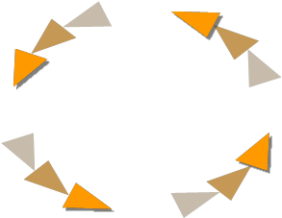
Realizing the potential of gene therapy
Targeting
Modification of vector targeting
Delivery
Improve low efficiency of gene transfer
therapeutic
benefit
Selectivity
Target cancer cell gene expression
Trials
Clinical facilities to do specialised clinical trails

Slide 40
potential barriers to gene therapy development
Regulations: potential risk vs potential benefit
  there will always be differences on what is ethical
  what we know is better than what we do not know
  regulation is a moving target
Industry
  narrow focus to ensure product survival
  market size

Slide 41
potential barriers to gene therapy development
Academia
  lack of clinical realism
  to much ‘me to’ research vs innovation
Infrastructure
  few specialised centres for trials/research
  lack of clinical grade vector
Clinical
  conservatism
  competition with other products
  trial design difficult

