Slide 1
Measures of Association:
Correlation Analysis
Assistant Prof. Özgür Tosun

Slide 2
But First: Numbers for Prostate Cancer
America
In the US, many men choose to be screened for prostate-specific antigens (PSA) which can be an indicator of the disease.
England
In the UK, it's more common for men to get checked only after they start experiencing problems.

Slide 3
Question is:
In the UK, man are diagnosed with prostate cancer later, and are less likely to survive for five years before dying
Does that mean more men die of prostate cancer in the UK compared to US?

Slide 4
Additional Info
Many men have "non-progressive" prostate cancer that will never kill them
While screened American men in this situation are marked as having "survived" cancer, unscreened British men aren’t
Five-year survival rates of prostate cancer are much higher in the US than in the UK (99% rather than 81%)

Slide 5
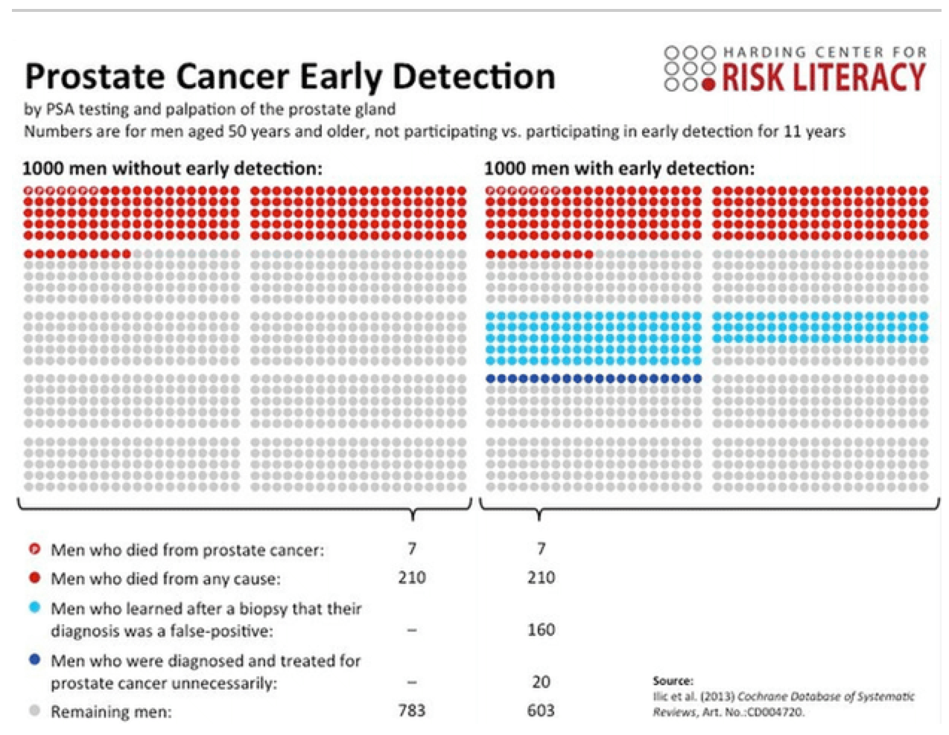
Harding Center's diagrams shows that the risk of death is the same whether men are screened for prostate cancer or not

Slide 6
What numbers tell?
The numbers of deaths from prostate cancer every year per 100,000 men are almost the same (23 in the US, 24 in the UK)
Likewise in 1999, there were reports about Britain's survival rate for colon cancer (at the time 35%) being half that of the US (60%), experts again ignored the fact that that the mortality rate was about the same

Slide 7

Former New York mayor Rudy Giuliani declared in 2007 that someone's chance of surviving prostate cancer in the US was twice that of someone using the "socialized medicine" of Britain's National Health Service, he was wrong.

Slide 8
Doctors understand the numbers???
Research shows just how confused doctors often are about survival and mortality rates
In a survey of 412 doctors in the US it was found that 75% of physicians mistakenly believed that higher survival rates meant more lives were saved

Slide 9
Back to Theory

Slide 10
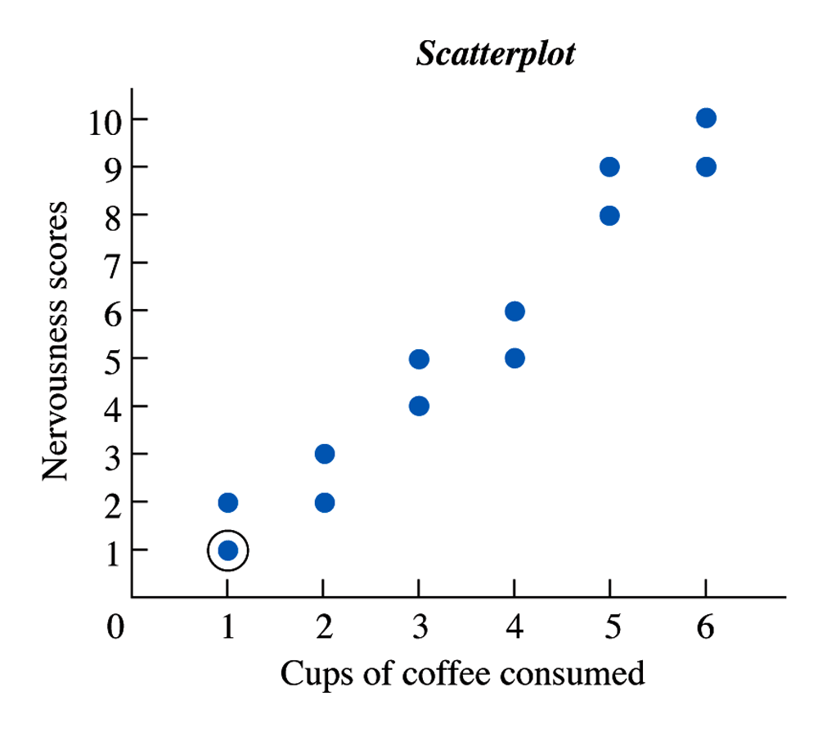
A Scatterplot Showing the Existence of a Relationship Between the Two Variables

Slide 11
Correlation Coefficient
A correlation coefficient is the descriptive statistic that summarizes and describes the important characteristics of a relationship
in mathematical terms, a correlation coefficient provides a measure of the strength and direction of the relationship between two variables

Slide 12
Drawing Conclusions
The term correlation is synonymous with relationship (association)
However, the fact there is a relationship between two variables does not mean that changes in one variable cause the changes in the other variable

Slide 13
Drawing Conclusions
For example, there is a relation between the number of alarms in a fire and the extent of the damage.
However, the fire alarms themselves did not cause the damage, rather the fire did.
Therefore, although a relationship may exist, other factors also may affect the variables under study.
Icecream consumption versus drawning in the sea

Slide 14
Types of Relationships

Slide 15
Linear Relationships
In a linear relationship, as the X scores increase, the Y scores tend to change in only one direction
In a positive linear relationship, as the scores on the X variable increase, the scores on the Y variable also tend to increase
In a negative linear relationship, as the scores on the X variable increase, the scores on the Y variable tend to decrease

Slide 16
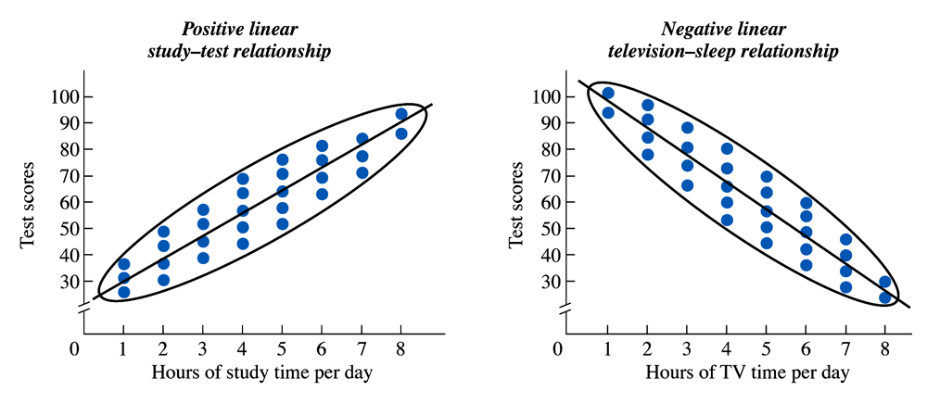
A Scatterplot of a Positive Linear Relationship

Slide 17
A Scatterplot of a Negative Linear Relationship

Slide 18
Data and Scatter Plot Reflecting
No Relationship

Slide 19
Nonlinear Relationships
In a nonlinear, or curvilinear, relationship, as the X scores change, the Y scores do not tend to only increase or only decrease: At some point, the Y scores change their direction of change.

Slide 20
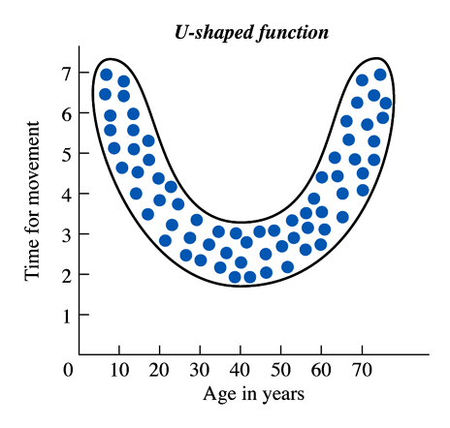
A Scatterplot of a Nonlinear Relationship

Slide 21
A Scatterplot of a Nonlinear Relationship

Slide 22
Strength of the Relationship

Slide 23
Correlation Coefficients
The Pearson and Spearman correlation coefficients, which are denoted by r, provide a number that indicates both the strength and the direction of the relationship between the two values
Correlation coefficients may range between -1 and +1.
The closer to 1 (-1 or +1) the coefficient is, the stronger the relationship; the closer to 0 the coefficient is, the weaker the relationship.

Slide 24
r
When r equals −1, it indicates a perfect negative or inverse relationship
when r equals 0, it indicates no relationship
when r equals +1, it indicates a perfect positive relationship.

Slide 25
Strength
The strength of a relationship is the extent to which one value of Y is consistently paired with one and only one value of X
The absolute value of the correlation coefficient indicates the strength of the relationship
The sign of the correlation coefficient indicates the direction of a linear relationship (either positive or negative)

Slide 26
STRENGHT OF THE RELATIONSHIP
r | Strenght
0.90 to 1.00 | Perfect Correlation
0.70 to 0.89 | High Correlation
0.50 to 0.69 | Moderate Correlation
0.30 to 0.49 | Low Correlation
0.00 to 0.29 | No or Weak Correlation
However, in order to mention about a statistically important correlation, p value must be evaluated.
If p value of a correlation is lower than the α, then this correlation is statistically significant (no matter the value of r)

Slide 27
Methods for Measures of Association
  Methods to define the strenght and direction of the association
    (Correlation analysis)
  Methods to define the functional structure of the association
    (Regression analysis)

Slide 28
Correlation Coefficients
Quantitative
Pearson Correlation
Spearman Correlation
Quantitative/Qualitative
Phi Coefficient
Qualitative 2x2
Contingency Coefficient
Qualitative 2x3 etc
Kappa (Chance
corrected agreement)
Qualitative (paired) nxn

Slide 29
Pearson Correlation (r)
For two continuous variables, this analysis provides information about the strenght and the direction of the linear association
-1<= r <=+1

Slide 30
Pearson Correlation (r)
It is the parametric correlation analysis
Distributions for both variables must be normal
Number of subjects must be adequate (usually at least 10)

Slide 31
Strenght decreases
-1
0
+1
Strenght
increases

Slide 32
Duration of exercise Performance
60 100
65 100
70 99
75 99
80 90
85 95
90 90
95 88
100 89
105 87
110 83
115 79
120 78
125 70
130 72
Height (cm) Age (Month)
60 1
62 3
62 5
80 7
80 9
81 11
90 13
97 15
100 17
100 20
100 21
104 23
108 25
114 27
130 30

Slide 33
Perfect Positive Correlation
Height
Age
r=0.97 p<0.001

Slide 34
Perfect Negative Correlation
Performance
Duration of exercise
r=-0.96 p<0.001

Slide 35
Low Correlation
Positive but low correlation

Slide 36
Low Correlation
Negative but low correlation

Slide 37
No Correlation
Hemoglobin
Age
r=0.027 p=0.887

Slide 38
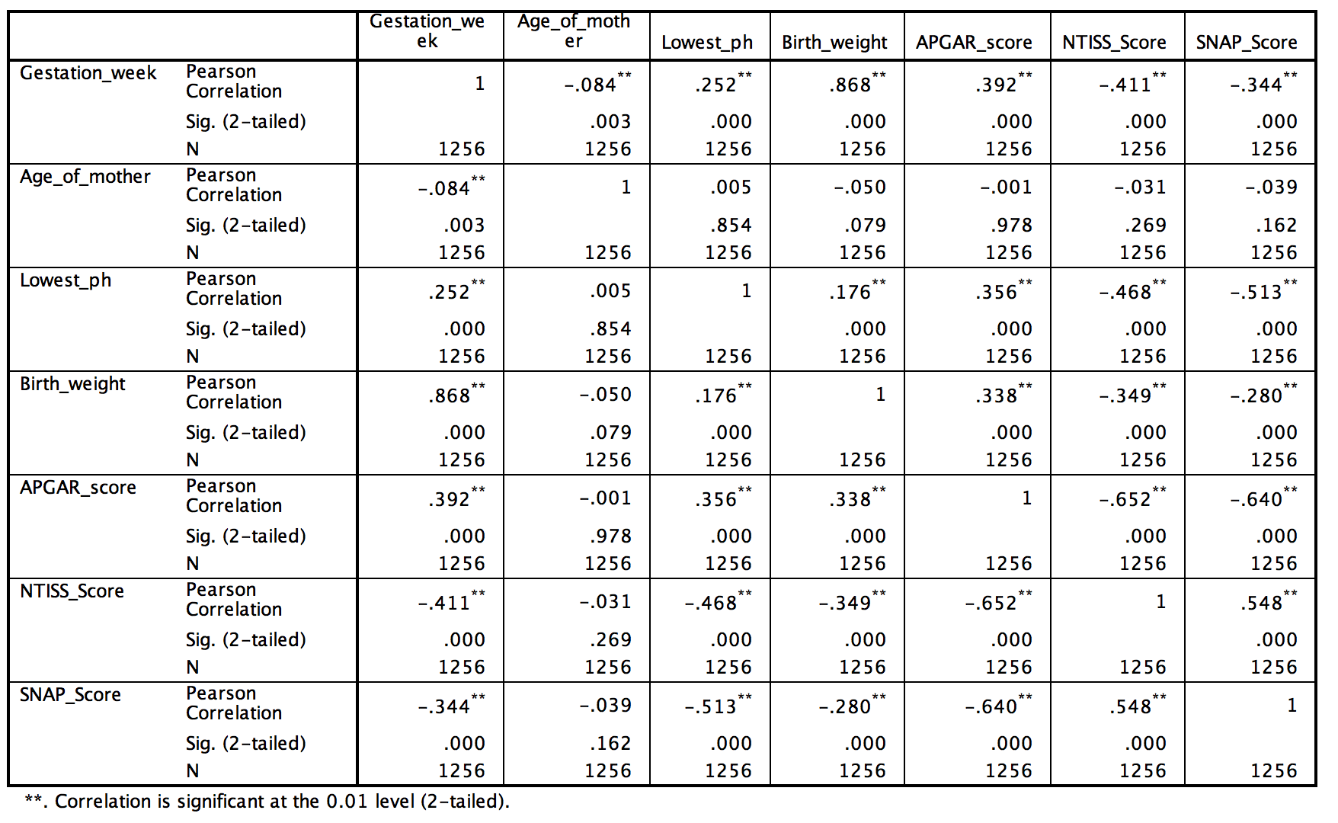
Correlation Matrix

Slide 39
Spearman Rank Correlation (r_{s})
When one or both of the continuous variables are non-normal distributed
When one or both variables are ordinal
Nonparametric correlation analysis
Alternative for Pearson Correlation

Slide 40
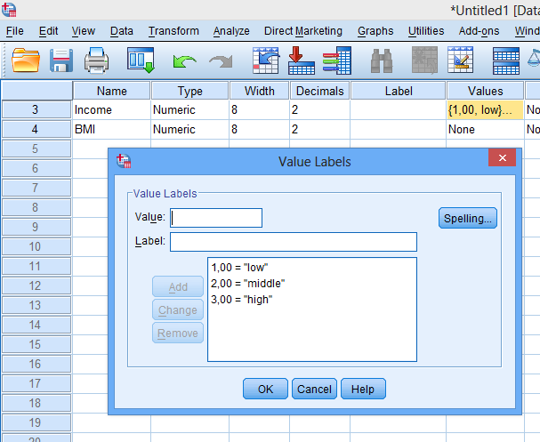
Example

Slide 41
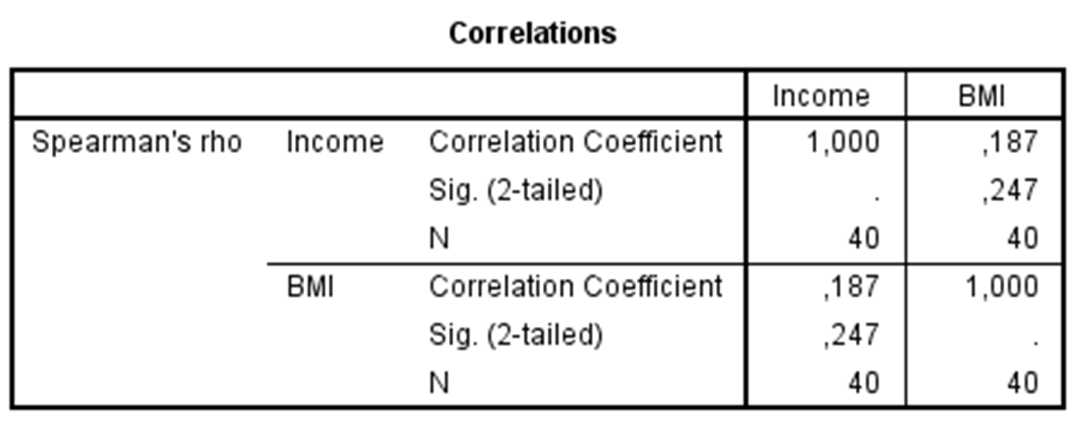
In this specific example:
  Income is continous
  BMI is ordinal

Slide 42
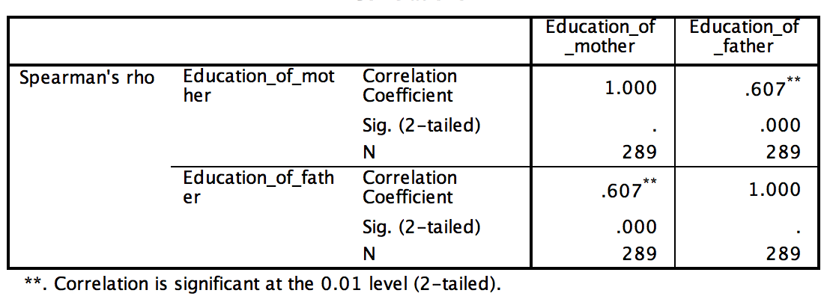
Another Example with Ordinal Variables

Slide 43
Measures of Association for Crosstables

Slide 44
Phi (φ) Coefficient
For 2 x 2 crosstabs designs
For dichotomous variables such as (good-bad), (male-female), (diseased-nondiseased)…
Similar to Pearson (r)
Phi coefficient is significant if the Chi Square is significant

Slide 45
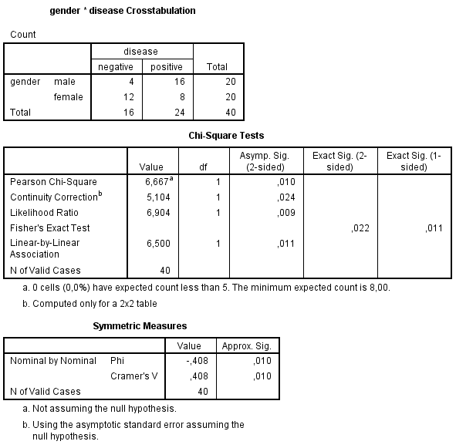

Slide 46
Contingency Coefficient
This is a nonparametric technique that can be used to measure the relationship between two nominal-level variables. The variables need not be dichotomous but may have two or more categories.
Ranges from 0 to <1 depending on the number of rows and columns with 1 indicating a high relationship and 0 indicating no relationship

Slide 47
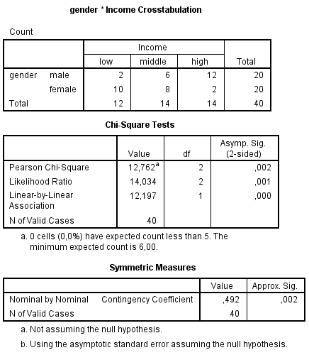

Slide 48
Kappa (κ)
Chance corrected agreement
    In clinical trials and medical research, we often have a situation where two different measures/assessments are performed on the same sample, same patient, same image,… the agreement needs to be calculated as a summary statistics
    is a statistical measure of inter-rater agreement or inter-annotator agreement for qualitative (categorical) items

Slide 49
Kappa (κ)
Chance corrected agreement
    is a measure of agreement between two sources, which is measured on a binary scale (i.e. condition present/absent).
    κ statistic can take values between 0 and 1.
    Poor agreement: κ < 0.20
    Fair agreement: κ = 0.20 to 0.39
    Moderate agreement: κ = 0.40 to 0.59
    Good agreement: κ = 0.60 to 0.79
    Very good agreement: κ =0.80 to 1.00

Slide 50
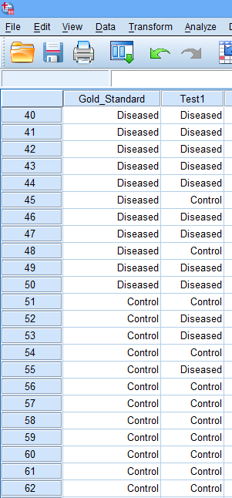

Slide 51
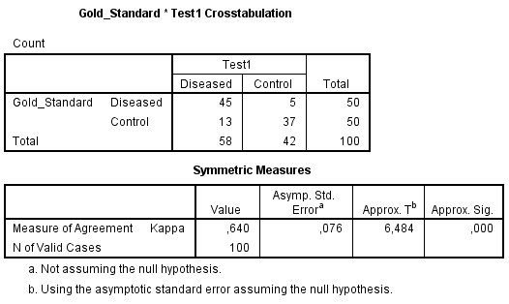

Slide 52
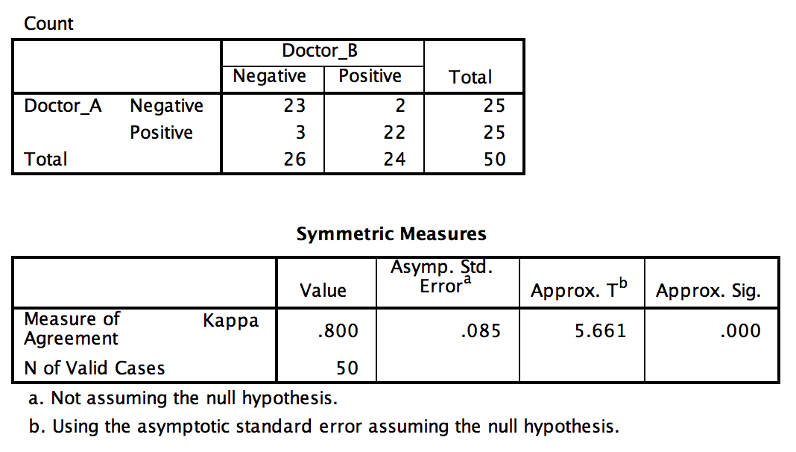
Another Example for Inter-Rater Agreement
Between Two Doctors

