Slide 1
PUBLIC INTERNATIONAL LAW - I
Theory and History of International Law
Defining International Law
Comparing International Law with related fields
Introduction to History and Theory of International Law

Slide 2
Defining International Law
Every sovereign power, whether it is large or small, powerful or weak, has created for itself a framework of principles within which to develop.
The term ‘international law’ was first used by Jeremy Bentham in 1780
Law that governs the relations between states amongst each other. (Until WW-II)
Since the inter-war period, the matter has become more complicated…

Slide 3
INTERNATIONAL LAW
Consists of rules and principles of general application dealing with the conduct of states and of international organizations and with their relations Inter se, as well as with some of their relations with persons, whether natural or juridical.
However, international law is still predominantly made and implemented by states.

Slide 4
General and Regional international law
‘General international law’ refers to rules and principles that are applicable to a large number of states, on the basis of either customary international law or multilateral treaties
Regional international law, which applies only to certain groups of states

Slide 5
Characteristics of international law
International law has a number of special characteristics making it completely different from highly developed national legal systems which are connected with the existence of the modern state

Slide 6
Domestic Law & International Law
Domestic law is addressed to a large number of governmental bodies and private individuals…
International law is primarily concerned with the legal regulation of the international intercourse of states which are organized as territorial entities, in formal terms as ‘sovereign’ and ‘equal’.

Slide 7
Characteristics of international law
Thus, international law is a horizontal legal system, lacking a supreme authority, the centralization of the use of force, and a differentiation of the three basic functions of law-making, law determination, and law enforcement typically entrusted to central organs.
Nevertheless, a state which violates an international obligation is responsible for the wrongful act towards the injured state, or, under certain circumstances, to the international community as a whole

Slide 8
Reprisals & Retortion
Reprisals are acts which would normally be illegal but which are rendered legal by a prior illegal act committed by the other state.
Retortion is a lawful act which is designed to injure the wrongdoing state —for example, cutting off economic aid (this is lawful because there is no legal obligation to provide economic aid, apart from under special treaty provisions).

Slide 9
International Organizations
International organizations with more specialized functions may exercise a more effective control over their members..
And regional organizations may exercise an even stricter discipline over their members

Slide 10
However, it must be admitted that sanctions work less effectively in international law than in national law. States are few in number and unequal in strength, and there are always one or two states which are so strong that other states are usually too weak or too timid or too disunited to impose sanctions against them.

Slide 11
Comparing International Law with related fields
International law itself is divided into Conflict of Laws and Public International Law.
The former deals with those cases, within particular legal systems, in which foreign elements obtrude, raising questions as to the application of foreign law or the role of foreign courts.

Slide 12
The rules of international law must be distinguished from what is called international comity
Similarly, the mistake of confusing international law with international morality must be avoided

Slide 13
Historical Development
The foundations of international law (or the law of nations) as it is understood today lie firmly in the development of Western culture and political organization.

Slide 14
Early Origins of International Law
While the modern international system can be traced back some 400 years, basic concepts of international law can be discerned in political relationships thousands of years ago
Around 2100 BC, for instance, a treaty was signed between the rulers of Lagash and Umma, the city-states located in the area known as Mesopotamia

Slide 15
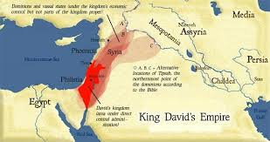
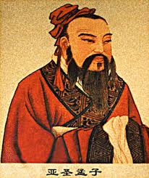
The role of ancient Israel =>
the Prophet Isaiah declared that sworn agreements, even
where made with the enemy, must be performed.
Peace and social justice were the keys to
man’s existence, not power.
Many of the Hindu rules displayed a growing sense of morality and generosity
Chinese Empire devoted much thought to harmonious relations between its constituent parts

Slide 16
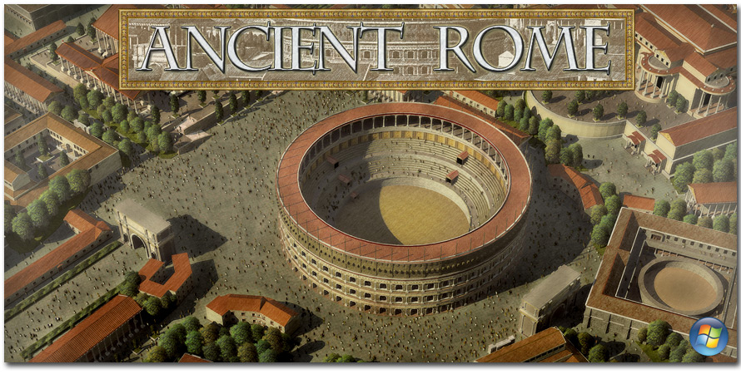
The value of Greece in a study of international law lies partly in the philosophical, scientific and political analyses bequeathed to mankind and partly in the fascinating state of inter-relationship built up within the Hellenistic world
The Romans had a profound respect for organization and the law. The law knitted together their empire and constituted a vital source of reference for every inhabitant of the far-flung domain. The early Roman law (the jus civile) applied only to Roman citizens.

Slide 17
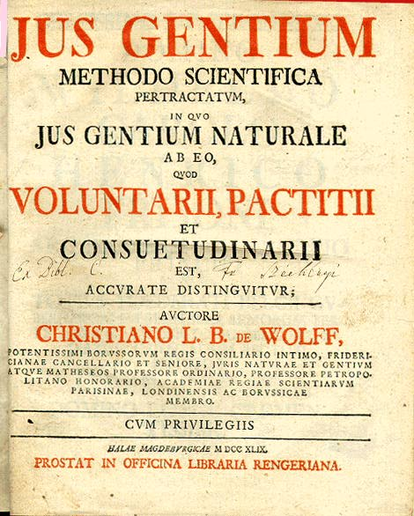
It was totally unable to provide a relevant background for an expanding, developing nation. This need was served by the creation and progressive augmentation of the jus gentium.

Slide 18
European International Law
Even during the Middle Ages in Western Europe international law existed..
When strong centralized states, such as England, Spain, France began to emerge, claiming unrestricted sovereignty and no longer submitting to a superior authority, new international standards evolved..
This was followed by the development of the sovereign state, in reality in Spain and, in the transition to the seventeenth century, also in France.

Slide 19
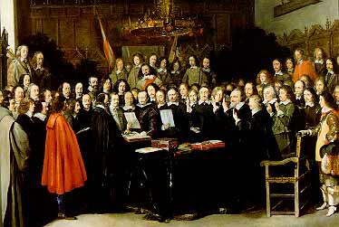
Peace of Westphalia
Features of European international law in state practice after 1648
In state practice, the year 1648 marking the Peace of Westphalia is considered as a watershed, at least in Europe where a new political order was created, to be replaced only after the defeat of Napoleon by the Vienna Congress of 1815.

Slide 20
French and British Revolutions
Freedom &
Self Determination
Industrial Revolution
The French Revolution of 1789, however, had profoundly challenged the basis of the existing system by advocating the ideas of freedom and self-determination of people
Between about 1750 and 1850, the United Kingdom experienced the first industrial revolution.

Slide 21
Colonization and the relation to non-European powers
The nature of international law in the age of European colonization of the world, was the relationship of European states, unified by Christianity, to non-European powers.

Slide 22
The Western hemisphere…
The American Declaration of Independence of 1776, invoking the principle of self-determination, had led to the recognition after seven years of war of a new subject of international law by the mother country, followed at the beginning of the nineteenth century by the independence of Latin-American states from Spain and Portugal.

Slide 23
Theories of International Law
Naturalists
Positivists
These writers agreed that the basic principles of all law were derived, not from any deliberate human choice or decision, but from principles of justice which had a universal and eternal validity and which could be discovered by pure reason;
Law and justice were not the same thing, and laws might vary from time to time and from place to place, according to the whim of the legislator.

Slide 24
The theory of sovereignty
The theory of sovereignty began as an attempt to analyse the internal
structure of a state
The theory dates back to the sixteenth century and political scientists usually refer to the writings of Machiavelli (1469– 1527), Jean Bodin (1530–1596) and Thomas Hobbes (1588– 1679)

Slide 25
Communist approaches to international law
Marxist theory described law and politics as the means whereby the ruling classes maintained their domination of society. The essence of economic life was the ownership of the means of production, and all power flowed from this control.
Capital and labour were the opposing theses..
National states were dominated by the capitalist class and would have to disappear in the re-organising process.

Slide 26
New approaches to IL
Traditionally, international law has been understood in a historical manner and studied chronologically. This approach was especially marked in the nineteenth century as international relations multiplied…
However, after the SecondWorldWar a growing trend appeared intent upon the analysis of power politics and the comprehension of international relations in terms of the capacity to influence and dominate.

Slide 27
International Law & Municipal Law
International Law is traditionally concerned with the relations among states
‘Municipal law’ is the technical name given by international lawyers to the national or internal law of a state.
Which rule prevails in the case of conflict?
How do rules of international law take effect in the internal law of states?

Slide 28
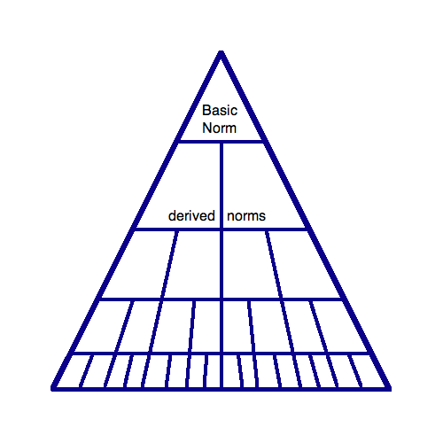
Kelsen’s Grundnorm

Slide 29
Monist Theory – (Monism)
has a unitary perception of the ‘law’ and understands both international and municipal law as forming part of one and the same legal order.
The most radical version of the monist approach was formulated by Kelsen.

Slide 30
Dualist Theory - Dualism
Dualist (or pluralist) view assumes that international law and municipal law are two separate legal systems which exist independently of each other.
The central question then is whether one system is superior to the other.
International Law and municipal law operate in different areas

Slide 31
The attitude of international law to municipal law
International law does not entirely ignore municipal law.
For instance, as we have seen, municipal law may be used as evidence of international custom or of general principles of law, which are both sources of international law

Slide 32
The attitude of national legal systems to international law
The attitude of municipal law to international law is much less easy to summarize than the attitude of international law to municipal law.
For one thing, the laws of different countries vary greatly in this respect.

