Slide 1
INTRODUCTION TO TOXICOLOGY
Prof. Dr. Şahan SAYGI
NEU Faculty of Pharmacy
Department of Toxicology
2015

Slide 2
Contents
History: Poisoning
History: Toxicology Research
Toxicology and Our Daily Lives
Determining Toxicity

Slide 3
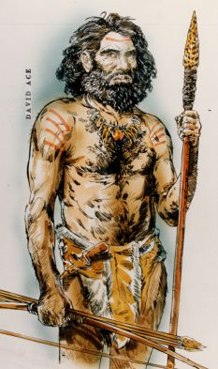
History: Poisoning
Poisoning and the knowledge of poisons have a long and colorful history.
Even the cave dwellers had some knowledge of the adverse effects of a variety of naturally occuring substances that they used in hunting and in warfare.

Slide 4
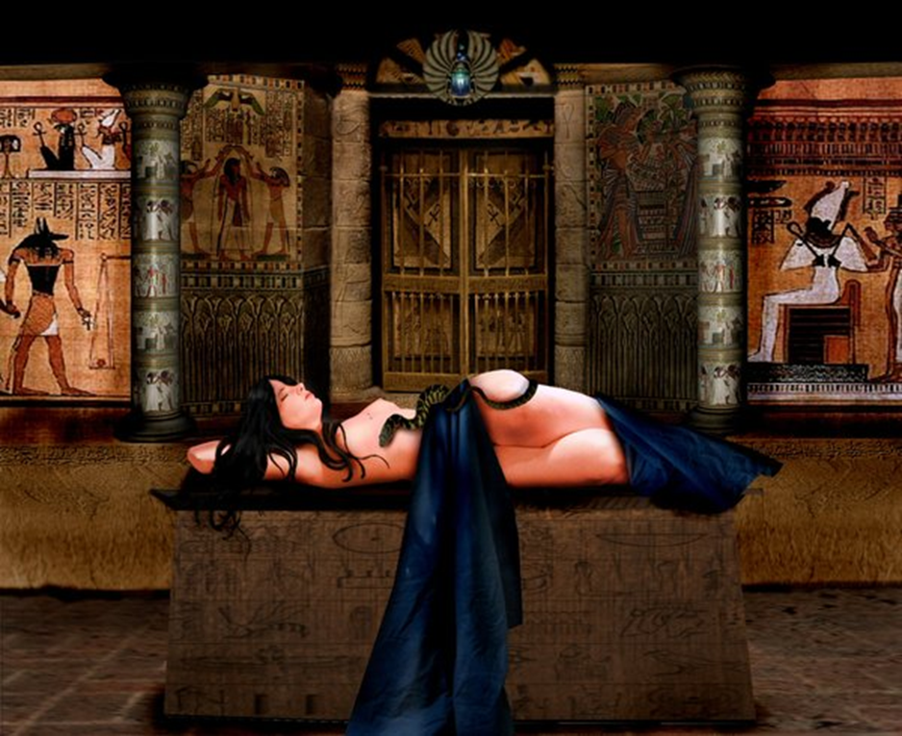
Famous early victims of plant and animal poisons were the Greek philosopher Socrates and the Egyptian Queen Cleopatra.
Cleopatra committed suicide through the bite of an asp, a poisonous snake.

Slide 5
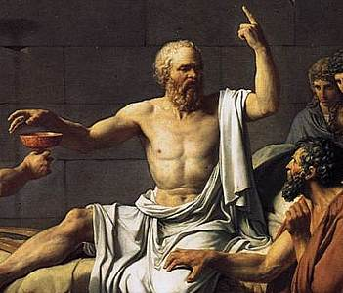
Socrates was forced to drink Hemlock for corrupting the youth of Athens.

Slide 6
As time progresed, toxicological knowledge and its applications expanded.
Poisoning became institutionalized in a number of places.
Some governments utilized poisons for state executions, a practice that continues in some jurisdictions, via means such as lethal injections.

Slide 7
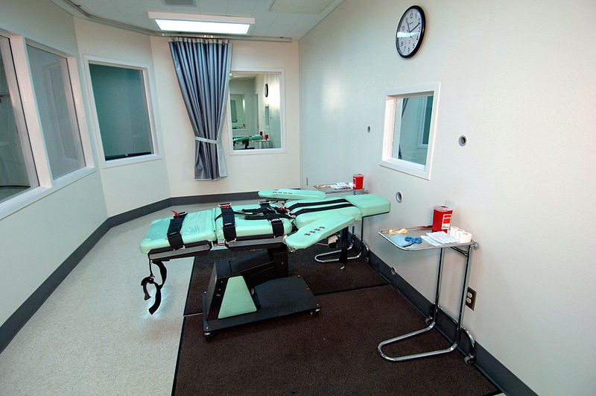

Slide 8
The European Renaissance was a time notorious for poisonings and poisoners.

Slide 9
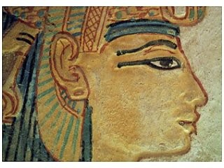
Unintentional poisoning has always been with us.
Through the science of toxicology we now better understand these risks and work to avoid harm to human health.
The naturally occuring element lead was used in the Roman era to line vessels and as pottery glaze, as well as in cosmetics.

Slide 10
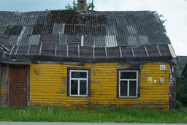
In the 19th century in the USA, paint manufacturers began to use lead as a pigment.
Though banned in paint today, society needs to be ever vigilant in protecting children from exposure to older paint chips.

Slide 11
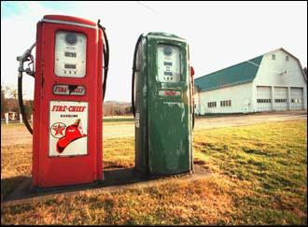
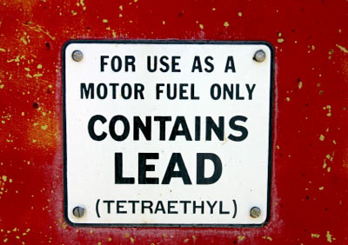
Lead was also used in gasoline to prevent engine knocking.
Studies have demonstrated a correlation between minimal lead exposure and higher cognitive function.

Slide 12
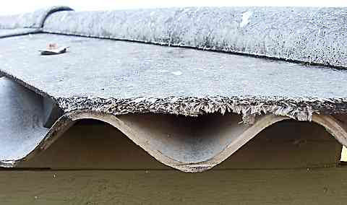
Workers are in danger of being unknowingly poisoned at rates higher than general population.
Asbestos,as an example, was widely knownn in antiquity, but also increased as a result of the industrial revolution.
Used in textiles, building materials, insulation, and brake lining.
Causing severe lung damage, asbestosis and mesothelioma.
Asbestos is now strictly regulated.

Slide 13
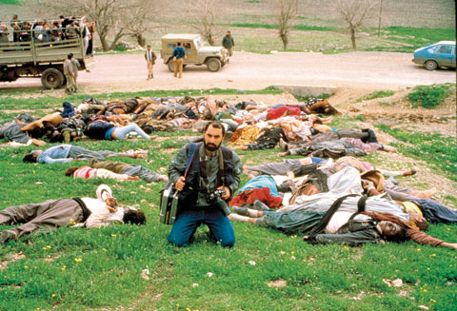
Chemical and biological warfare date to antiquity.
In World War I, the Germans used poison gas in a systemized and large scale fashion.
In 1988, Iraqi Government troops attacked Kurdish town of Halabja with chemical bombs involving multiple chemical agents including mustard gas, sarin, tabun and VX.

Slide 14
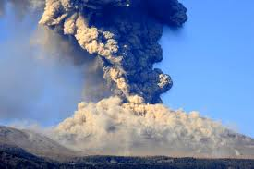
Another broad area of poisonings relates to toxicological disasters while some may be natural (e.g., sülfür and other toxic gases emitted from volcanoes),
Others are related to industrial disasters.

Slide 15
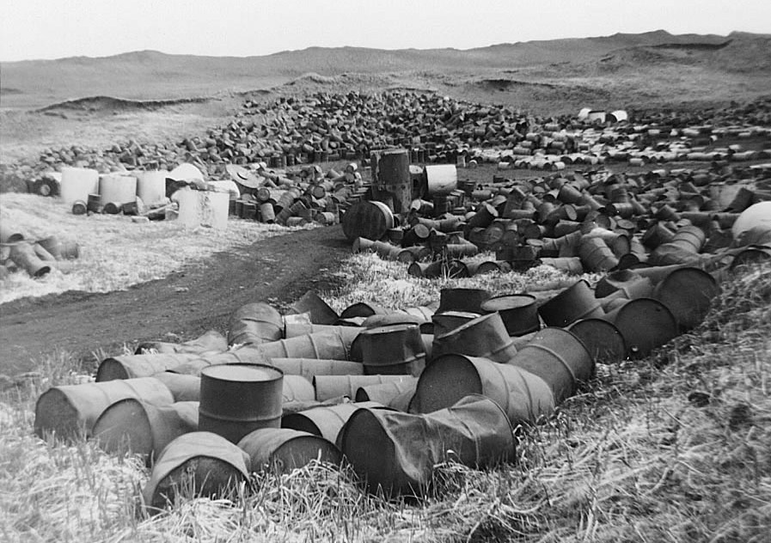
Love Canal is an ironic example.
The territory of the Canal was used by Hooker Chemicals as a dumping ground for numerous hazardous substances.
A large population was put at risk.
Hundreds of families living in homes on top of the dumpsite needed to evacuate.

Slide 16
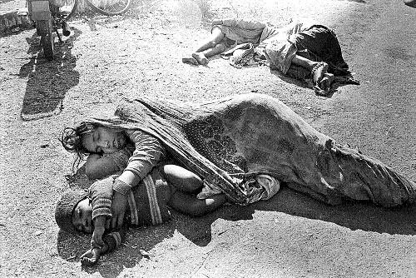
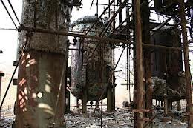
In 1984, in Bhopal, India, a release of the chemical methyl isocyanate resulted in many thousands of deaths and many more injuries.

Slide 17
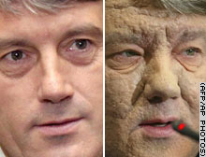
A more recent example of political poisoning is the remarkable survival of the Ukranian President Viktor Yushchenko, after alleged poisoning with dioxin, and, possibly endotoxin, prior to the 2004 elections.

Slide 18
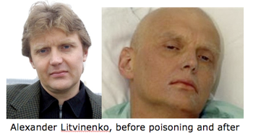
In 2006, Alexander Litvinenko, a former Russian spy, was fatally poisoned with radioactive polonium-210.
The radioactive isotope was allegedly added to tea he drank at a London hotel.

Slide 19
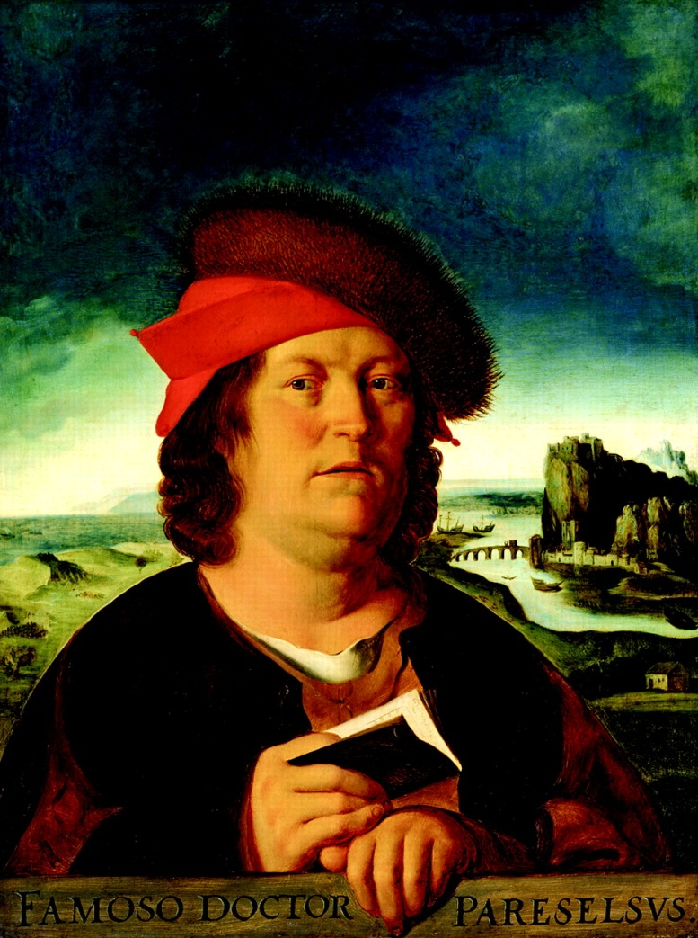
History: Toxicology Research
During periods of intellectual ferment in Europe, scholars began more systematic studies of poisons and their effect.
Paracelsus (1493-1541) identified the specific chemical components of plants and animals that were responsible for their toxic properties.
He also was able to Show that varying the amount of the poison affected the severity of the effects.

Slide 20
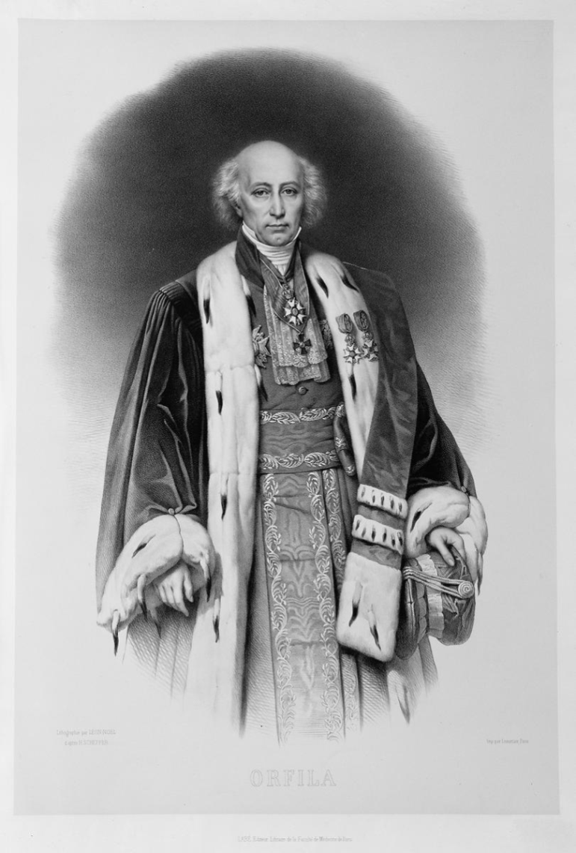
Orfila (1787-1853) who is often referred to as the father of toxicology, was the first to establish a systematic correlation between the chemical properties and biological effects of poisons.
Using autopsy results, he was able to link the presence of particular poisons with specific damage to tissue and organs.

Slide 21
Toxicology developed as a modern science during the 20th century, particularly after the Second World War.
Thus toxicology came to be known as the science of poisons.

Slide 22
“Toxicology is the study of the adverse physicochemical effects of chemical, physical or biological agents on living organisms and the ecosystem, including the prevention and amelioration of such adverse effects”.
Examples of such agent:
cyanide (chemical),
radiation (physical), and
snake venom (biological).

Slide 23
The effects on organisms can occur at multiple levels including molecular and the organ levels.
Toxicological research is an exciting field of study utilizing and integrating principles developed in a variety of disciplines including:
chemistry,
biochemistry,
physiology,
pathology,
biology,
genetics and
pharmacology.

Slide 24
The ultimate objective of the combined research of such toxicological specialists is to determine how an organism is affected by exposure to an agent.
This includes an understanding of:
How the agent moves through the organism
How it may be changed by interacting with living cells and tissues
What parts of the organism are affected by its presence
The health outcomes of this exposure.

Slide 25
Today, toxicology divides six applied areas;
Clinical,
Forensic,
Analytical,
Environmental,
Occupational, and
Regulatory.

Slide 26
Clinical toxicology concerned with the diagnosis and treatment of human poisoning
Forensic toxicology deals with the medicolegal aspects of clinical poisoning
Analytical toxicology concerned with the identification and quantification of toxic chemicals in biological materials
Environmental and occupational toxicology deal with toxic hazards in the environment and in the workplace, respectively
Regulatory toxicology focuses on laws and regulations and their enforcement. Risk assessment is often considered as part of regulatory toxicology.

Slide 27
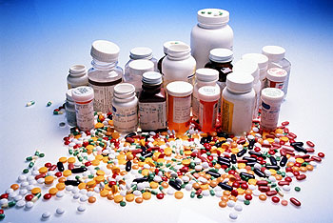
Toxicology and Our Daily Lives
Toxicology is just as important to us today.
Our improved health status and increase in life expectancy are due to in part to advances in pharmacology.
Toxicology research helps ensure that the beneficial effect of therapeutic agents are not outweighed by unwanted side effects.

Slide 28
There are about 100.000 chemicals in commercial use and 1.000 new ones added every year.
Toxicology knowledge helps in the prevention of adverse effects.
More specialized branches of toxicology, such as toxicogenomics and nanotoxicology, increasingly have a significant becoming on our daily lives.

Slide 29
Determining Toxicity
The Dose Makes the Poison
The basic principle was first stated by Paracelsus about 500 years ago. In his words:
“All substances are poisons; there are none which is not a poison. The right dose differentiates a poison and a remedy”

Slide 30
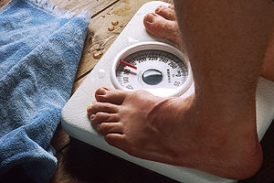
What is Dose?
The dose of a chemical or physical agent is the amount of that agent comes into contact with a living organism or some part of a living organism.
In toxicology; it is common fort he dose to be expressed in terms of body weight and often, in terms of time as well.
For example, the dose may be given as 10 mg/kg or 10 mg/kg/day.

Slide 31
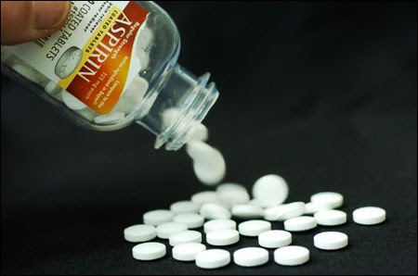
Medications arechemicals designated for positive effects, but at the right dose.
A baby aspirin tablet may not cure an adult of a headache, while two ordinary aspirins are more likely to do the job.
One hundred aspirins taken all together will likely result in toxic effects.

Slide 32
As toxicological knowledge grew more sophisticated, it became possible to define dose in other ways better reflect the connection between dose and effect.
One example is the “target organ dose” or the amount that reaches the site(s) at which the adverse affect occur.
This is also known as the biologically effective dose.

Slide 33
It is always importantto note that the extent and nature of adverse effects, for a given agent, may vary, dependent upon the dose and route of exposure.
Major routes of exposure include:
Ingestion,
Inhalation or
Skin contact (Dermal).

Slide 34
Effects are also dependent upon the:
Age,
Sex,
As well as other characteristics of this individual, including
Underlying disease,
Nutritional status, and
History of previous exposures.

Slide 35
References:
http://toxlearn.nlm.nih.gov/Toxicology/tx010101/tx010101.htm
http://toxlearn.nlm.nih.gov/Module1.htm
http://sis.nlm.nih.gov/enviro/toxtutor.html

