Slide 1
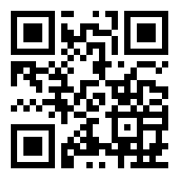
Near East University
Faculty Of Economics & Administrative Sciences MAN - 101 Introduction To Business Week 1 - Business Tuğberk KAYA
tugberk.kaya@neu.edu.tr

Slide 2
What does ‘the word of businesses’ remind us?
Business is related with delivering goods or services to the community.
Business is a medium to earn money to make one’s living in society.
Business includes in managing resources.
Business can be done for basic purpose: to make a profit and to make money.
Business can also be done solely to serve the public without thinking about profit and making money.

Slide 3
Are the any differences between organizations and businesses?

Slide 4
Organization
Organizations are any deliberately established groups of people working together in a systematic manner for a common purpose, such as companies, corporations, associations, clubs, units or unions.

Slide 5
Two types of organizations
1-Profit-seeking organizations: are the main group in business life. They need to making money and profit.
2-Not for Profit Organizations: No needs to making money and profits.
For example, the government agencies, labor unions, NGOs, various institutions like foundations, serve to public.

Slide 6
Who are responsible for establishing and managing organizations?

Slide 7
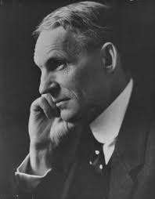
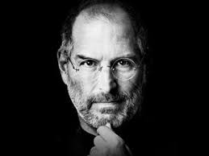
In order to establish a new organization, we need
“Entrepreneur”

Slide 8
on the other hand, we need “MANAGER” to manage organization

Slide 9
Who are entrepreneurs?
They are business people. They are responsible for taking risk and forming businesses from scratch to provide goods/services for the community needs.
They start business from zero. Their one of the main stimulus are profits and customer satisfaction.
Sometimes they have success in starting and operating business however, they can fail when revenues are less than expenditures.

Slide 10
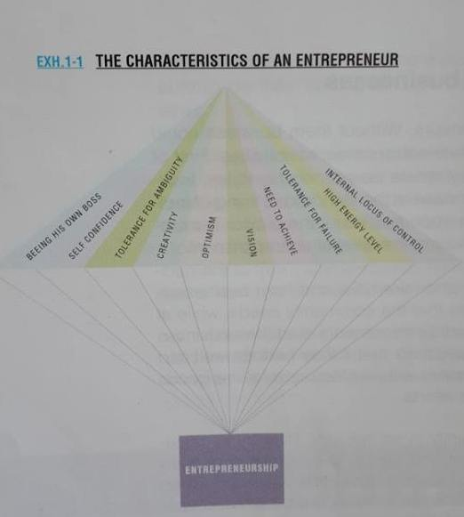

Slide 11
Who are managers?
The owners of the company set the general objectives to be accomplished. Then they select a person who will combine of the company’s resources to attain those goals.

Slide 12
What are the resources/assets of a company?
There are two types of resources: Tangible vs Intangible.
Tangible: Factories, machinery, tools, equipment, materials, etc.
Intangible: Knowledge, skills, technology know-how, patents, brands, etc.
MANAGER is the person who combines all these two types of resources/assets for accomplishing the tasks.

Slide 13
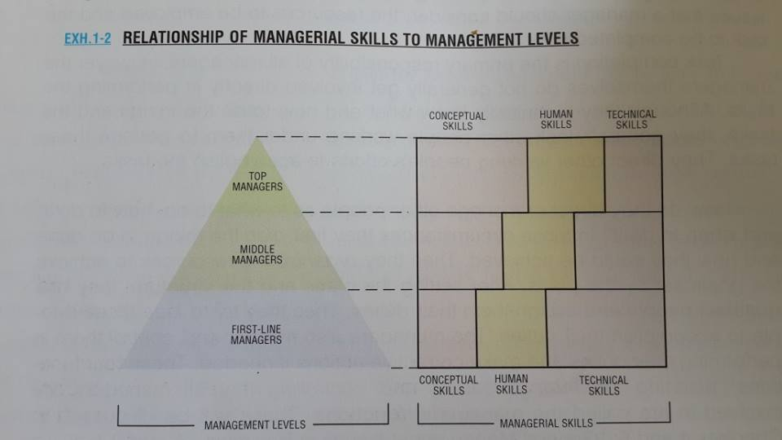

Slide 14
3 types of skills
Conceptual Skills: …is the ability to see the organizations as a whole with its interrelated and interdependent parts, departments and divisions within the context of its industry and the general environment.
Human Skills: …relates to the manager’s ability to work with people. A manager’s success in motivating, communication, coordinating and resolving conflicts among employees is very much dependent on this skill.
Technical skill: …is the ability of managers to perform specific task. This skill includes a mastery of methods, techniques and equipment involved in specific functions.

Slide 15
What managers do?

Slide 16
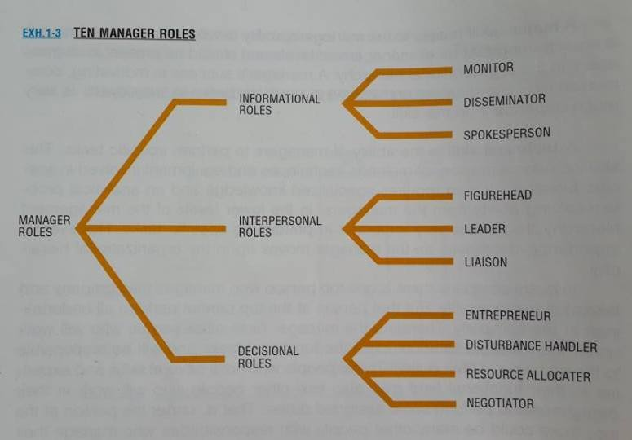

Slide 17
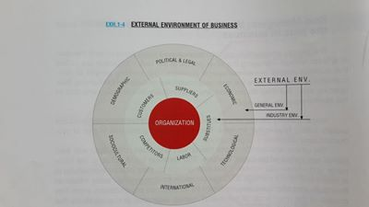

Slide 18
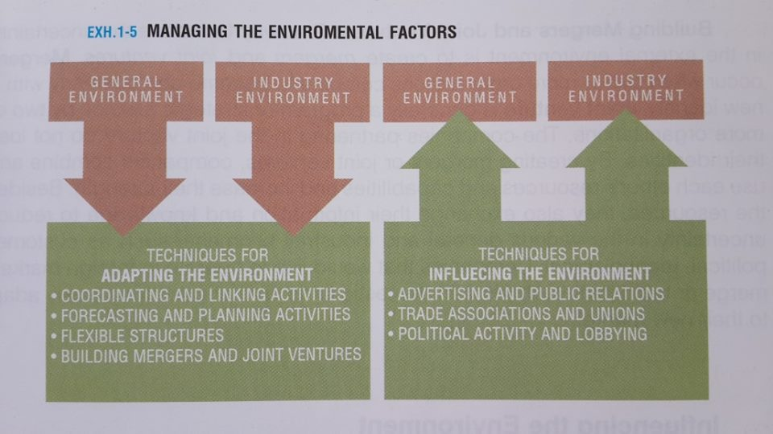

Slide 19
References
Ebert, R. J. and Griffin, R. W. (2015) Business Essentials. 10th Edn. Harlow: Pearson Education Limited
Kadri Mirze (2002) Introduction to Business. Istanbul: Literatür Publishing.

Slide 20
Any Questions?
tugberk.kaya@neu.edu.tr

