Slide 1
MAN 404 Human Resource Management
Introduction to HRM Week 1– 18/02/2015
Tugberk Kaya
tugberk.kaya@neu.edu.tr
Near East University

Slide 2
Introduction
Let’s introduce ourselves…
What is HR?
“People are our most important assets”

Slide 3
What is HRM?
Four key activities:
Selection,
Performance management,
Reward,
Development
(Fombrum, Tichy, Devanna 1984)

Slide 4
Definitions
HRM is the process of acquiring, training, appraising, and compensating employees, and attending to their labor relations, health and safety, and fairness concerns. (Dessler, 2008)
‘HRM comprises a set of policies designed to maximize organizational integration, employee commitment, flexibility and quality of work.’ (Guest, 1987)
‘The management of work and people towards desired ends’ (Purcel et. al, 2003)

Slide 5
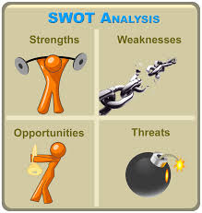
SWOT Analysis
Prepare a SWOT Analysis for yourself.

Slide 6
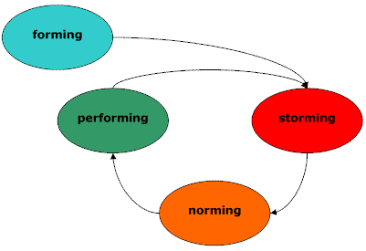
Group Formation
(Tuckman and Jensen 1977).

Slide 7
Forming
Getting to know one another
- Group Name
Developing a shared purpose and goal
- Grade
Gaining commitment
-Exchange of contact details

Slide 8
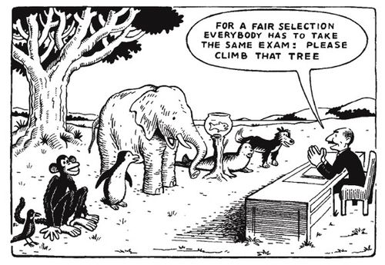
Why HR is important?

Slide 9
Aims of HRM
Old Employment Model
New Employment Model
Inflexible
High Conflict
Low Productivity
Flexible
Low Conflict
High Performance

Slide 10
The Changing Environment of HRM
Globalization
‘The process by which businesses or other organizations develop international influence or start operating on an international scale’ (Oxford English Dictionary)

Slide 11
Reasons for Globalisation
Sales Expansion
Cheap Labour Force
Partnerships

Slide 12
Effects of Globalization
Cultural Aspects;
High Context or Low Context Societies (Hall & Hall, 1990)
- Cyprus vs UK
Individualism or Collectivism (Hofstede & Hofstede, 2005)
Japan vs USA
Monochromic or Polychronic (Trompenaars & Hampden-Turner, 2011)
This subject will be covered in detail in Week 10.

Slide 13
Technological Trends
Virtual Organizations (Amazon)
High-Tech Jobs/Service Jobs
Increase in importance of Human Capital.

Slide 14
Human Capital
Human Capital refers to the knowledge, education, training, skills and expertise of a firm’s workers.
‘The center of gravity in employment is moving fast from manual and clerical workers to knowledge workers…’ - Peter Drucker
Remember! Knowledge is the important asset!
In order to use human capital effectively HR managers needs to apply Strategic HRM.

Slide 15
Break -Create an Edmodo Account -Sign the Attendance Sheet -Double check if you are enrolled to the e-mail list

Slide 16
Strategic HRM
What is strategy?
Where you are?
Where do you want to be?
How you will get there?

Slide 17
Why Strategic HRM?
People play a strategic role in organisational success
HR strategies must be integrated with business strategies (vertical integration)
Individual HR strategies must cohere (horizontal integration)

Slide 18
Aim of Strategic HRM
Aims to create High-Performance Work System.
‘An integrated set of HRM policies and practices that together produce superior employee performance.’

Slide 19
HR Manager Proficiencies
HR Proficiencies:
Employee Selection
Training
Compensation
2. Business Proficiencies:
Merge business objectives with employee objectives.
Strategic planning
Production
Marketing
Finance

Slide 20
HR Manager Proficiencies
3. Leadership
Leading teams effectively
Change management
4. Continuous Learning:
-Research and apply recent trends in the industry.

Slide 21
http://www.youtube.com/watch?v=0G58IaiZs8E
‘In September, it recalled 615,000 Sienna minivans in the US to fix a lever problem that could cause vehicles to shift out of park mode "without the driver depressing the brake pedal’ September 2013
The company called back more than 780,000 vehicles in the US to address a suspension defect in its RAV4 and Lexus HS 250h models, after fears that an initial recall last year did not fix the problem. October 2013
Toyota is recalling 885,000 vehicles to fix a problem that could cause a water leak from the air conditioning unit. October 2013
‘Toyota is recalling 1.9 million of its top-selling Prius hybrid cars because of a software fault that may cause the vehicle to slow down suddenly.’ February 2014
http://www.bbc.com/news/business-24576729 http://www.bbc.com/news/business-26148711

Slide 22
One representative from each group
Presentations will be 20 minutes long (10 Minutes each)
20% of your total mark.
Professional Image

Slide 23
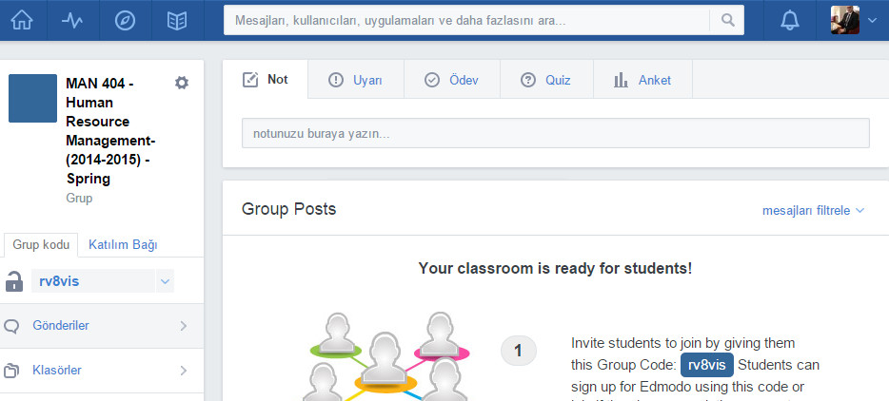
e-Learning
Class Name: MAN 404 – Human Resource Management- (2014-2015) – Spring
Group Code: rv8vis
Join URL: https://edmo.do/j/8q3q3e

Slide 24
Reading List
Dessler, G. (2008) Human Resource Management. 11th edn. Harlow: Pearson Education Ltd
Mondy, R. (2005) Human Resource Management. Harlow: Pearson Education Ltd
The International Journal of Human Resource Management http://www.tandfonline.com/toc/rijh20/current
Harvard Business Review http://hbr.org/
Emerald http://www.emeraldinsight.com/index.htm
Relevant websites

Slide 25
References
Dessler, G. (2008) Human Resource Management. 11th edn. Harlow: Pearson Education Ltd
Drucker, P. F. (1993) Post-capitalist society. New York: Harper Collins Publishers
Guest, D. (1987), “Human resource management and industrial relations”, Journal of
Management Studies, Vol. 24 No. 5, pp. 503-21. DOI: http://dx.doi.org/10.1108/17410400810867508
DEVANNA, M. A., FOMBRUN, C . and TICHY, N . (1984). 'A framework for strategic human resource management'. In Fombrun, C., Tichy, N. M. and Devanna, M. A. (Eds), Strategic Human Resources Management. New York: WUey.
Hall, E.T. and Hall, M.R. (1990) Understanding cultural differences. London: Nicholas Brealey Publishing
Hofstede, G. and Hofstede, G.J. (2005) Cultures and Organizations: Software of the Mind. 2nd edn. New York: The McGraw-Hill Companies
Mondy, R. (2005) Human Resource Management. Harlow: Pearson Education Ltd
Purcell, J., Kinnie, N., Hutchinson, S., Rayton, B. and Swart, J. (2003) Understanding the People and Performance Link: Unlocking the Black Box. London: CIPD
Tuckman and Jensen (1977);
https://www.learning.ox.ac.uk/media/global/wwwadminoxacuk/localsites/oxfordlearninginstitute/documents/supportresources/lecturersteachingstaff/developmentprogrammes/StagesinGroupDevelopment.pdf
Trompenaars, F. and Hampden-Turner, C. (2011) Riding the Waves of Culture: Understanding Cultural Diversity in Business. 2nd edn. London: Nicholas Brealey Publishing

Slide 26
Any Questions? tugberk.kaya@neu.edu.tr

