Slide 1
MAN 404 Human Resource Management
Training & Development
Week 6
Tuğberk Kaya
tugberk.kaya@neu.edu.tr
Near East University

Slide 2
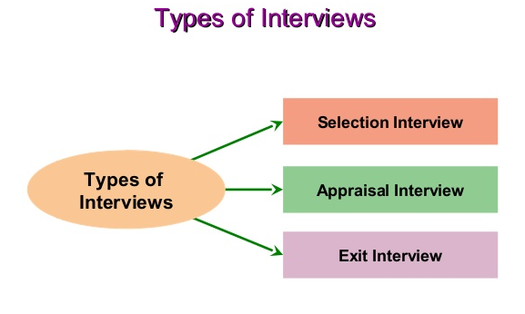
Recap – Interviews

Slide 3
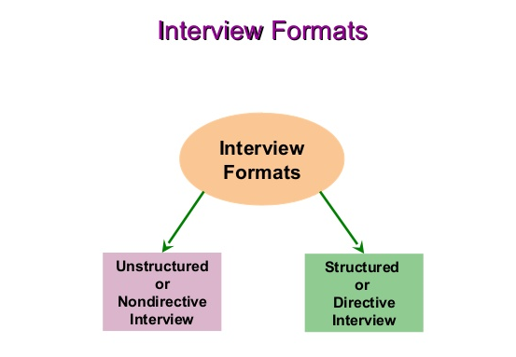
Recap

Slide 4
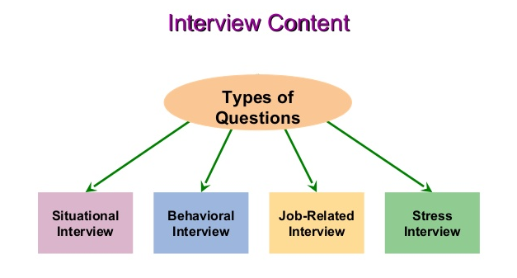
Recap

Slide 5
Recap

Slide 6
Orienting Employees
Employee orientation
A procedure for providing new employees with basic background information about the firm.
Orientation content
Information on employee benefits
Personnel policies
The daily routine
Company organization and operations
Safety measures and regulations
Facilities tour

Slide 7
Orienting Employees (cont’d)
A successful orientation should accomplish four things for new employees:
Make them feel welcome and at ease.
Help them understand the organization in a broad sense.
Make clear to them what is expected in terms of work and behavior.
Help them begin the process of becoming socialized into the firm’s ways of acting and doing things.

Slide 8
The Training Process
Training
The process of teaching new employees the basic skills they need to perform their jobs.
The strategic context of training
Performance management: the process employers use to make sure employees are working toward organizational goals.
Web-based training
Distance learning-based training
Cross-cultural diversity training

Slide 9
The Training and Development Process
Needs analysis
Identify job performance skills needed, assess prospective trainees skills, and develop objectives.
Instructional design
Produce the training program content, including workbooks, exercises, and activities.
Validation
Presenting (trying out) the training to a small representative audience.
Implement the program
Actually training the targeted employee group.
Evaluation
Assesses the program’s successes or failures.

Slide 10
Make the Learning Meaningful
At the start of training, provide a bird’s-eye view of the material to be presented to facilitates learning.
Use a variety of familiar examples.
Organize the information so you can present it logically, and in meaningful units.
Use terms and concepts that are already familiar to trainees.
Use as many visual aids as possible.

Slide 11
Make Skills Transfer Easy
Maximize the similarity between the training situation and the work situation.
Provide adequate practice.
Label or identify each feature of the machine and/or step in the process.
Direct the trainees’ attention to important aspects of the job.
Provide “heads-up” preparatory information that lets trainees know they might happen back on the job.

Slide 12
Motivate the Learner
People learn best by doing so provide as much realistic practice as possible.
Trainees learn best when the trainers immediately reinforce correct responses
Trainees learn best at their own pace.
Create a perceived training need in the trainees’ minds.
The schedule is important too: The learning curve goes down late in the day, less than full day training is most effective.

Slide 13
Analyzing Training Needs
Task analysis
A detailed study of a job to identify the specific skills required, especially for new employees.
Performance analysis
Verifying that there is a performance deficiency and determining whether that deficiency should be corrected through training or through some other means (such as transferring the employee).

Slide 14
Training Methods
On-the-job training (OJT)
Having a person learn a job by actually doing the job.
OJT methods
Coaching or understudy
Job rotation
Special assignments
Advantages
Inexpensive
Immediate feedback

Slide 15
Steps in On-the-job training
Step 1: Prepare the learner
Step 2: Present the operation
Step 3: Do a tryout
Step 4: Follow up

Slide 16
Training Methods
Apprenticeship training
A structured process by which people become skilled workers through a combination of classroom instruction and on-the-job training.
Informal learning
The majority of what employees learn on the job they learn through informal means of performing their jobs on a daily basis.
Job instruction training (JIT)
Listing each job’s basic tasks, along with key points, in order to provide step-by-step training for employees.

Slide 17
Managing Organizational Change and Development
What to change?
Strategy: mission and vision
Culture: new corporate values
Structure: departmental structure, coordination, span of control, reporting relationships, tasks, decision-making procedures
Technologies: new systems and methods
Employees: changes in employee attitudes and skills

Slide 18
Overcoming Resistance to Change
What causes resistance?
All behavior in organizations is a product of two kinds of forces—those striving to maintain the status quo and those pushing for change.
Lewin’s Change Process
Unfreezing: reducing the forces striving to maintain the status quo.
Moving: developing new behaviors, values, and attitudes, sometimes through structural changes.
Refreezing: reinforcing the changes.

Slide 19
Overcoming Resistance to Change
Change initiatives
Political campaign: creating a coalition strong enough to support and guide the initiative.
Marketing campaign: tapping into employees’ thoughts and feelings and also effectively communicating messages about the prospective program’s theme and benefits.
Military campaign: Deploying executives’ scarce resources of attention and time to actually carry out the change.

Slide 20
How to Lead the Change
Establish a sense of urgency.
Mobilize commitment through joint diagnosis of problems.
Create a guiding coalition.
Develop a shared vision.
Communicate the vision.
Help employees to make the change.
Generate short-term wins.
Consolidate gains and produce more change.
Anchor the new ways of doing things in the company’s culture.
Monitor progress and adjust the vision as required.

Slide 21
Evaluating the Training Effort
Designing the study
Time series design
Controlled experimentation
Training effects to measure
Reaction of trainees to the program
Learning that actually took place
Behavior that changed on the job
Results that were achieved as a result of the training

Slide 22
References
Dessler, G. (2008) Human Resource Management. 11th edn. Harlow: Pearson Education Ltd
Guest, D. (1987), “Human resource management and industrial relations”, Journal of Management Studies, Vol. 24 No. 5, pp. 503-21. DOI: http://dx.doi.org/10.1108/17410400810867508
Mondy, R. (2005) Human Resource Management. Harlow: Pearson Education Ltd
Trompenaars, F. and Hampden-Turner, C. (2011) Riding the Waves of Culture: Understanding Cultural Diversity in Business. 2nd edn. London: Nicholas Brealey Publishing

Slide 23
Any Questions? tugberk.kaya@neu.edu.tr

