Slide 1
Human Resource Management
Performance Management & Appraisal Week 7
MAN 404
Tuğberk Kaya
tugberk.kaya@neu.edu.tr
Near East University

Slide 2
Definitions
Performance appraisal
Evaluating an employee’s current and/or past performance relative to his or her performance standards.
Performance management
The process employers use to make sure employees are working toward organizational goals.

Slide 3
Why Performance Management?
Increasing use by employers of performance management reflects:
The popularity of the total quality management (TQM) concepts.
The belief that traditional performance appraisals are often not just useless but counterproductive.
The necessity in today’s globally competitive industrial environment for every employee’s efforts to focus on helping the company to achieve its strategic goals.

Slide 4
Why appraise performance?
Appraisals play an integral role in the employer’s performance management process.
Appraisals help in planning for correcting deficiencies and reinforce things done correctly.
Appraisals, in identifying employee strengths and weaknesses, are useful for career planning
Appraisals affect the employer’s salary raise decisions.

Slide 5
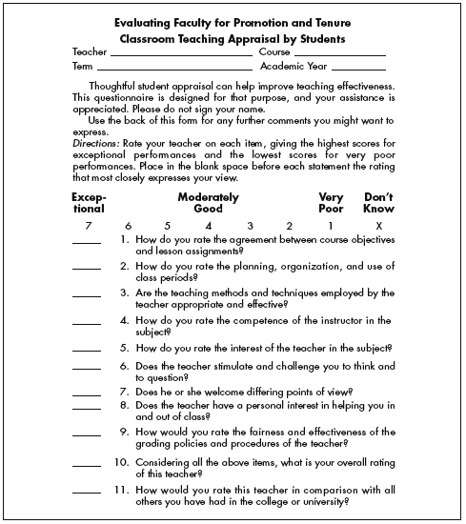

Slide 6
Realistic Appraisals
Motivations for soft appraisals
The fear of having to hire and train someone new
The unpleasant reaction of the appraisee
A company appraisal process that’s not conducive to candor
Hazards of giving soft appraisals
Employee loses the chance to improve before being forced to change jobs.
Lawsuits arising from dismissals involving inaccurate performance appraisals.

Slide 7
Continuous improvement
A management philosophy that requires employers to continuously set and relentlessly meet ever-higher quality, cost, delivery, and availability goals by:
Eradicating the seven wastes:
overproduction, defective products, and unnecessary downtime, transportation, processing costs, motion, and inventory.
Requiring each employee to continuously improve his or her own personal performance, from one appraisal period to the next.

Slide 8
The Components of an Effective Performance Management Process
Direction sharing
Role clarification
Goal alignment
Developmental goal setting
Ongoing performance monitoring
Ongoing feedback
Coaching and support
Performance assessment (appraisal)
Rewards, recognition, and compensation
Workflow and process control and return

Slide 9
Defining Goals and Work Efforts
Guidelines for effective goals
Assign specific goals
Assign measurable goals
Assign challenging but doable goals
Encourage participation
SMART goals are:
Specific, and clearly state the desired results.
Measurable in answering “how much.”
Attainable, and not too tough or too easy.
Relevant to what’s to be achieved.
Timely in reflecting deadlines and milestones.

Slide 10
Performance Appraisal Roles
HR department
Serves a policy-making and advisory role.
Provides advice and assistance regarding the appraisal tool to use.
Prepares forms and procedures and insists that all departments use them.
Responsible for training supervisors to improve their appraisal skills.

Slide 11
Performance Appraisal Roles
Supervisors
Usually do the actual appraising.
Must be familiar with basic appraisal techniques.
Must understand and avoid problems that can cripple appraisals.
Must know how to conduct appraisals fairly.

Slide 12
Steps in Appraising Performance
Defining the job
Making sure that you and your subordinate agree on his or her duties and job standards.
Appraising performance
Comparing your subordinate’s actual performance to the standards that have been set; this usually involves some type of rating form.
Providing feedback
Discussing the subordinate’s performance and progress, and making plans for any development required.

Slide 13
Designing the Appraisal Tool
What to measure?
Work output (quality and quantity)
Personal competencies
Goal (task) achievement
How to measure?
Graphic rating scales
Alternation ranking method
Graphic rating scale

Slide 14
Management by Objectives (MBO)
Involves setting specific measurable goals with each employee and then periodically reviewing the progress made.
Set the organization’s goals.
Set departmental goals.
Discuss departmental goals.
Define expected results (set individual goals).
Performance reviews.
Provide feedback.

Slide 15
Potential Rating Scale Appraisal Problems
Unclear standards
An appraisal that is too open to interpretation.
Halo effect
Occurs when a supervisor’s rating of a subordinate on one trait biases the rating of that person on other traits.
Central tendency
A tendency to rate all employees the same way, such as rating them all average.

Slide 16
Potential Rating Scale Appraisal Problems
Strictness/leniency
The problem that occurs when a supervisor has a tendency to rate all subordinates either high or low.
Bias
The tendency to allow individual differences such as age, race, and sex to affect the appraisal ratings employees receive.

Slide 17
How to Avoid Appraisal Problems
Learn and understand the potential problems, and the solutions for each.
Use the right appraisal tool. Each tool has its own pros and cons.
Train supervisors to reduce rating errors such as halo, leniency, and central tendency.
Have raters compile positive and negative critical incidents as they occur.

Slide 18
Who Should Do the Appraising?
The immediate supervisor
Peers
Rating committees
Self-ratings
Subordinates
360-Degree feedback
Increase opinions in order to provide fair decision!

Slide 19
Creating the Total Performance Management Process
“What is our strategy and what are our goals?”
“What does this mean for the goals we set for our employees, and for how we train, appraise, promote, and reward them?”
What will be the technological support requirements?

Slide 20
Performance Management
Mission and values
Objectives
Performance agreement
Performance review
Continuous assessment
Feedback
Performance
Related
pay
Performance rating
Development
(Based on Armstrong 2008)

Slide 21
The People and Performance Model
Training and Development
Performance appraisal
Career opportunity
Job security
Recruitment
Ability and Skill
Pay satisfaction
Motivation and
Front line management –implementing
Enacting
Leading
Controlling
Organisational Commitment
Motivation
Job satisfaction
Discretionary behaviour
Worklife Balance
Opportunity to Participate
Performance outcomes
Job challenge /autonomy
Teamworking
Involvement
People and Performance Model
Purcell et al. 2003
Communication

Slide 22
References
Armstrong, M. (2008) Armstrong's Handbook of Human Resource Management Practice. 12th edn. London: Kogan Page Ltd
Dessler, G. (2008) Human Resource Management. 11th edn. Harlow: Pearson Education Ltd
Guest, D. (1987), “Human resource management and industrial relations”, Journal of
Management Studies, Vol. 24 No. 5, pp. 503-21. DOI: http://dx.doi.org/10.1108/17410400810867508
Mondy, R. (2005) Human Resource Management. Harlow: Pearson Education Ltd
Purcell, J., Kinnie, N., Hutchinson, S., Rayton, B. and Swart, J. (2003) Understanding the People and Performance Link: Unlocking the Black Box. London: CIPD

Slide 23
Any Questions? tugberk.kaya@neu.edu.tr

