Slide 1
Cancer Immunology
Asst.Prof.Dr. Umut Gazi
Email: umut.gazi@hotmail.com
Room No: 208 (Faculty of Medicine)

Slide 2
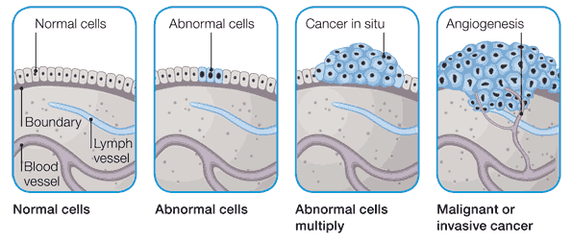
Cancer represents a wide spectrum of conditions caused by a failure of the controls that normally govern cell proliferation, differentiation and cell survival.
They give rise to clones of cells that can expand to a considerable size, producing a tumour or neoplasm.
A tumour that is not capable of indefinite growth and does not invade the healthy surrounding tissue is benign. A tumour that continues to grow and becomes progressive invasive is malignant (the term cancer refers to specially to a melignant tumour).
Metastasis is process that small clusters of cancerous cells dislodge from a tumour, invade the blood or lymphatic vessels, and are carried to other tissues where they continue to proliferate.

Slide 3
Mallignant tumours or cancers are classified according to the origin of the tissue/cell from which the tumour is derived:
Name | Origin of tissue/cell
Carcinomas | endodermal or ectodermal tissues such as skin or epithelial lining of internal organs and glands.
Sarcomas | mesodermal connective tisues such as bone, cartilage, fat muscle, or blood vessels.
Leukemias | blood forming tissue such as bone marrow and causes large numbers of abnormal blood cells to be produced and enter the blood.
Lymphomas | lymphatic system which is responsible for fighting disease along your immune system
Brain and Spinal Cord Cancer | CNS

Slide 4
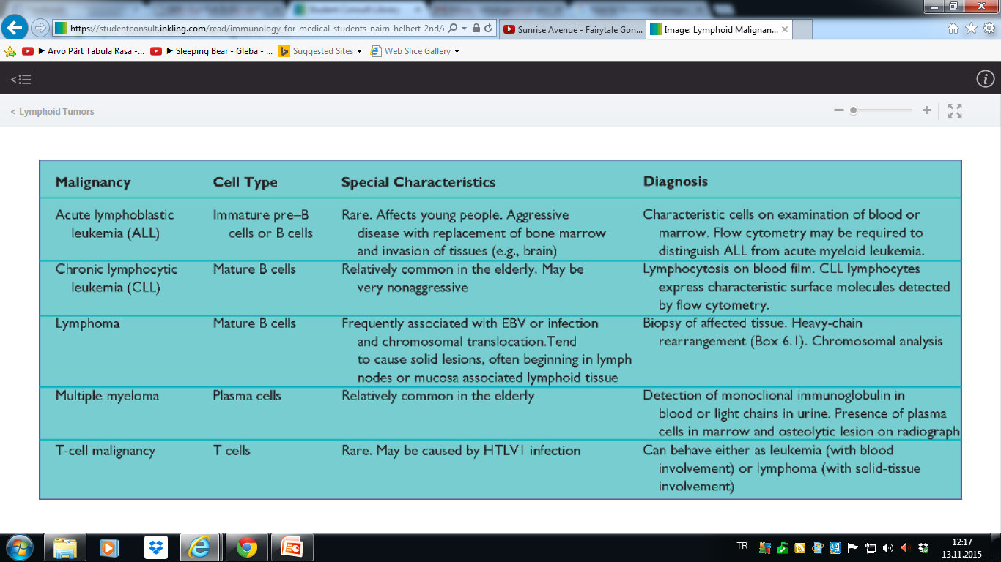
LYMPHOID MALIGNANCIES AND THEIR CHARACTERISTICS

Slide 6
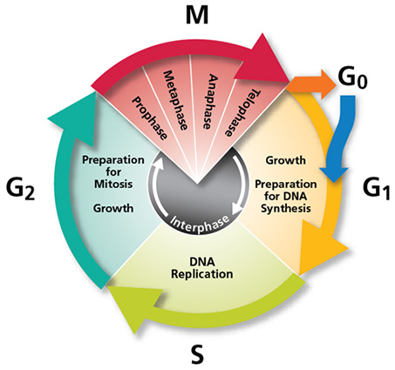
Cellular transformation is a multi-step process involving a combination of genetic lesions affecting genes that regulate cell cycle entry, cell cycle exit and cell death. Cancer-associated genes can be divided into three categories.
Activating mutations in genes that promote cell proliferation such as MYC and RAS (poto- or cellular- oncogenes).
There are also inactivating mutations in genes that promote cell cycle arrest such as P53 and RB (tumor-suppressor genes or anti-oncogenes).
Additionally deregulated expression of genes involved in the control of programmed cell death (including oncogene such as BCL-2 which is an anti-apoptosis gene).

Slide 7
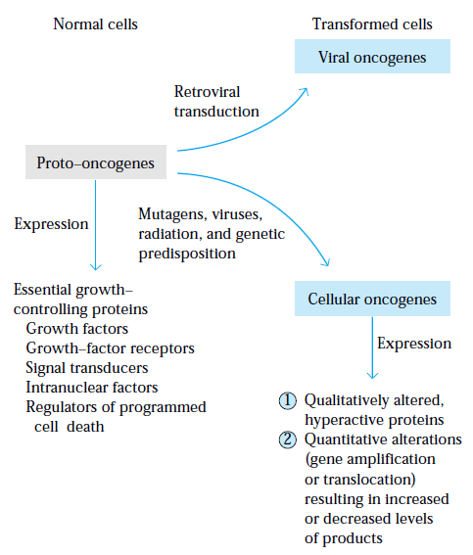
Oncogene is a gene that encodes a protein capable of inducing cellular transformation.
Oncogenes derived from viruses are viral oncogenes; their counterparts in normal cells are proto-oncogenes.
Mutations or genetic rearrangements of proto-oncogenes by carcinogens or viruses might alter the normally regulated function of these genes, converting htem into potent cancer-causing oncogenes.
Genetic rearragement includes the chromosomal translocation of a proto-oncogene from one chromosomal site to another where its expression will be altered (ex. near immunoglobulin heavy chain enhancer)

Slide 8
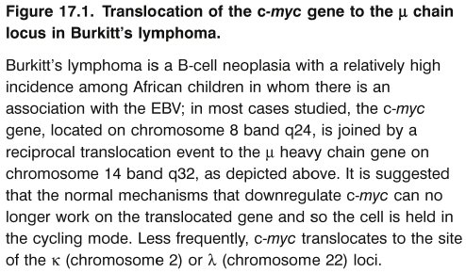
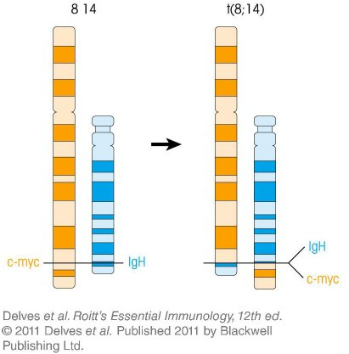

Slide 9
What our immune response do during cancer development??
Immune responses to tumours do occur, but they are frequently modest and seem to makel little inroads in tumour growth.
The antigens expressed on tumour cells but not on normal cells are caled tumor-spesific antigens. They may result from mutations in tumor cells that generate altered cellular proteins. As they are foreign, they can induce immune responses.
On the other hand, tumor antigens that are also expressed on normal cells are called tumor-associated antigens; these antigens are normall cellular constituents whose expression is dysregulated in tumors. They are potemtial targets for immunotherapy or are useful markers for clinical diagnosis and for observation of patients.
Typically these antigens have been identifies by their ability to induce the proliferation of antigen-spesific CTLs or helper T-cells.

Slide 10
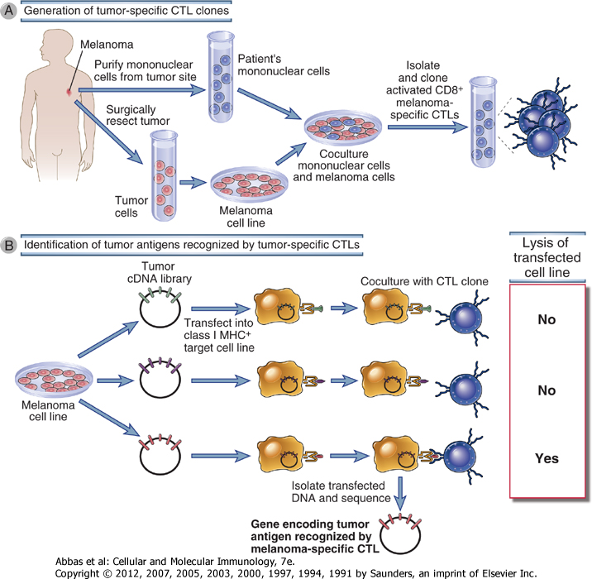

Slide 11
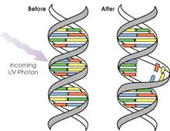
Tumor antigens
They have been identified on tumors induced with chemical or physical carcinogens and on some virally induced tumors.
Some chemically or physically induced tumour genes have been shown to differ from normal cellular genes by a single point mutations.
Many of them are not cell-membrane proteins; rather they are short peptides derived from cytosolic proteins that can be processed and presented together with MHC class I molecules.

Slide 12
Tumor antigens
In contrast to chemically induced tumors , virally induced tumors express tumor antigens shared by all tumors induced by the same virus.
DNA viruses (such as Epstein-Barr virus, human popillomavirus) are implicated in the development of a variety of tumors in humans. The only well-defined human RNA tumor viruse (retrovirus )that causes tumors is human T-cell lymphotropic virus (HTLV-1) responsible for a melignant tumor of CD4+ T-cells.
Endogenously expressed viral proteins can be processed an and presented with MHC class I molecules on the tumor cell surface.

Slide 13
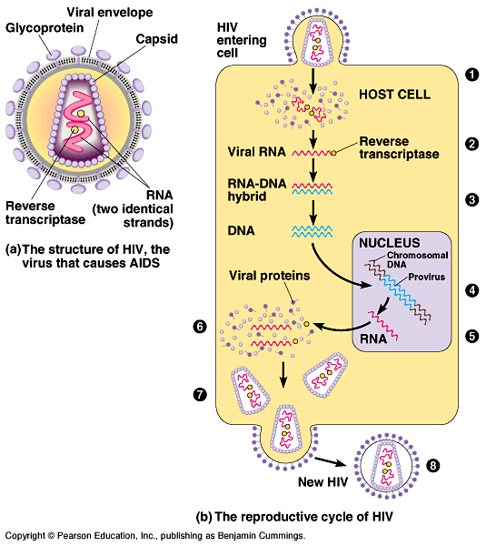
Tumour virus infections are caused by oncogenic DNA or RNA viruses. They can cause cancer by two different processes:
directly through the expression of viral proteins that disrupt tissue cells and result in their transformation; and
indirectly through mutation of the host cell DNA through chromosomal translocation and viral integration (also known as insertional mutagenesis).

Slide 14
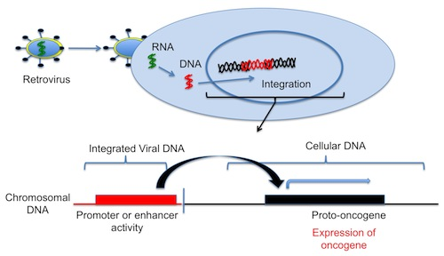

Slide 15
Tumor antigens
Oncofetal antigens (ex: carcinoembryonic antigen, and α-fetoprotein) are proteins that are expressed at high levels in cancer cells and in normal developing fetal but not adult tissues.
These antigens appear before the immune system acquires immunocompetence, so if they appear later on cancer cells, they are recognized as nonself and induce immunolofic response.
Serum levels of carcinoembryonic antigen and α-fetoprotein can be used as a diagnostic marker for colorectal cancer and liver cancer respectively.
However serum CEA can also be elevated in setting of non-neoplastic diseases, such as chronic inflammatpoory conditions of bowel or liver.

Slide 16
Tumor antigens
Differentiation antigens are molecules that are specific for particular lineages or differentiation stages of various cell types. Their importance is as potential targets for immunotherapy and for identification of the tissue of origin of tumors.
These differentiation antigens (e.g. CD20 on B-cell lymphoma) are normal self molecules and therefore they do not usually induce strong immune responses in tumor bearing host.
Abnormally expressed but unmutated cellular proteins can also be regarded as tumor antigens. For instance, MAGE proteins, a cancer/testis antigen, are silent in most normal tissues, except the testes or trophoblasts in placenta but are expressed in varity of malignant tumours.

Slide 17
Tumor antigens
Most human tumors express higher than normal levels or abnormal forms of surface glycoproteins and glycolipids (e.g.gangliosides, blood group antigens, and mucins), which may be diagnostic markers and targets for therapy. Some aspects of the malignant phenotype of tumors, including tissue invasion and metastatic behaviour, may reflect altered cell surface properties that result from abnormal glycolipid and glycoprotein synthesis.
Products of mutated genes include oncogenes and mutated tumor suppressor genes as well as those that are not related to the malignant phenotype. The genetic differences are introduced by point mutations, deletions, chromosomal translocations or viral gene insertions.
These altered products may enter class I antigen-processing pathway. In addition, these proteins may enter the class II antigen-processing pathway in APC cells that phagocytosed dead tumor cells.

Slide 18
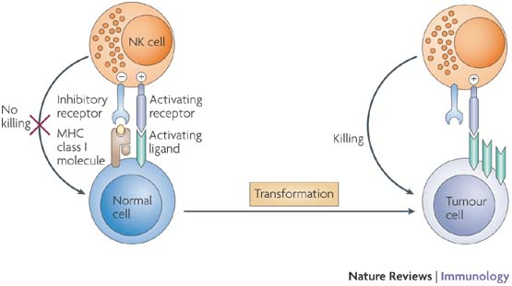
Innate Immune Responses to Tumors
Natural killer (NK)-cell activation is regulated by a balance between signals mediated through activating and inhibitory receptors.
Upon cellular transformation, MHC class I ligands for inhibitory receptors are often reduced or lost.
In parallel, cellular stress and DNA damage lead to the upregulation of ligands (e.g. MIC-A, MIC-B and ULB) for activating NK-cell receptors (e.g. NKG2D) on the tumour cell.
During tumour progression, tumour variants may evolve that upregulate ligands for inhibitory receptors and/or lose ligands for activating receptors. These tumours may escape NK-cell-mediated recognition.
NK cells can be also targeted to IgG antibody-coated tumor cells by Fc receptors (CD16).

Slide 19
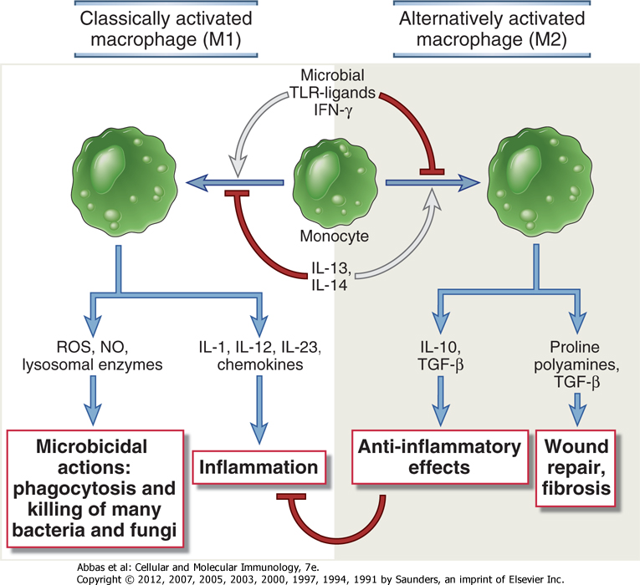
Innate Immune Responses to Tumors
Classically activated M1 macrophages display various anti-tumor functions.
Possible mechanism for their activation include direct recognition of some surface antigens and activation of macophages by IFN-γ produced by tumor-spesific T cells.
The killing mechanisms include the release of lysosomal enzymes, reactive oxygen species and nitric oxide.
M1 macrophage also produce cytokine TNF that can kill the tumors by inducing thrmbosis in tumor blood vessels.

Slide 20
Innate Immune Responses to Tumors
In contrast M2 macrophages may contribute to tumor progression.
These cells secrete vascular endothelial growth factor (VEGF), transforming growth factor-β (TGF- β) and other soluble factors that promte tumor angiogenesis.

Slide 21
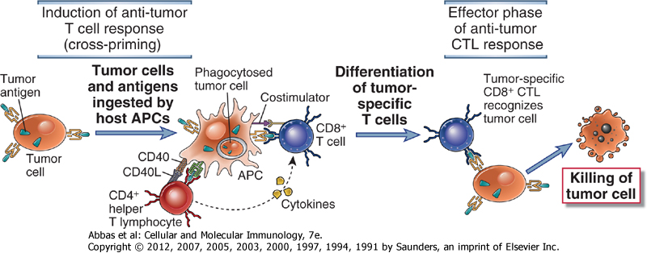
Adaptive Immune Responses to Tumors
The principal mechanism of adaptive tumor immunity is killing of tumor cells by CD8⁺ CTLs.
However, most tumor cells are not derived from APCs and therefore do not express the costimulators needed to initiate helper T-cell responses thatpromote the differentiation of CD8⁺ T-cells.
A likely explanation is that tumor cells or their antigens are ingested by host APCs, particularly dendritic cells, and peptides derived from these antigens are displayed bound to class I MHC molecules (cross-presentation) for recognition by CD8⁺ CTLs.
Once effector CTLs are generated, they are able to kill the tumor cells without the need for costimulation.

Slide 22
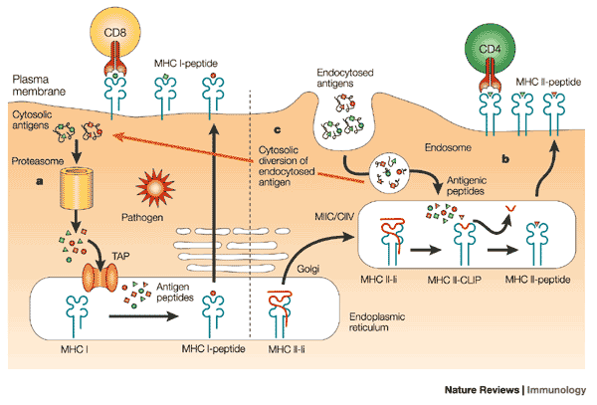

Slide 23
Adaptive Immune Responses to Tumors
APCs can also display antigens bound to class II MHC molecules for recognition by CD4⁺ T-helper cells.
These cells may secrete cytokines such as TNF and IFN-γ, that can increase tumor cell class I MHC expression and sensitivity to lysis by CTLs.
IFN may also activate macorphages to kill tumor cells.

Slide 24
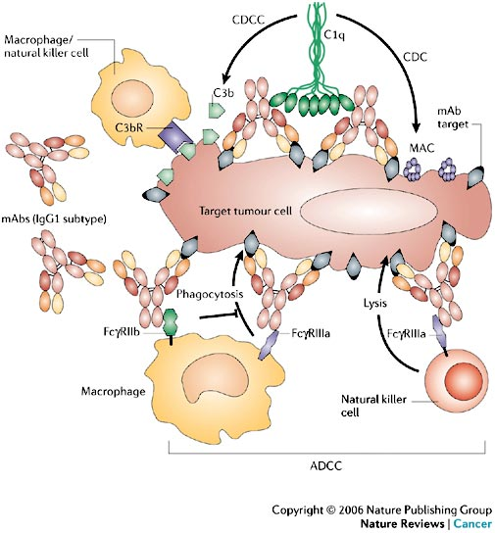
Adaptive Immune Responses to Tumors
Tumour-bearing hosts may produce antibodies with the help of activated CD4+ helper T-cells.
Antibodies may kill tumour cells by
Activating complement, or
Antibody-dependedn cell-mediated cytotoxiciy in which Fc receptor-bearing macrophages or NK cells mediate the killing.
However, the ability of antibodies to eliminate tumor cells has been demonstrated largely in vitro and there is little evidence for effective humoral immune responsesn against tumors.

Slide 25
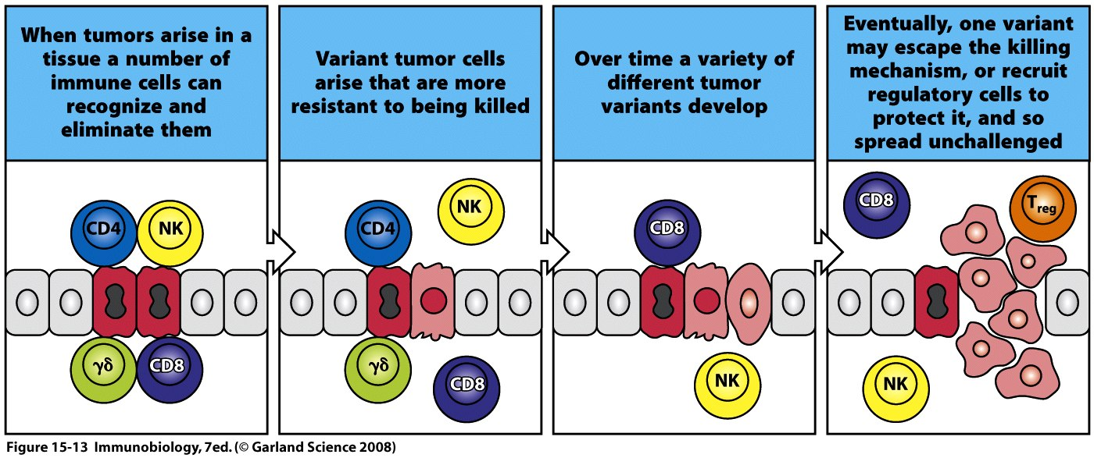
According to the concept of immune surveillance, immune system is able to recognize and destroy clones of transformed cells before they grow into tumors and to kill tumors after they are formed. However, overall importance of immune surveillance is still contravesial.
The concept of immune surveillance is considered in three phases:
(1) elimination phase in which tumor cells are destroyed by immune cells,
(2) equilibrium phase occurs if elemination is not completely successfull, and tumor cells undergo changes or mutation that aid their survival during an immune attack (this is called immunoediting), and
(3) escape phase occurs when tumor cells have accumulated sufficient mutations to elude attentions of the immune system. Tumor is now able to grow unimpede and become clinically detectable.

Slide 26
During the equilibrium phase, there are numerous mechanisms by which tumors can either avoid stimulating an immune response or evade it when it occurs.
These mechanisms can be divided into those that are intrinsic to the tumor cells and those that are extrinsic i.e. mediated by other cells.
INTRINSIC MECHANISMS
Tumors may lose expression of antigens (e.g. via mutation or deletion of tumor antigens) that elicit immune responses. Such “antigen loss variants” (through the selective pressures of immunoediting) are common in rapidly growing tumors.
Apart from tumor-spesific antigens, class I MHC expression may be downregulated on tumor cells

Slide 27
Tumor antigens may be hidden from the immune system by glycocalyx molecules, such as sialic-acid containing mucopolysaccharides. This process is called antigen masking.
Tumors may fail to induce effector T cell responses because the most tumor cells do not express costimulators or class II MHC molecules. Therefore induction of tumor-spesific T-cell responses often requires cross-priming by dendritic cells.
Tumors may engage molecules (via CTLA-4 and PD-1, responsible for inhibitory pathways in T-cells) that inhibit immune responses. Plus, antigen-presentation of tumor cell or peptides takes place in the absence of strong innate immune response. This can give tise to the Treg cells. Some tumors express Fas ligand (FasL) that recgnizes the death receptor Fas on leukocytes that attempt to attack the tumor.
Secreted products (such as TGF-β) of tumor cells may suppress anti-tumor immune response.

Slide 28
EXTRINSIC MECHANISMS
Tumor-associated M2 macrophages may promote tumor growth and invasiness by altering the tissue microenvironment via releasing mediators that impair T-cell activation and effector functions (e.g. IL-10, arginase) and promote angiogenesis (e.g. VEGF).
Tumor cells can increase the levels of regulatory T-cells (vie release of immunosuppressive cytokines such as TGF-β) that may suppress T-cell responses to tumors.
Recruitment of myeloid-derived suppressor cells (MDSC) that is a heterogenous group of cell types, including precursors of dendritic cells, monocytes and neutrophils. They can release mediators that
inhibits various macrophage inflammatory functions
suppress T-cell responses
induce regulatory T-cell development

Slide 29
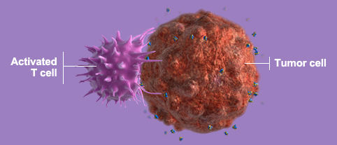
WHY IMMUNOTHERAPY??
The most current therapies in cancer rely on drugs that kill dividing cells or block cell division. Thereby yjeu can also have severe effects on normal proliferating cells.
Immunotherapy has the potential of being the most tumor-spesific treatment.
Immunotherapy for tumors aims
to augment the weak host immune response to the tumors or
to administer tumor-spesific antibodies (a form of passive immunity)

Slide 30
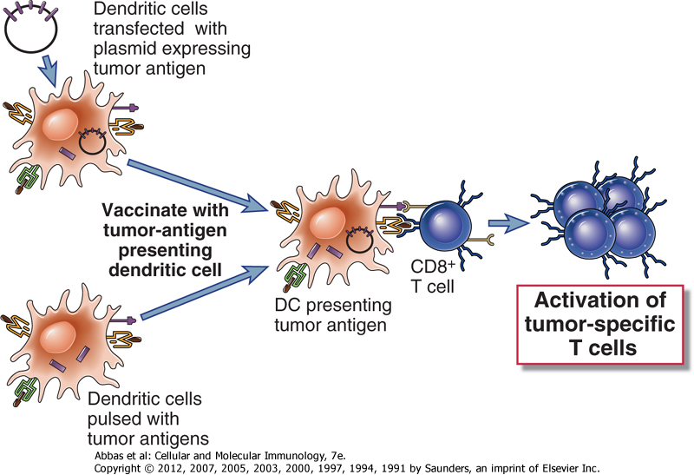
STIMULATION OF ACTIVE HOST IMMUNE RESPONSES TO TUMORS
(1) Vaccination with tumor antigens
Denditic cells that are purified from patients are either incubated with tumor antigens or transfected with genes encoding these antigens and then injected back into the patient.
A cell-based vaccine is now approved to treat advanced prostate cancer.
Alternative approach is the use of DNA vaccines composed of plasmids of viral vectors encoding tumor antigens.
Not suitable for antigens unique to individual tumors, such as antigens produce by random point mutations in cellular genes. Better for the tumor antigens shared by many tumors.

Slide 31
(2) Augmentation of host immunity to tumors with costiumlators and cytokines
Cell-mediated immunity to tumors may be enhanced by expressing co-stimulators and cytokines in tumor cells and by treating tumor-bearing individuals with cytokines that stimulate the proliferation and differnetiation of T-lymphocytes and NK cells.
Many cytokines also have the potential to induce nonspesific inflammatory responses, which by themsevles may have anti-tumor activity.
This approach of using transfected tumor cells as vaccines has worked in mouse models, but clinical trials have not yet been successful.

Slide 32
Cytkines may also be adminisered systemically for the treatment of various human tumors.
However their use in patients is limited by serious toxis side effects.

Slide 33
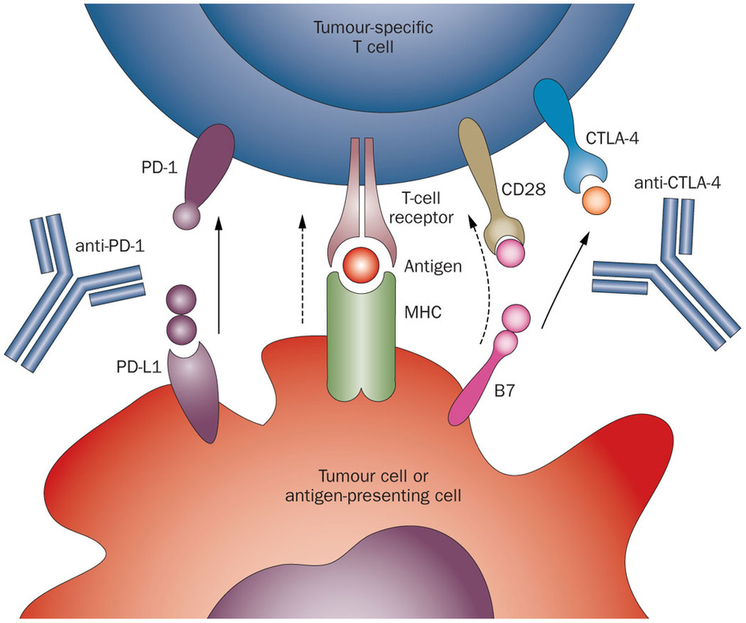
(3) Blocking inhibitory pathways to tumor immunity
Anti-CTLA4 and anti-PD1 antibody blocks a signal used by some kinds of tumors that can suppress the immune system. By blocking the inhibitory signaling the antibody can restore the cancer-fighting ability of T-cells.
A common complication of this treatment has been the dveelopment of autoimmune reactions, which is predictable in light of the known role in maintaining self-tolerance.
(4) Nonspesific stimulation of the immune system
Nonspesific stimulation of patients with tumors by injection of inflammatory substances such as bacillus Calmette-Guerin (BCG) at the sites of tumro growth has been tried for many years. Intravascular BCG is currently used to treat bladder cancer.
Cytokines therapies is another example.

Slide 34
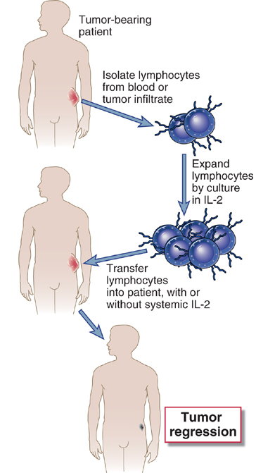
PASSIVE IMMUNOTHERAPY FOR TUMORS WITH T-CELLS AND ANTIBODIES
(1) Adoptive Cellular Therapy
One approach is to generate lymphokine-activated killer cells (LAK) cells. LAK cells are IL-2 activated NK cells. Peripheral blood leukocytes from patients are cultured in high concentrations of IL-2.
Used in advances cases of metastatic tumors, and the efficiency changes from person to person.
Alternatively, tumor-infiltrating lymphocytes (TIL) from the inflammatory infiltrate present in and around solid tumors can be isolated and expanded by culture in IL-2. TILs may be enriched for tumor-spesific CTLs and for activated NK cells. Is now being used in metastatic melanoma.
Patient T-cells can also be transduced with genes encoding TCR spesific for a tumor antigen.

Slide 35
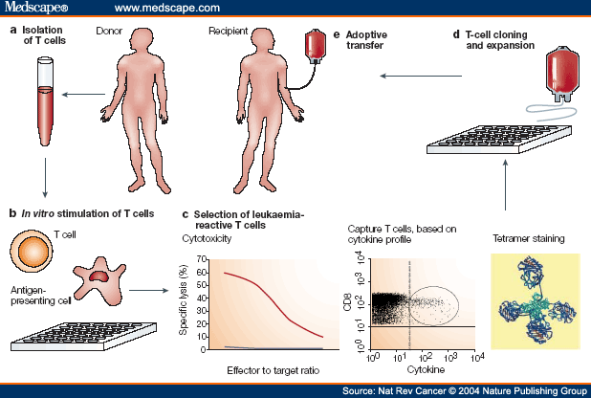
(2) Graft-versus-leukemia effect
Donor T cells that are specific for antigens expressed by leukaemic cells are isolated and expanded in vitro, and then infused into the transplant recipient to establish a potent immune response against the cancer.
Administratin of alloreactive T-cells together with hematopoietic cell transplants can contribute to edadication of tumor.
The graft-versus-leukemia effect is directed at the allogeneic MHC molecules present on the recipient’s hematopoietic cells, including the leukemia cells.

Slide 36
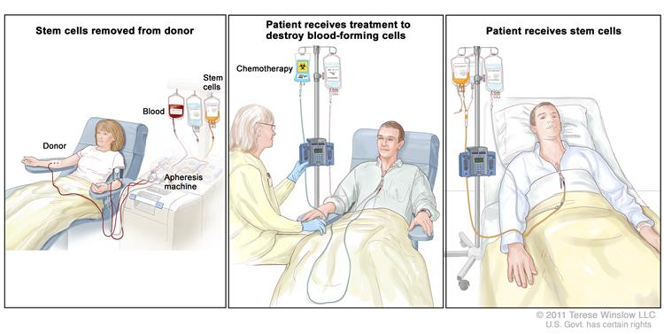

Slide 37
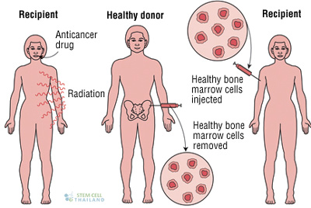

Slide 38
(3) Therapy with anti-tumor antibodies
ANTI-TUMOR MONOCLONAL ANTIBODIES IN TRIALS OR APPROVED FOR CLINICAL USE
SPECIFICITY OF ANTIBODY | FORM OF ANTIBODY USED | CLINICAL USE
HER2/Neu | Humanized mouse monoclonal | Breast Cancer (approved)
CD20 (B cell marker) | Humanized mouse monoclonal | B cell lymphoma (approved)
CD25 | Humanized mouse monoclonal, immunotoxin | T cell lymphomas / leukemias (trials)
Carcinoembrynic antigen | Humanized mouse monoclonal | Gastrointestinal cancers, lung cancer (trials)
CA-125 | Mouse monoclonal | Ovarian cancer
GD₃ ganglioside | Humanized mouse monoclonal | Melanoma (trials)

Slide 39
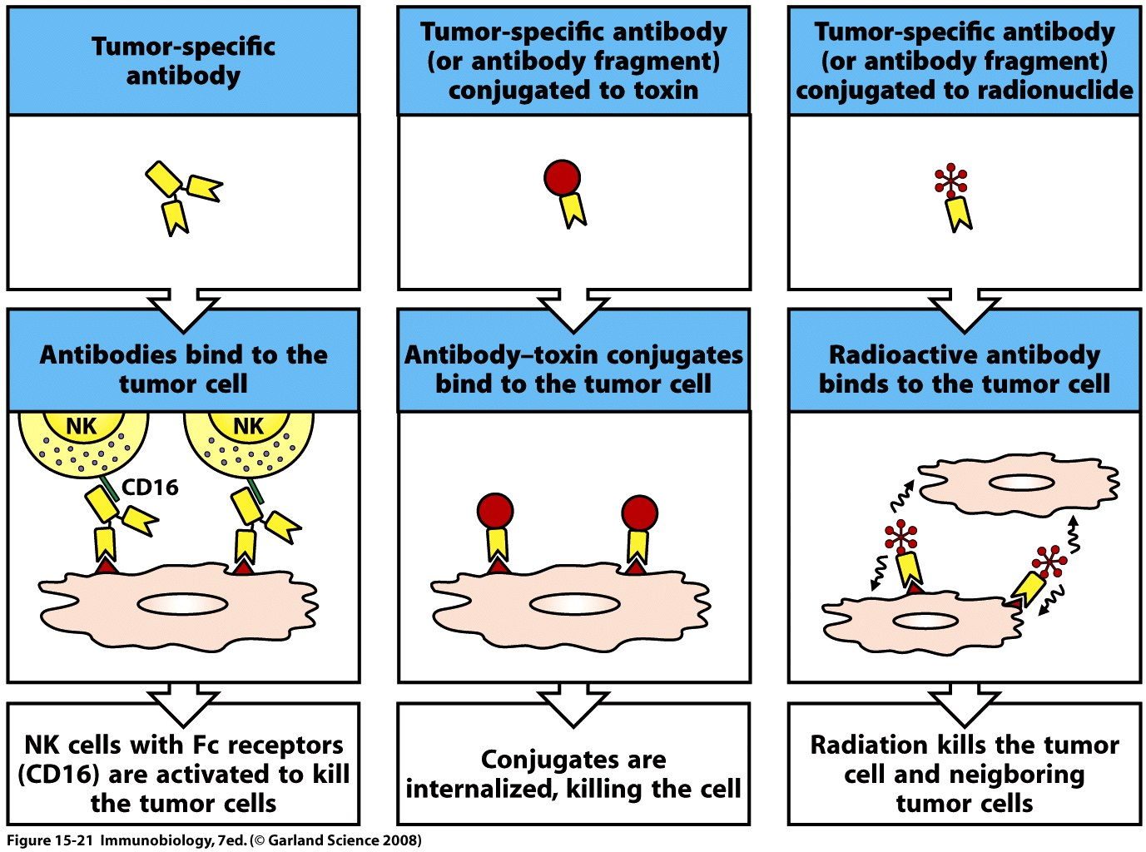
Tumor-spesific antibodied may be coupled to toxic molecules (such as ricin and diphteria toxin that inhibit protein synthesis), radioisotopes, and anti-tumor drugs to promote the delivery of these cytotoxic agents spesifically to the tumor.
Practical difficulties:
systemic effects as a result of circulation through normal tissues, and
Antibody response against the toxins and the injected antibodies.

Slide 40
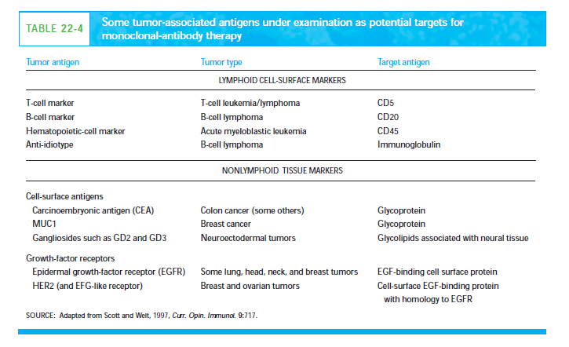

Slide 41
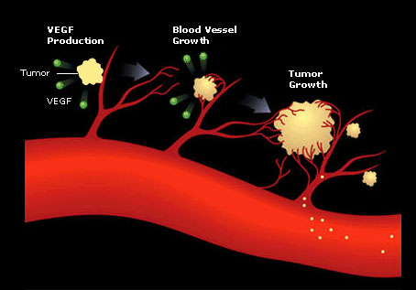
New blood vessels are biochemically and structurally different from normal resting blood vessels.
Potential targets include
VEGF receptor
Eph receptor
Oncofetal fibronectin
MMP-2
MMP-9
Aminopeptidase A
NG2 proteoglycan

Slide 42
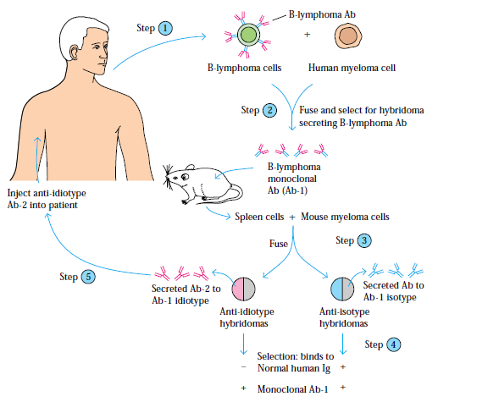
Anti-idiotypic antibodies have been used to treat B cell lymphomas that express surface immunoglobin with particular idiotypes.

Slide 43
WHAT IS THE ROLE OF THE IMMUNE SYSTEM IN PROMOTING TUMOR GROWTH?
Cells of innate immune system are considered to be the most direct tumor-promoting culprits among immune cells; Marophages as well as other cells are sources of
VEGF that promotes angiogenesis, and
matrix metalloproteinase that modify extracellular tissue
free radical that cause DNA damage
soluble factors that promote cell cycle progression and tumor survival
The adaptive immune system can
promote chronic activbation of innate immune cells in several ways
contribute to tumor progression by released products that directly regulate proliferation programs

