Slide 1
Mechanisms of Innate Immunity

Slide 2
There are lots of micoorganisms that we encounter everyday through breathing, touching, and eating.
Most are detected and destroyed within minutes or hours by defense mechanisms that do not rely on the clonal expansion of antigen-specific lymhphocytes.
Thus most do not require period of induction. These are the mechanisms of innate immunity.
Only if an infectious organism can breach these lines of defense will an adaptive immune response ensue, with gene generation of antigen-specific effector cells and memory cells.

Slide 3
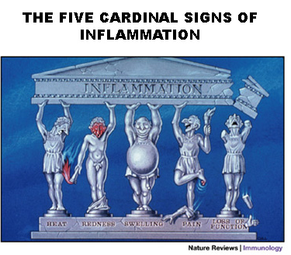
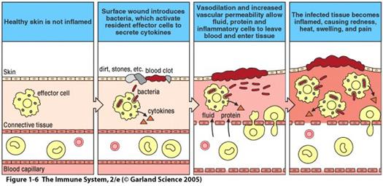
The two major types of responses of the innate immune system that protect against microbes are inflammation and antiviral defense.
Inflammation is the process by which leukocytes and circulating plamsa proteins are brought into sites of infection and activated to destroy and eleminate the offending agents. It can also be induced in response to damaged or dead cells.
In contrast, antiviral defence consists of changes in cells that prevent virus replication and increase susceptibility to killig by lymphocytes, thus eleminating reservoirs of viral infection.

Slide 4
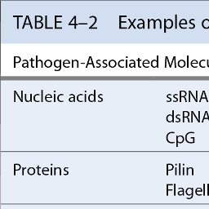
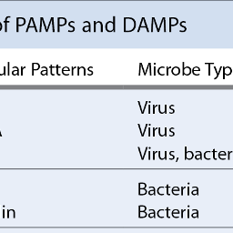
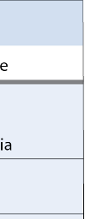
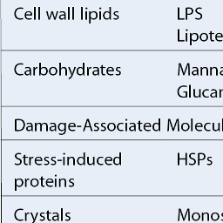
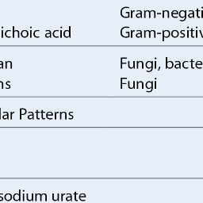
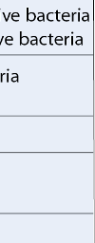
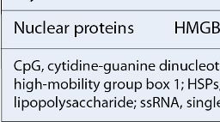
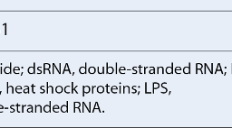
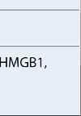
The innate immune system recognizes molecular structures that are characteristic of microbial pathogens but not mammalian cells. These microbial substtances are called pathogen-associated molecular patterns (PAMPs).
The innate immune system can also recognize endogenous molecules that are produced by or released from damaged and dying cells. These substances are called damage-associated molecular patterns (DAMPs).
The innate immune system uses several types of receptors, present in different locations in cells, and soluble molecules in the blood and mucosal secretions to recognize PAMPs and DAMPs.
These cellular receptorsfor pathogens and damage-associated molecules are often called pattern recognition receptors (PRRs).

Slide 5
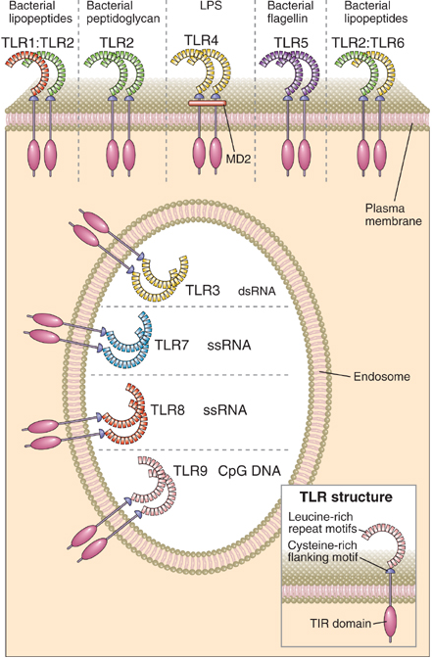
Toll-like receptor are expressed on many cell types and recognize products of wide variety of microbes as well as endogenous molecules.
They were originally identified as a Drosophila gene gene involved in establishing the dorsal-ventral axis during embryogenesis.
The TLRs are type I integral membrane glycoproteins that contain leucine-rich repeats flanked by characteristic cysteine-rich motifs in their extracellular regions and a Toll/IL-1 receptor (TIR) homology domain in their cytoplasmic tail.
TLRs are found on cell surface and on intracellualr membranes and are thus able to recognize ligands in different cellular locations.

Slide 6
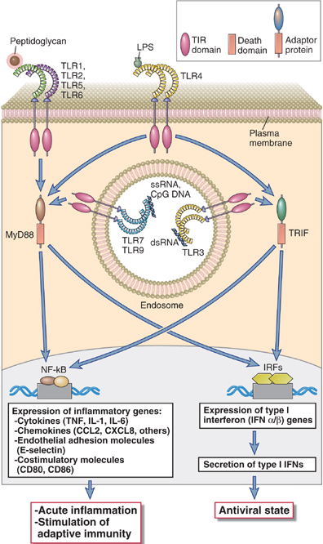
The ligand binding to the leucine-rich domains causes physical interactions between TLR molecules and the formation of TLR dimers.
The repertoire of specificities of the TLR system is extended by the ability of TLRs to heterodimerize with one another. Ex: TLR2-TLR6 heterodimer.
This is followed by recruitment of TIR domain-containing adaptor proteins (ex: MyD88, TRIF) which facilitate the recruitment and activation of various protein kinases, leading to the activation of different transcription factors such as NF-κΒ, AP-1, IRF-3 and IRF-7.

Slide 7
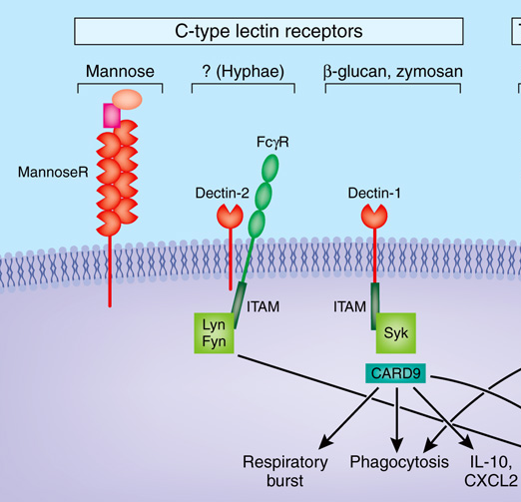
Other examples for PRR include ......
C-type lectin family that recognize carbohydrates on the surface of microbes to stimulate phagocytosis of microbes abd stimulate subsequent adaptive immune responses. ‘C’ implies Ca²⁺-dependent binding ability.
They can be found in soluble form (released in the blood and extracellular fluids) and as an integral protein found on the surfaces of immune cells.
Several types of C-type lectins bind to different carbohydrates including mannose, glucose, N-acetylglucosamine and β-glucans.
Mannose Receptor is involved in recognition certain terminal sugars including D-mannose, L-fucose and N-acetyl-glucosamine which are often present on the surface of microorganisms
Dectin-1 binds to Β-glucan (major constitutent of fungal cell wall in yeast form)
Dectin-2 recognizes high-mannose oligosaccharides onthe hyphal form of certain fungi species.

Slide 8
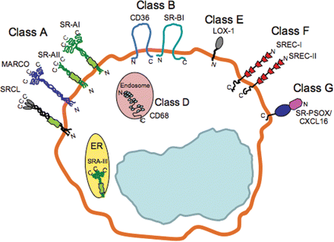
Other examples for PRR include ......
Scavanger Receptors comprise a structurally and functionally diverse collection of cell surface proteins that were originally grouped on the basis of common characteristic of mediating the uptake of oxidized lipoproteins into cells.
Some of these scavanger receptors such as SR-A and CD36, are expressed by macrophages and are involved in phagocytosis of microorganisms.
There is a wide range of molecular structures recognized by scavanger receptors such as LPS, lipoteichoic acid, nucleic acid, β-glucan and proteins.
Their significance of in innate immunity is highlighted by increased susceptinility to infections in gene knock-out mice.

Slide 9
In addition to membrane-bound receptors which may sense PAMPs and DAMPs outside cells or in endosomes, the innate immune system has evolved to equip cells with cytosolic PRR that detect these ligands in cytoplasm.
One example receptor family is NOD (nucleotide oligormerization domain-containing protein)-like receptor (NLR) family.
Typical NLR proteins contain
Leucine-rich repeat domain- involved in ligand binding
NACHT domain – involved in NLR oligomerisation
An effector domain – involved in the formation of signaling complexes. There are three NLR subfamilies, the members of which use different effector domains to initiate signaling, called CARD, Pyrin or BIR domains.

Slide 10
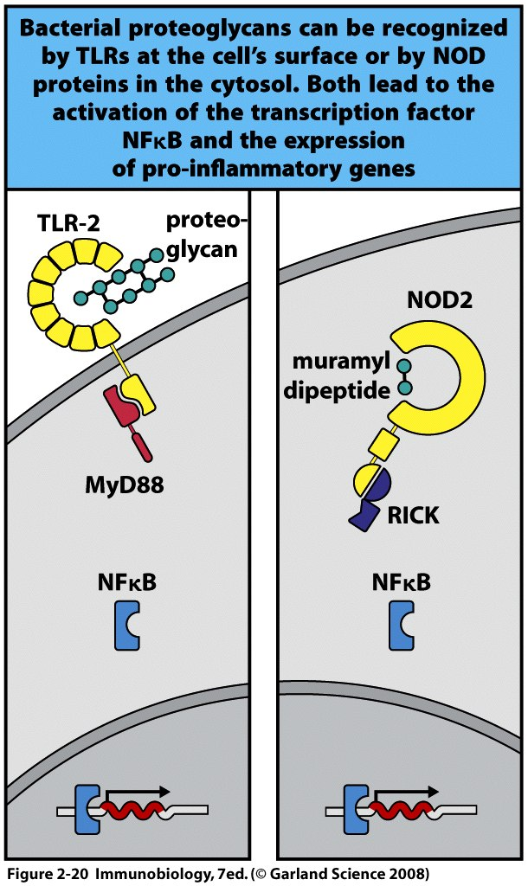
Two of the most studied NLRs are NOD1 and NOD2 which are members of the CARD domain-containing NOD subfamily of NLRs. They are expressed in the cytoplasm of several cell types including mucosal epithelial cells.
NOD1 binds to a breakdown product of Gram-negative bacteria proteoglycans, while NOD2 isinvolved in the reocognition of a distinct molecule called muramyl dipeptide from both gram-negative and gram-positive organisms.
When oligomers of NODs recognize their peptide ligands, a conformational change occurs that allows the CARD effector domains of the NOD proteins to recruit multiple copies of the kinase RIP2.
The formed complex is called NOD signalosome and the RIP2 kinase in this complex activate NF-κΒ involved in pro-inflammatory gene expression
Signals from NLRs can act in in additon to the signals from TLRs.

Slide 11
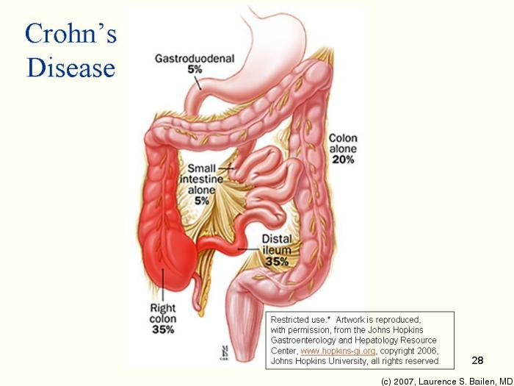
NOD2 appear to be important in innate immune responses to bacterial pathogens in GI tract such that NOD2 polymorphism was foudn to be associated with an increase in the risk for an inflammatory disease of bowel called Crohn’s disease.
Crohn's disease (also spelled Crohn disease) is a chronic inflammatory disease of the intestines. It primarily causes ulcerations (breaks in the lining) of the small and large intestines, but can affect the digestive system anywhere from the mouth to the anus.
Intestinal epithelial cells from individuals with a Crohn’s disease-associated mutation in NOD2 have impaired secretion of antimicrobial peptides called defensins when exposed to invasive batceria.
This is thought to be becasue of loss-of-function of NOD2 which woudl lead to overaccumulation of gut bacteria leading to chronic inflammation

Slide 12
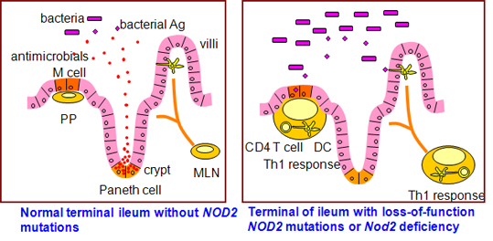

Slide 13
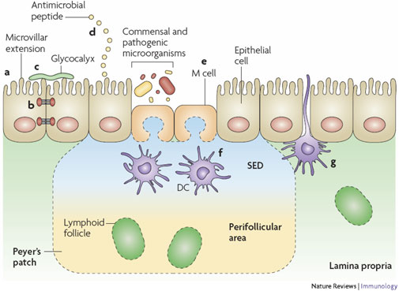
Cellular Components Include......
Intact Epithelial Surfaces exhibit physical and biochemical adaptations to maintain barrier integrity including actin-rich microvillar extensions (a), epithelial-cell tight junctions (b), apically attached and secreted mucins that form a glycocalyx (c) and the production of various antimicrobial peptides (d).
Antimicrobial peptides include defensins and
cathelicidins.
The effects include both direct toxicity of microbes and activation of cells involved in inflammatory responses.
Commensal microorganisms also have protective effects as they compete with pathogenic organisms for the nutrients and attachment sites on epithelial cells.

Slide 14
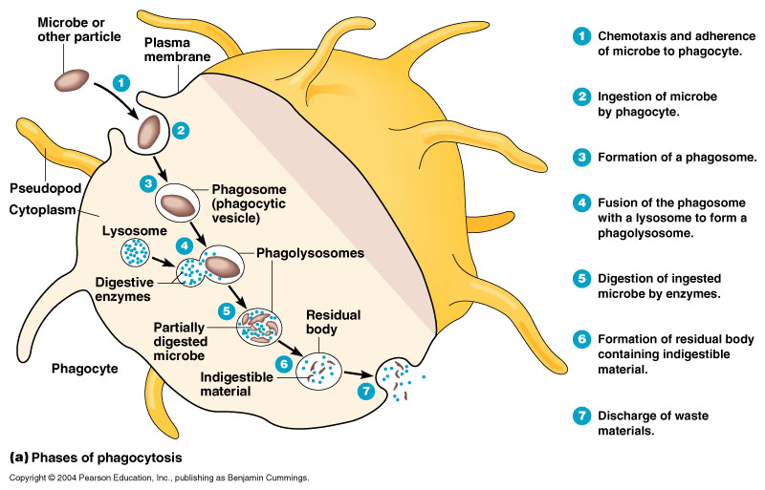
Cellular Components Include......
Phagocytes which are cells with the ability to phagocytose foreing material. Examples include macrophages and neutrophils. Phagocytes are the first line of defense against microbes that breah apithelial barriers.

Slide 15
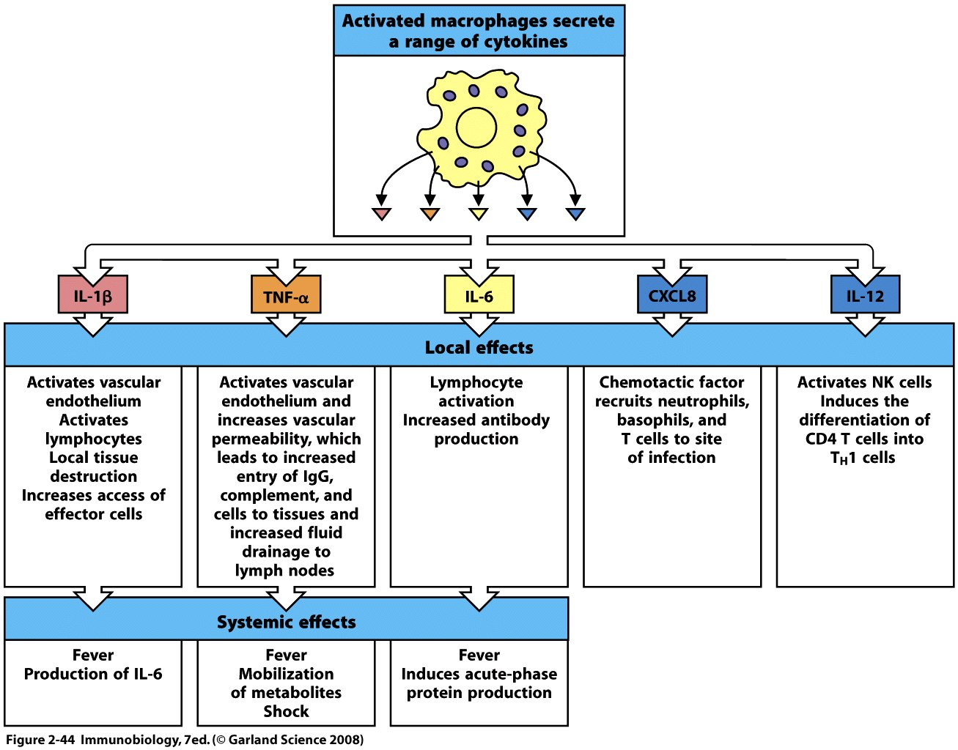
Apart from phagocytosis. Macrophages, as teh first immune cells encountering pathogens, has an essential role in orchesterating innate immune response by releasing wide range of cytokines. Some important ones are..

Slide 16
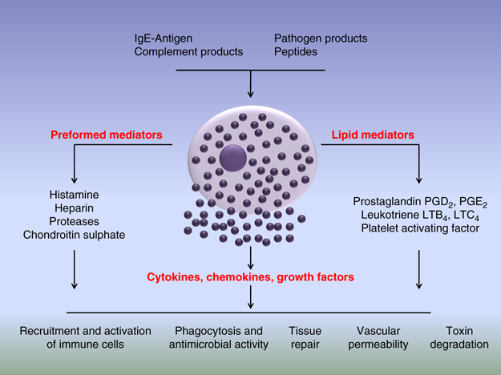
Migration of immune cells to an infected are is further helped by the mast cell which are usually located adjacent to blood vessels. Their degranulation results in the the release of mediators such as histamine that cause visodilation and increase vascular permeability to promote acute inflammation.
Apart from complement products and antibody binding mast cells can be activated upon recognition of microbial products via TLR on cell surface.
Activation of mast cells releases mediators, which fall under three major categories: (i) preformed granule-associated mediators; (ii) cytokines and chemokines and; (iii) newly generated lipid mediators which contribute in pro-inflammatory responses and host defense.

Slide 17
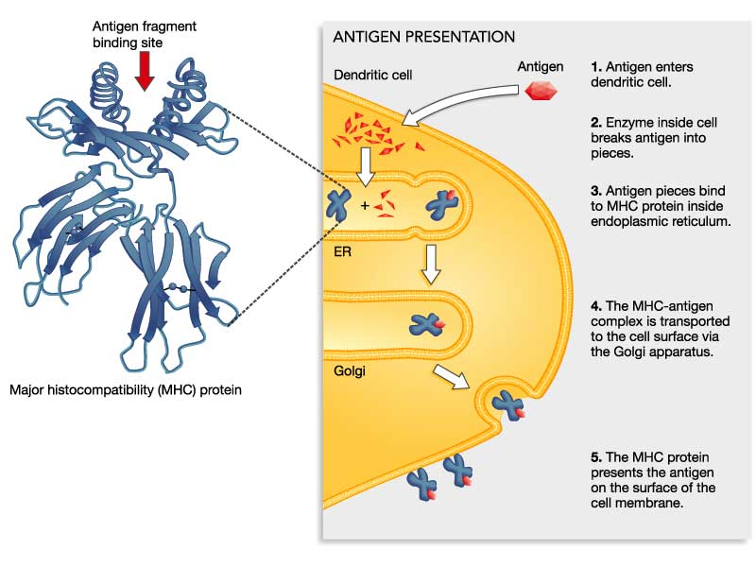
Another immune cell that can phagocytose foreing material are Dendritic cells (DCs). They are uniquely capable of triggering and directing adaptive T-cell-mediated immune responses by processing and presenting antigenic fragments to naive T-cells.
Microbial detection via TLR induces expression of costimulatory molecules and cytokines that are needed for the acivation of adaptive immune response.
Depending on the cytokines released, T-cells will differentiate into distinct subsets. For example IFNγ will induce T_{H}1 cell differentiation while IL-17 supports generation of T_{H}17.
MHC class II molecules present exogenous antigens
MHC class I molecules present endogenous antigen

Slide 18
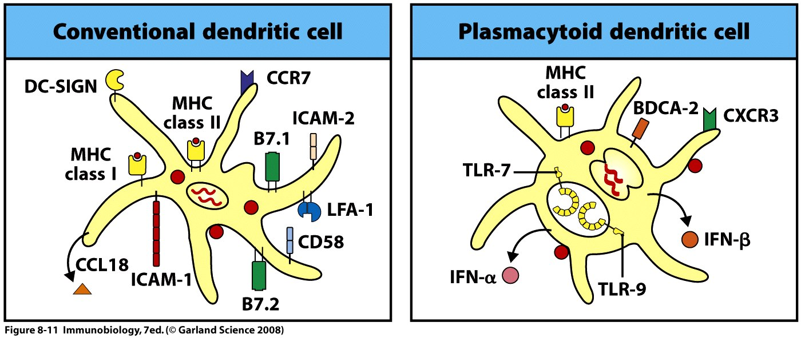
These functions are associated with conventional DCs which are primarily concerned with the activation of naive T-cells. When they are mature,they express MHC proteins and co-stimulatory molecules at high levels.
In contrast, Plasmacytoid DCs are less efficient in priming naive T-cells. They mainly express intracellular deceptors TLR7 and TLR9 for sensin viral infections. They generate large amounts of type-I interferons, particularly in response to viral infections. They were initially recognized as a rare population of peripheral blood cells.

Slide 19
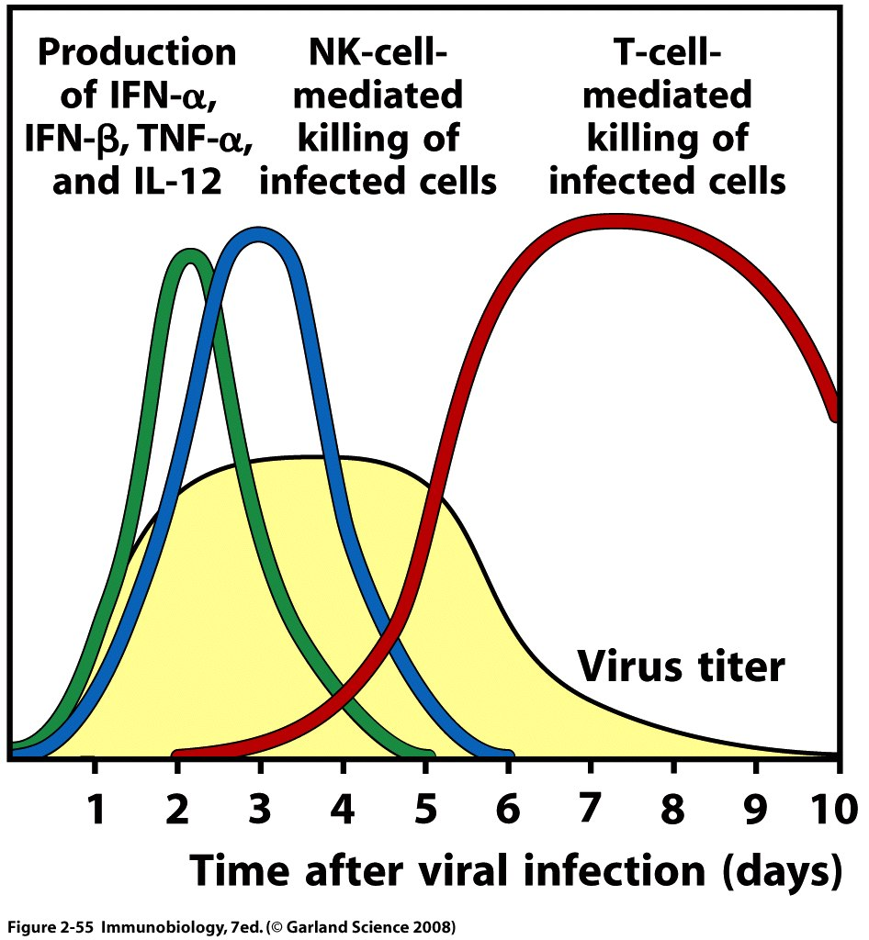
Interferons increase the NK cell killing activity which is crucial especially in the early phase of anti-viral immune responses.
As will be discussed in the following weeks, NK cells and CD8⁺ T-cells use similar mechanisms of killing (by releasing mediators such as perforin and granzyme). But CD8⁺ T-cells need almost a week to become activated.

Slide 20
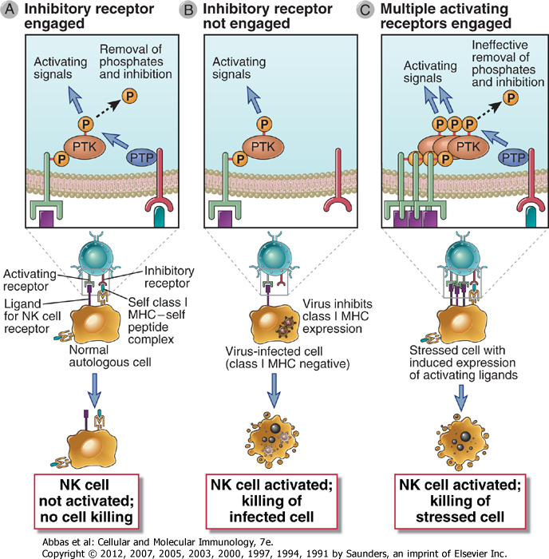
NK cell activation is regulated by a balance between signals that are generated from activating receptors and inhibitory receptors.
One particular inhibitory ligand is MHC class I molecules. If a virus infection or other stress inhibits class I MHC expression, the NK cell inhibitory receptor is not engaged and the activation receptor functions unopposed to trigger response of NK cells.
IFN increase MHC class I expression in normal healthy self cells.
NB: MHC class I molecules are expressed by almost all healthy cells in body (all nucleated cells) and thus are markers of normal, healthy self cells.

Slide 21
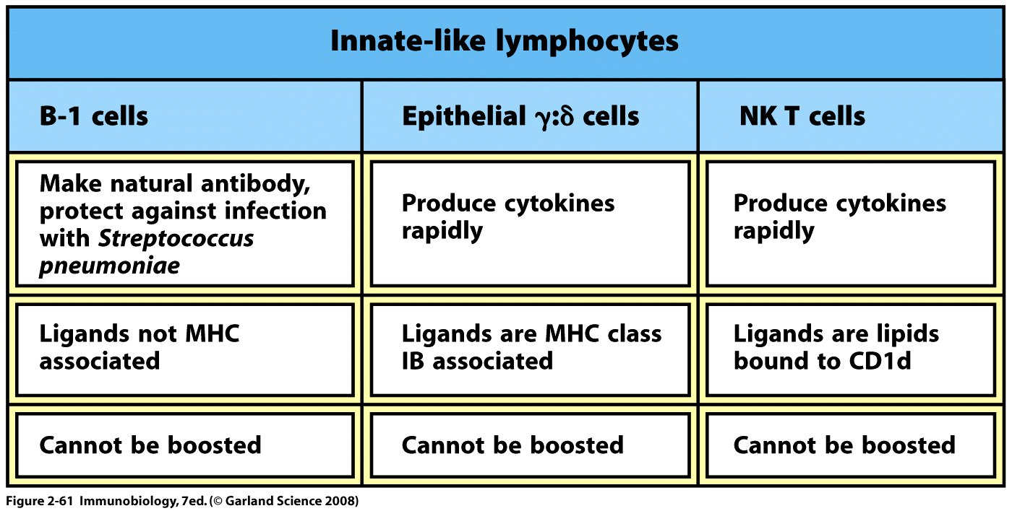
Not all lymphocytes belong to adaptive immunity. There are certain subsbsets of T- and B-lymhpocytes that do not need to undergo clonal expansion before responding effectively and express receptors with limited diversity. For this reason they called innate-like lymphocytes.
NB: Epithelial lymphocytes were also found to be activated by microbial heat shock proteins.
Apart from cytokine release they were also found to play a role in killing of infected cell.

Slide 22
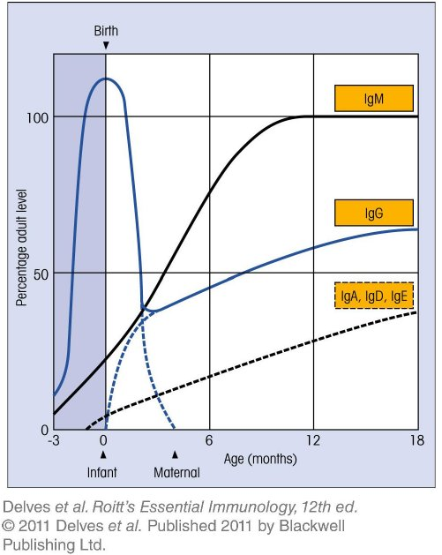
Apart from Cellular Components, Innate Immunıty also has Solbule Components that include......
Natural antibodies these are mostly IgM in adult. They are produced by distinct B-cell subsets (marginal B-cells and B-1 cells) with only a limited number of specificities.
But in newly born because of the maternal IgG,serum antibodies are dominated by IgG.
The IgG concentration falls over the first 3 months. Thereafter the rate of IgG synthesis by the newborn overtakes the rate of breakdown of materal IgG and the overall concentration increases steadıiy.

Slide 23
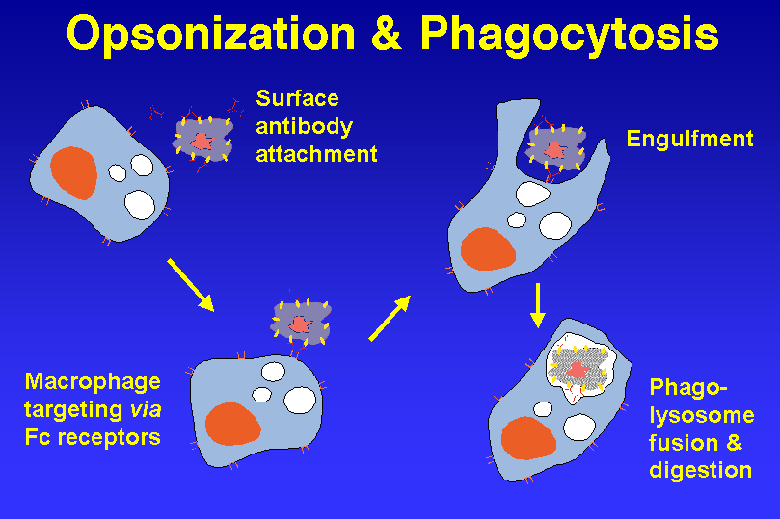
Natural antibodies can act as opsonins by binding to microbes and enhancing the ability of macrophages, neutrophils and dendritic cells to phagocytose the microbes. Interaction between natural antibody and an phagocyte is mediated by FcR expressed by the immune cell.

Slide 24
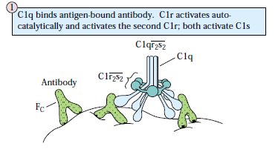
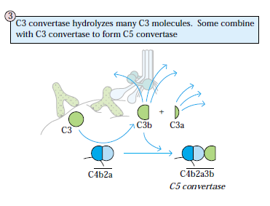
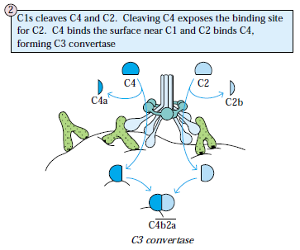
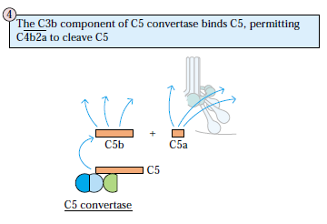
Natural antibodies can also activate the complement system which is another soluble member of innate immunity. The pathway is called calssical pathway.

Slide 25
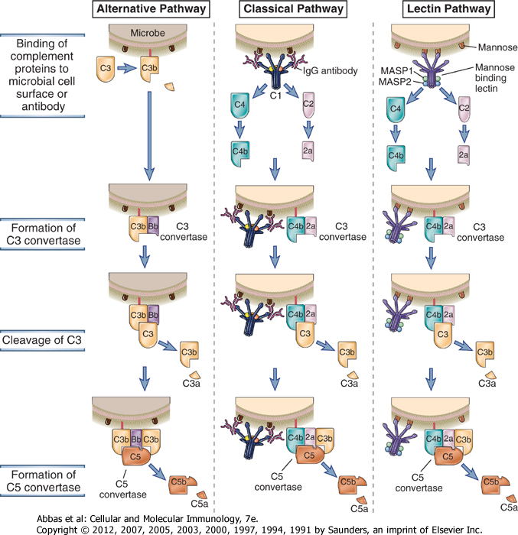
Apart from classical pathway, there are also alternative pathway and lectin pathway that leads to complement cascade activation.
Apart from the bieginning phases, all pathways involve the same enzymatic reactions.

Slide 26
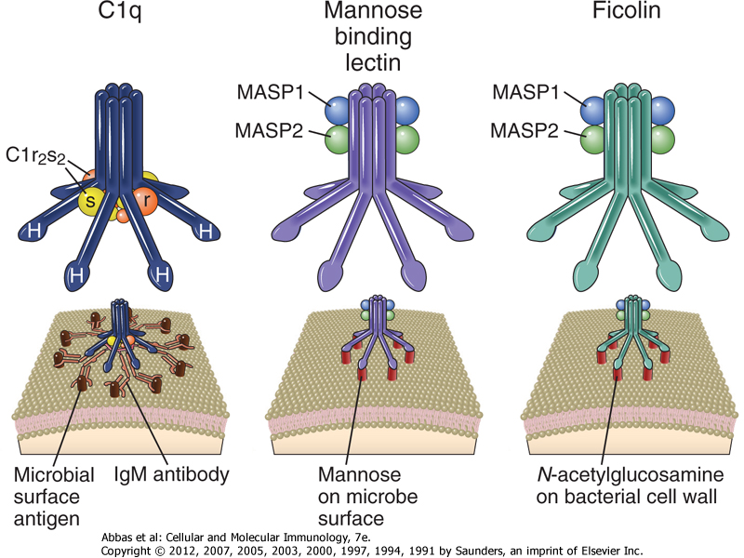
The first proteins with the enzymatic activities in both classical and alternative pathways have similar structure: Six globular heads at the end of collagenous-like stalks. Binding results in conformational changes that activate serine proteases.

Slide 27
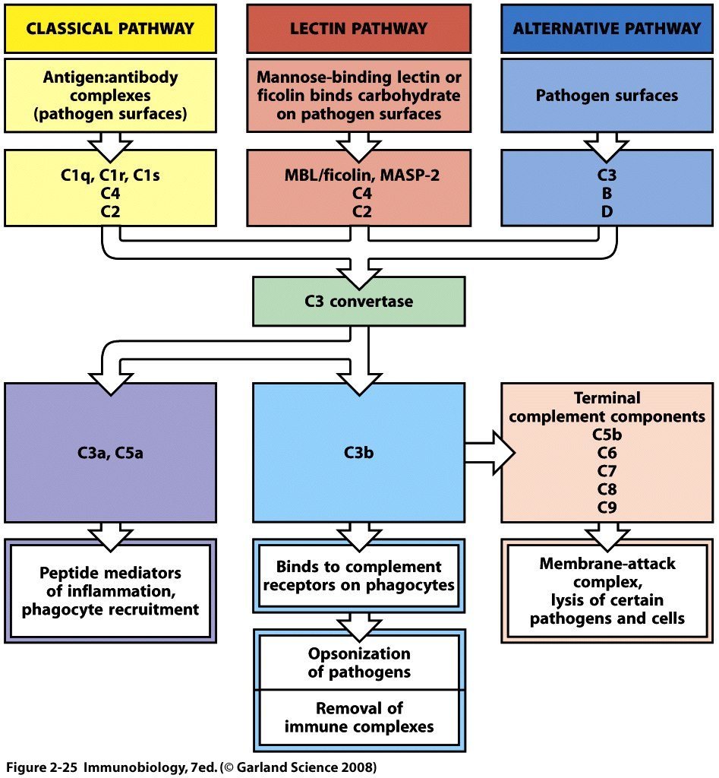

Slide 28
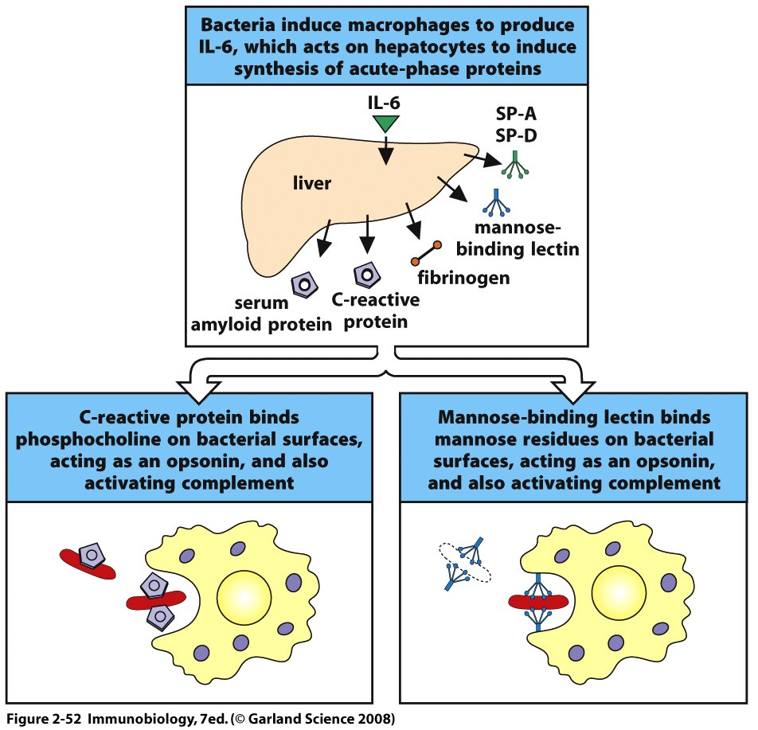
There are also acute phase proteins. They are present in plasma even in the absence of infection. But their levels are further increased as a result of IL-1, IL-6 or TNF impact on liver which generates them. These include but not restricted to, ficolins, MBL, and C-reactive proteins.
Each acute phase protein has different functions. One important function regarding the immune response (apart from complement activation) is opsonization by CRP, MBL and Ficolins.
Surfactant proteins appear to be mediate innate immune responses in lung.
They can directly inhibit bacterial growth and activate macrophages.

Slide 29
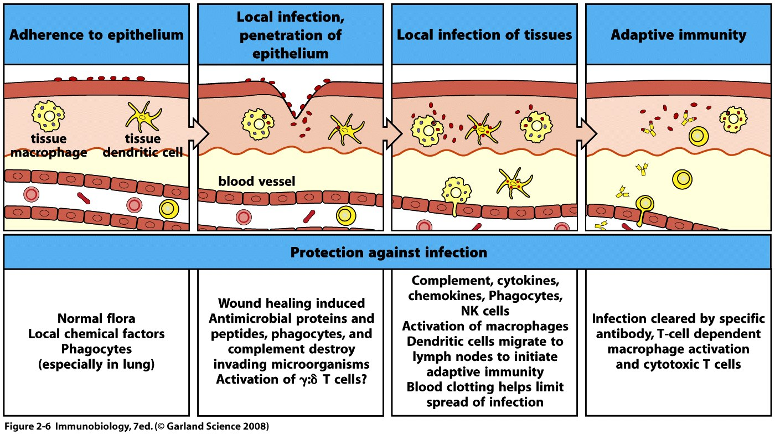
An infection and the resposne to it can be divided into a series of stages.
The major way by which the innate immune system deals with infections and tissue injury is to stimulate acute inflammation, which is the accumulation of leukocytes, plasma proteins and fluid derived from the blood.
Typically, the most abundant leukocyte that is recruited from the blood into acute inflammatory sites is the neutrophil, but blood monocytes, which become macrophages in the tissue, become increasingly prominent over time and may be the dominant population in some reactions.

Slide 30
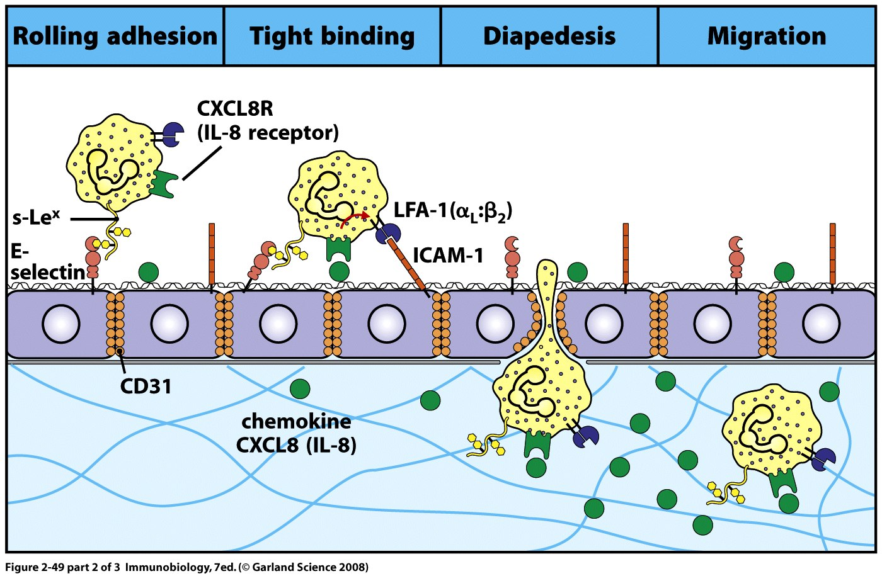

Slide 31
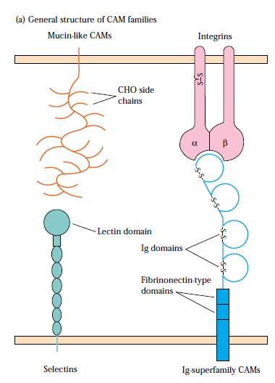
This migration of lecukoytes is facilitated by endothelial and leukocyte cellular adhesion molecules.
Most of these CAMs belong to 4 families of proteins:
the selectin family,
the mucin-like family,
the integrin family and the immunoglobulin (Ig) superfamily.

Slide 32
Selectin family member has a distal lectin-like domain that enables binding to specific carbohydrate groups which are primarily sialylated carbohydrate moieties which are often linked to mucin-like molecules.

Slide 33
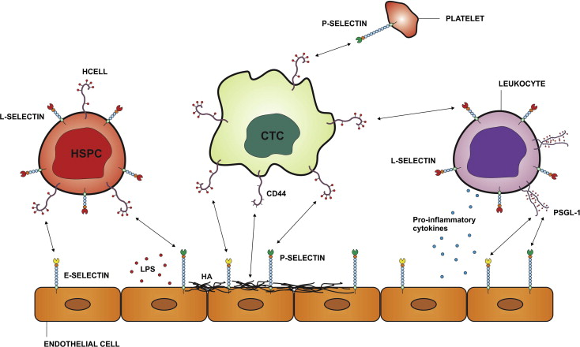
The family ıncludes three molecules designated L, E and P which are expressed by different cell types.
L-selectin is expressed by leukocytes (where L comes from) while E-selectin and P-selectin are expressed on vascular endothelial cells.

Slide 34
Group of serine- and threonine-rich proteins.
Heavily glycosylated.

Slide 35
They are heterodimeric proteins (consists of alpha and beta chains) that are expressed by leukocytyes and facilitate both adherence to the vascular endothelium and other cell-to-cell interactions.
Consists of different groups depending on the beta chain expressed.
Different integrins are expressed by different leukocyte populations.

Slide 36
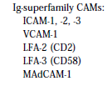
Has both Ig-like domains and mucin-like domains and therefore can bind to both integrins and selectins.

Slide 37
The first step involves selectins. P-selectin are expressed on endothelial cell surfaces in response to leukotriene B4, or histamine which is released from mast cells in response to C5a.
P-selectin expression can also be induced by exposure to TNF-α, IL-1 and LPS which also have additonal effect of inducing the synthesis of E-selectin on endothelial cell surface.
The interaction between selectins with sialyl-Lewis^{X} meioty allows monocytes and neutrophils to adhere reversibly so that circulating leukocytes look like they”roll” along endothelium.

Slide 38
The secod step depends on interactions between the leukocyte integrins LFA-1 with molecules on endothelium such as ICAM-1, which can also be induced on endothelial cells by TNFα, and ICAM-2.
LFA-1 normally adhere weakly but CXCL8 or other chemokines, bound to proteoglycans on he surface of endothelial cells, trigger conformational change in LFA-1 on rolling leukocytes after binding to associated chemokine receptor.
This conformational change increases adhesive properties of the leukocytes.

Slide 39
In the third step, the leukocyte extravasates or crosses the endothelial wall. This step also involves LFA-1, as well as an immunoglobulin-related molecule called PECAM or CD31.
These interactions enable the phagocyte to squeeze between the endothelial cells.
It then penetrates the basement membrane with the aid of enzymes that break down the ECM proteins of basement membrane. The movement through the basement membrane is known as diapedesis.

Slide 40
The forth and final step isthe migration of leukocytes through the tissues under the influence of chemokines.
Chemokines form a matrix-associated concentration gradient along which leukocytes can migrate to a focus of infection.
CXCL8 is released by the macrophages that first encounter pathogens and recruits neutrophils, which enter the infected tissue in large number in the early part of the induced response. In contrast, monocytyes are recruited later through the actions of chemokines such as CCL2.

Slide 41
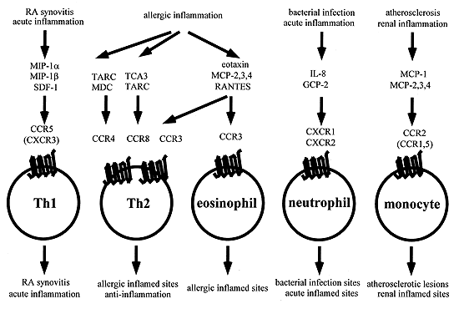
Chemokines will decide what type of immune cells including T-cells will be recruited to the site of infection.

Slide 42
Other than chemokines, Formyl-Methionyl-Leucyl-Phenylalanine (fMLP) derived from bacteial protein, and small complement cascade products such as C3a and C5a are also involved in directing cellular migration to the site of infection.
Leukotriene B4 receptor (LTB4) expressed by neutrophils and macrophages. LTB4 is produced following the stimulation of macrophages and mast cells in inflammatory sites.
Other released factors involved in recruitment of macrophages and neutrophils include those produced by blood clotting system (ex: peptid B and thrombin). Their effect, however, is indirect via stiulatiıon chemokine release.

Slide 43
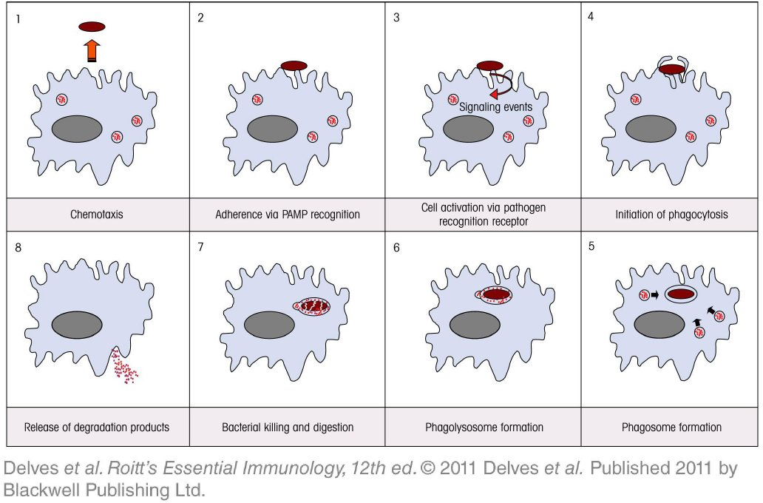
The first cells recruited to the site of infection are phagocytes that include neutrophils and monocytes (which later differentiate intop macrophages).

Slide 44
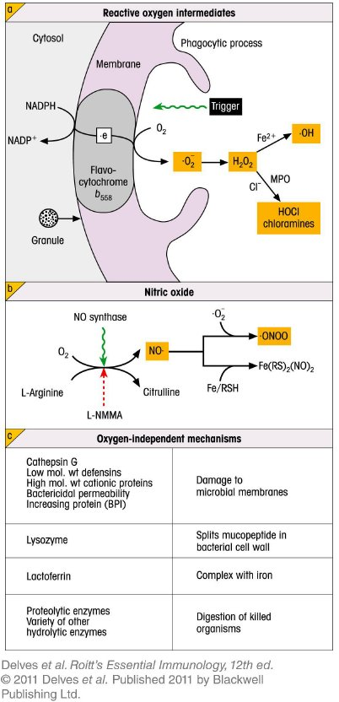
Phagocytes use both oxygen-dependent and oxygen-independent mechanisms to kill ingested pathogen via phagocytosis.
Electrons from NADPH are transferred by the flavocytochrome oxidase enzyme to molecular oxygen to form the microbicidal molecular species.
Inducible NO synthase utilizes L-arginine to produce NO. which yields the highly toxic peroxynitrite radical .ONOO on combination with superoxide anion. .ONOO cleaves to form protonation to form reactive NO₂ molecules and .OH.

Slide 45
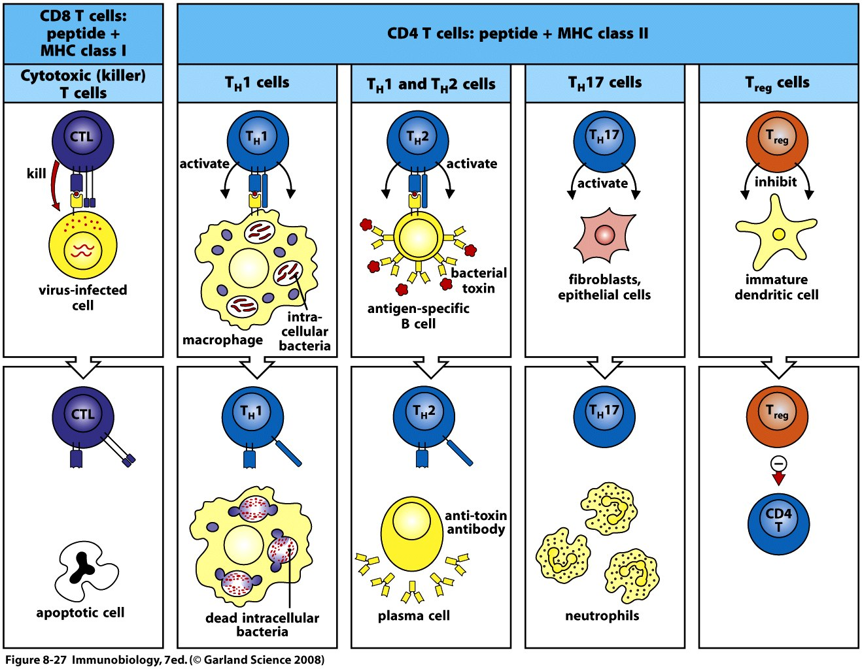
After phagocytosis, antigen presenting cells (APCs) provide the two signals required for the CD4+ T-cell activation. The signal 3 has the decisive role in the determination of which T-cell subtype to develop.

Slide 46
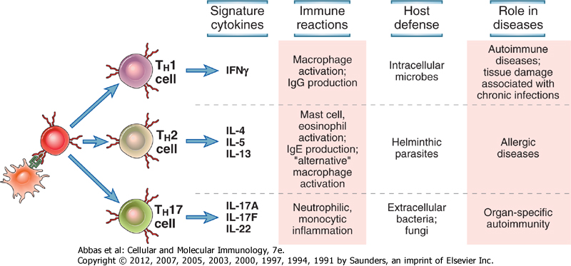
Each subset of diffeerentiated effector cells produces cytokines that promote its own development and may suppress the development of the other subsets. This provides a powerful amplification mechanism.
Differentiation of each subset is induced by the types of microbes which that subsetis best able to combat. For instance Th1 cell differentiation is driven by intracellualr microbes, against which the principal defense is TH1 mediated.
The most extreme polarization is seen when the immune stimulation prolonged for instance in chronic infections. In that case the immune response cna give result to autoimmune diseases.

Slide 47
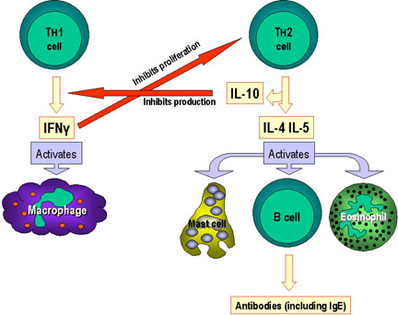

Slide 48
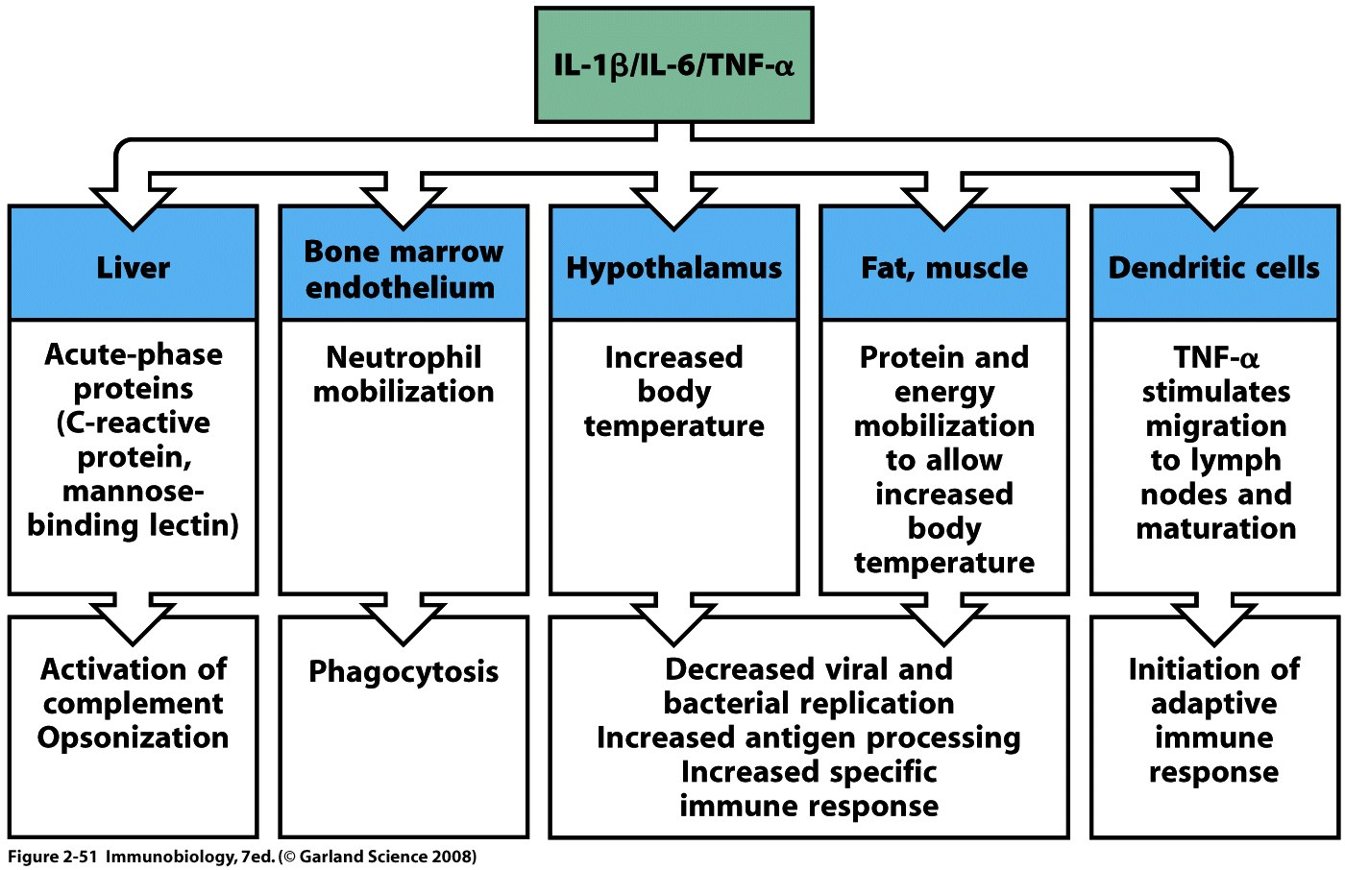
Apart from localized effects which helps the recruitment of immune cells to the site of infection, IL-1β, IL-6 and TNF-α also have wide spectrum of systemic effects.

Slide 49
In severe infections, TNF may be produced in large amounts and causes systemic clinical and pathologic abnormalities.
TNF may inhibit myocardial contractility and vascular smoothmuscle tone, resulting in a marked fall in blood pressure.
TNF may also cause thrombosis, mainly by stimulating endothelial expression of tissue factor, a potent activator of coagulation, and inhibiting expression of thrombomodulin, am inhibitor of coagulation.
Prolonged production of TNF can also cause wasting of muslce and fat cells, called cachexia.
Together with other cytokines such as IL-12, IFN-γ, and IL-1, TNF-α is thought to be responsible for LPS-induced septic shock.

Slide 50
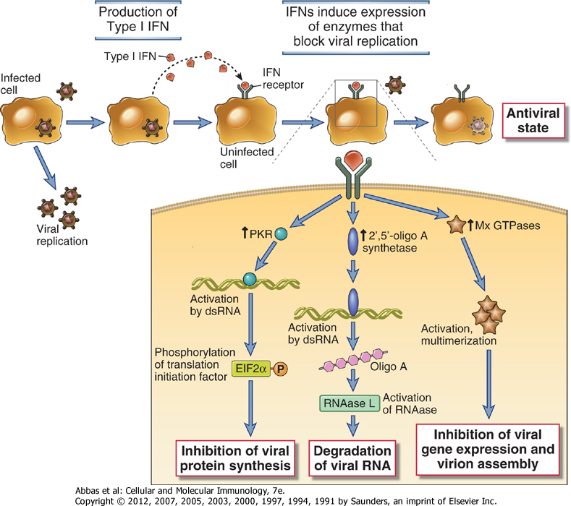
For the anti-viral immune responses, however, the crucial cyokine is different. The major way by which the innate immune system dels with viral infections is to induce the expression of type I interferons (IFN-α and IFN-β) whose most important action is to inhibit viral replication.
Plasmacytoid DCs are the major sources of IFN-α but it may also be produced by mononuclear phagocytes. IFN-β is produced by many cells. They act on other cells to prevent spread of viral infection as well as act in an autocrine manner to inhibit viral replication in that cell.
* PKR- double stranded RNA-activated protein kinase

Slide 51
IFNs are also involved in the enhancement of MHC class I expression which is involved in the antigen presentation to CD8 ⁺T-cells. CD8 ⁺T-cells can destroy the target cell via release of soluble mediators.
In contrast, MHC class II molecules are involved in exogenous antigen presentation to CD4⁺ T-cells by antigen presenting cells (DCs, Macrophages and B-cell). After the binding, CD4⁺ T-cells differentiate into different subsets according to the cytokines released.

Slide 52
Feedback Mechanisms That Regulate Innate Immunity
Regulatory cytokines such as IL-10 can be release in response to recognition of PAMPs or DAMPs that induce inflammation.
Production of natural antagonist of cytokines that bind to the same receptors as the structurally homologous one, so that it functions as a competitive inhibitor. For example IL-1RA (IL-1 receptor antagonist).
Expression of (decoy) cytokine receptors that do not transduce an activating signal upon ligand binding.
Numerous negative regulatory signaling pathways that block the activating signals generated by pattern recognition receptors and inflammatory cytokines. Examples incluyde SOCS (suppressors of cytokine signaling) that are inhibitors of JAK-STAT pathways.

