Slide 1

Chapter 5
Ultraviolet/Visible molecular absorption spectrometry
NEPHAR 201
Analytical Chemistry II
Assist. Prof. Dr. Usama ALSHANA

Slide 2
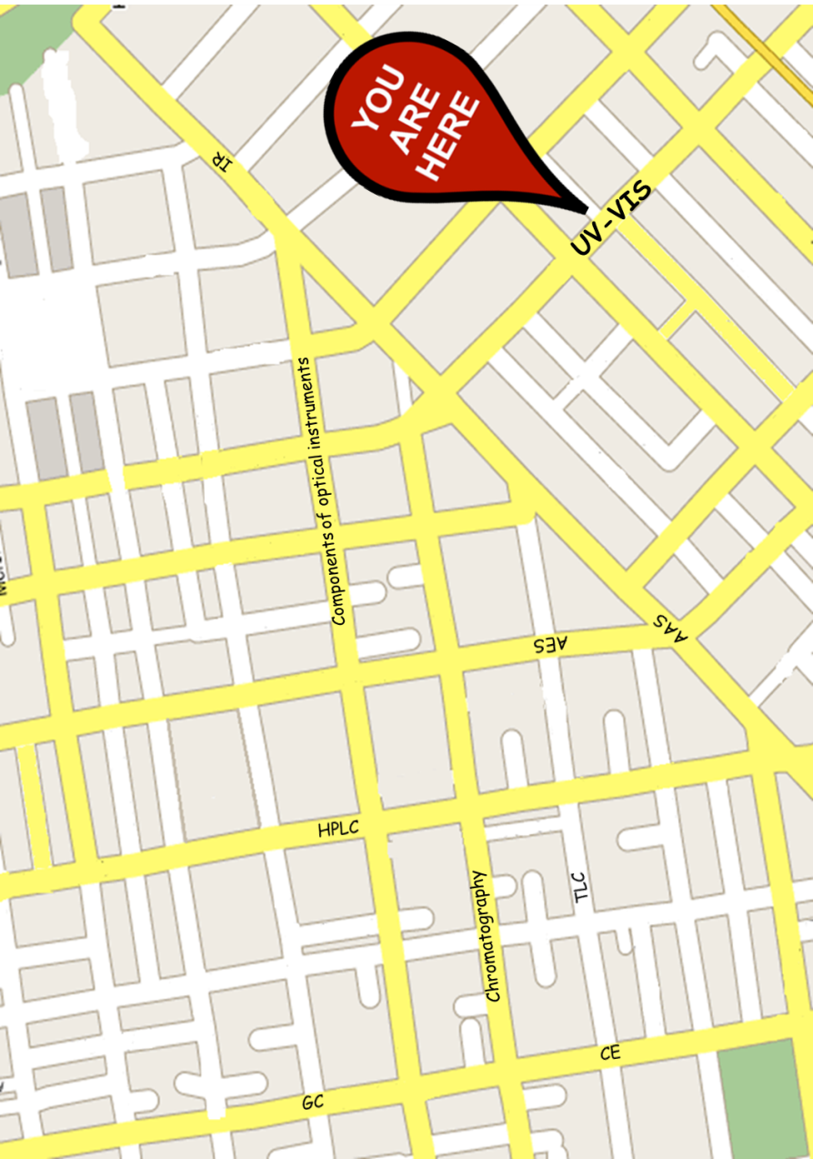

Slide 3
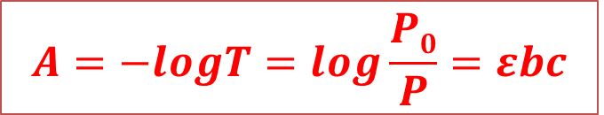
UV/VIS molecular absorption spectrometry
UV/VIS absorption spectrometry:
is based on the absorption in the region of 160-780 nm of the radiation spectrum,
is used for quantitative determination of inorganic and organic analytes,
is based on the measurement of absorbance (A) or transmittance (T) of solutions contained in transparent cells having a path length of b cm.
Concentration (c) of an absorbing analyte is linearly related to absorbance (A) as represented by Beer’s Law:
$$A=−logT=log\frac{P0}{P}=εbc$$

Slide 4
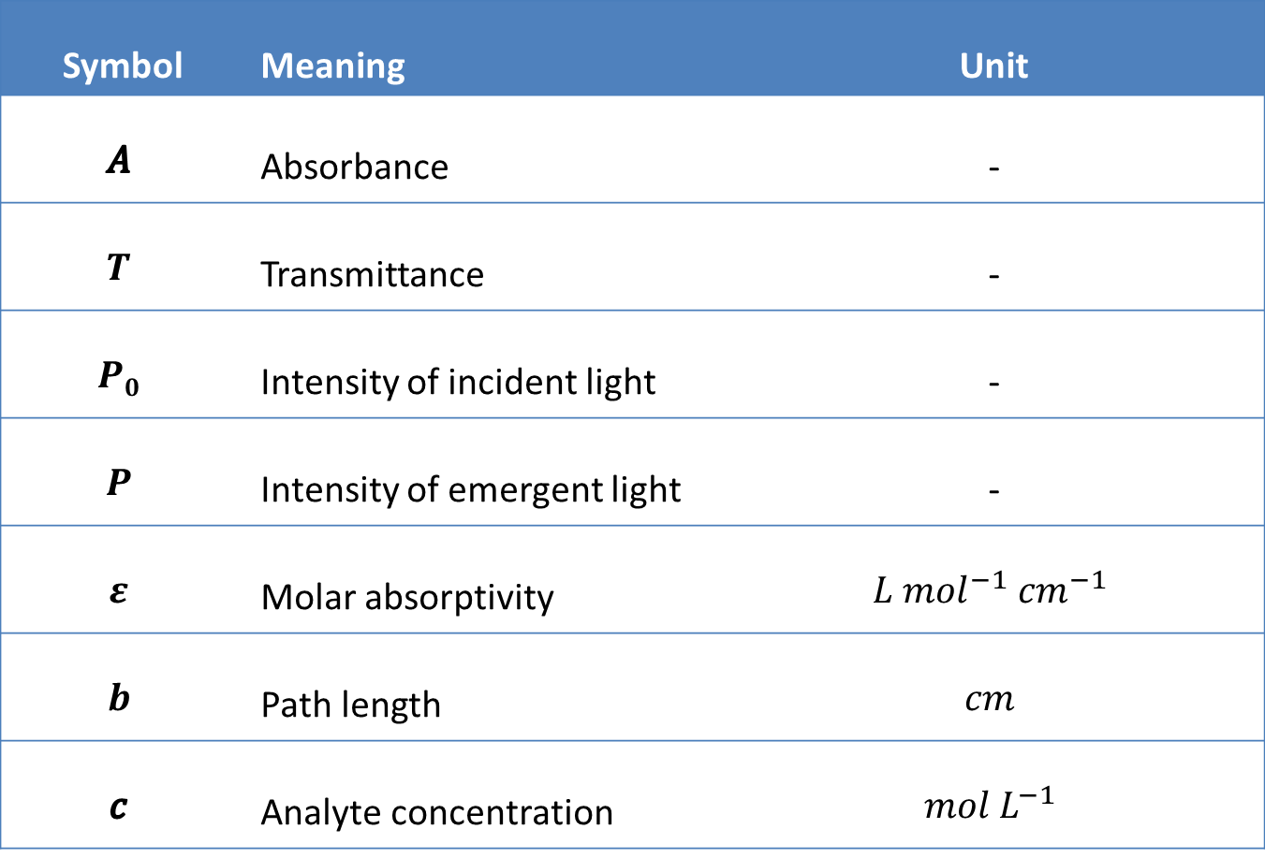
Symbol | Meaning | Unit
$$A$$ | Absorbance | -
$$T$$ | Transmittance | -
$$P0$$ | Intensity of incident light | -
$$P$$ | Intensity of emergent light | -
$$ε$$ | Molar absorptivity | $$L {mol}^{−1} {cm}^{−1}$$
$$b$$ | Path length | $$cm$$
$$c$$ | Analyte concentration | $$mol L^{−1}$$

Slide 5
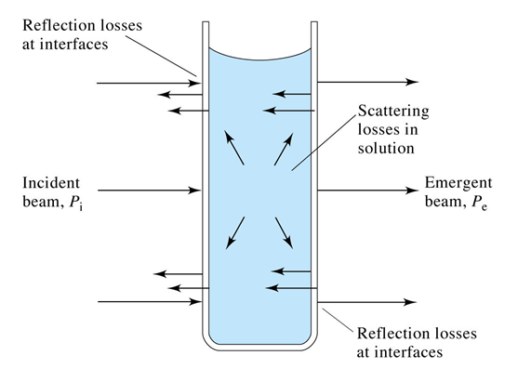
Measurement of Transmittance and Absorbance
Absorbance or transmittance cannot be measured directly due to:
Reflection losses at interfaces,
Scattering losses in solution,
Absorption by the solvent,
Absorption by the container walls.
To solve this problem, the power of the beam transmitted by the analyte solution is compared with the power of the beam transmitted by an identical cell containing only solvent (blank).

Slide 6
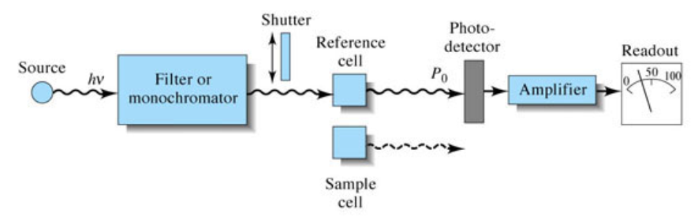
An experimental transmittance and absorbance are then obtained with the following equations:
To compensate for radiation loss, a reference cell is used.

Slide 7
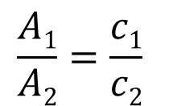

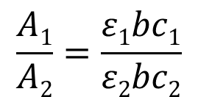
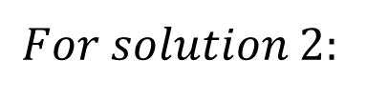

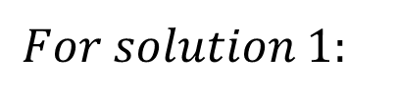
Applications of Beer’s Law
Proportionality example
A solution with a concentration of 0.14 M was found to have an absorbance of 0.43. If another solution of the same chemical is measured under the same conditions and has an absorbance of 0.37, what is its concentration?
Solution
$$For solution 1:$$
$$A1=ε1bc1$$
$$For solution 2:$$
$$A2=ε2bc2$$
$$\frac{A1}{A2}=\frac{ε1bc1}{ε2bc2}$$
$$\frac{A1}{A2}=\frac{c1}{c2}$$

Slide 8
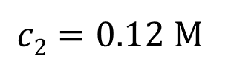
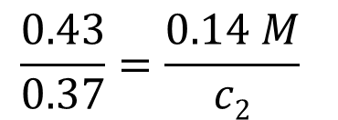
$$\frac{0.43}{0.37}=\frac{0.14 M}{c2}$$
$$c2=0.12 M$$
The Graphical Method
The graphing method is called for when several sets of data involving STANDARD SOLUTIONS are available for concentration and absorbance. This is probably the most common way of Beer's law analysis based on experimental data collected in the laboratory.
Graphing the data allows you to check the assumption that Beer's Law is valid by looking for a straight-line relationship for the data.

Slide 9
Beer’s Law and the graphical method
If the following absorbance values were obtained for standard solutions using a UV/VIS spectrophotometer, what is the concentration of a 1.00 cm (path length) sample that has an absorbance of 0.60?
Concentration (M) | Absorbance
0.10 | 0.12
0.20 | 0.27
0.30 | 0.41
0.40 | 0.55
0.50 | 0.69
Solution
Plot a calibration graph of Absorbance (y-axis) versus Concentration (x-axis).
Obtain a linear equation for the best-fit line.
Find the unknown concentration using that equation which gives an absorbance of 0.60.

Slide 10

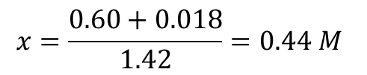
$$x=\frac{0.60+0.018}{1.42}=0.44 M$$
$$y=1.42x−0.018$$
The coefficient of determination, (R²) is a number that indicates how well data fit a statistical model – sometimes simply a line or a curve. An R² of 1.00 indicates that the regression line perfectly fits the data, while an R² of 0 indicates that the line does not fit the data at all. The closer to 1.00, the better.

Slide 11
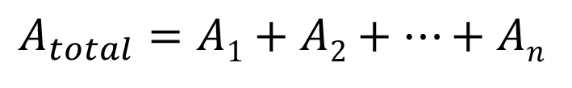
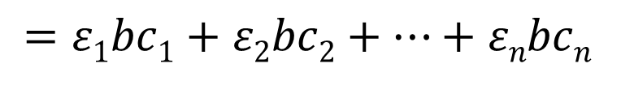
Application of Beer’s Law to Mixtures
Beer’s law applies to a medium containing more than one kind of absorbing substance.
Provided that there is no interaction among the various species, the total absorbance for a multicomponent system is given by:
$$A_{total}=A1+A2+…+An$$
$$=ε1bc1+ε2bc2+…+εnbcn$$
where, the subscripts refer to absorbing components 1, 2, …and n.

Slide 12
Assumptions in derivation of Beer’s Law
Monochromatic incident radiation (all molecules absorb light of one λ),
Absorbing molecules act independently of one another i.e, at low concentration,
Path length is uniform (all rays travel the same distance in sample),
No scattering,
Absorbing medium is optically homogeneous,
Incident beam is not large enough to cause saturation of the detector,
All rays are parallel to each other and perpendicular to surface of medium.

Slide 13
Limitations (deviations) of Beer’s Law
1
Real limitations
2
Chemical deviations
3
Instrumental deviations

Slide 14
1. Real Limitations
Beer’s law is good for dilute analyte solutions only.
High concentrations (> 0.01 M) will cause a negative error since as the distance between molecules becomes smaller, the charge distribution will be affected which alters the molecules ability to absorb a specific wavelength.
The same phenomenon is also observed for solutions with high electrolyte concentration, even at low analyte concentration. The molar absorptivity is altered due to electrostatic interactions.

Slide 15
b) In Beer’s law we assume that molar absorptivity (ε) is a constant.
However, ε is dependent on the refractive index and the refractive index is a function of concentration. Therefore, ε will be concentration dependent. However, the refractive index changes very slightly for dilute solutions and thus we can practically assume that ε is constant.
c) In some cases, the molar absorptivity (ε) changes widely with concentration, even at dilute solutions.
Therefore, Beer’s law is never a linear relation for such compounds, examples include methylene blue.

Slide 16
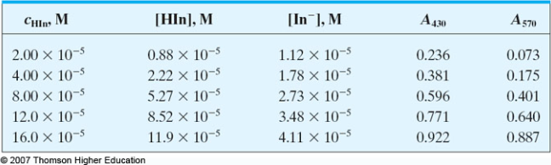
2. Chemical Deviations
This factor is an important one which largely affects linearity in Beer’s law. It originates when an analyte dissociates, associates, or reacts with the solvent. For example, an acid base indicator (HIn) when dissolved in water will partially dissociate according to its acid dissociation constant (K_{a}).
HIn_{(aq)}
H⁺ + In⁻_{(aq)}
Calculated absorbance data for various indicator concentrations

Slide 17
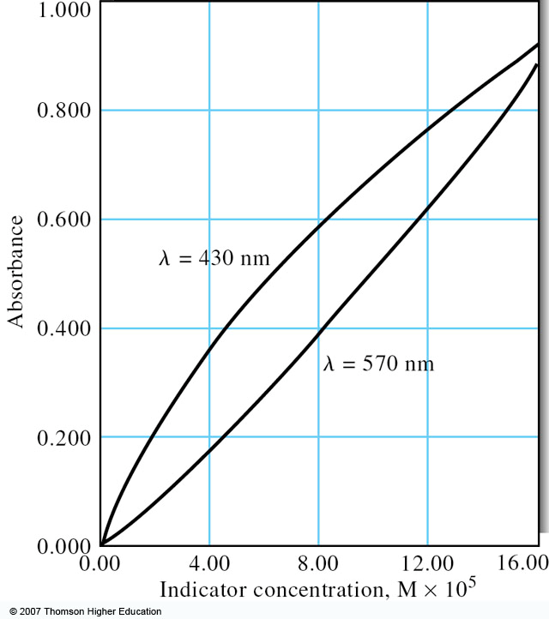
Chemical deviations from Beer’s Law for unbuffered solutions of the indicator HIn

Slide 18
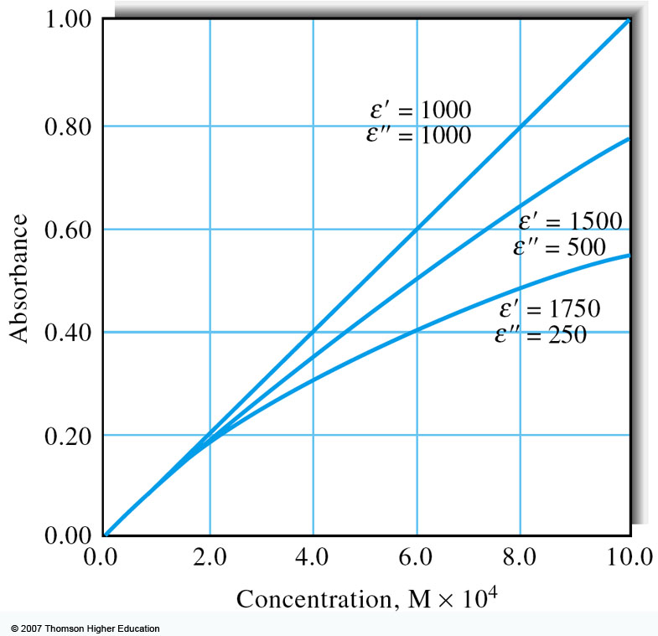
3. Instrumental Deviations
a) Beer’s law is good for monochromatic light only since ε is wavelength dependent.
It is enough to assume a dichromatic beam passing through a sample to appreciate the need for a monochromatic light.
Deviation from Beer’s Law with polychromatic light. The absorber (analyte) has the indicated molar absorptivities at the two wavelengths λ’ and λ”.

Slide 19
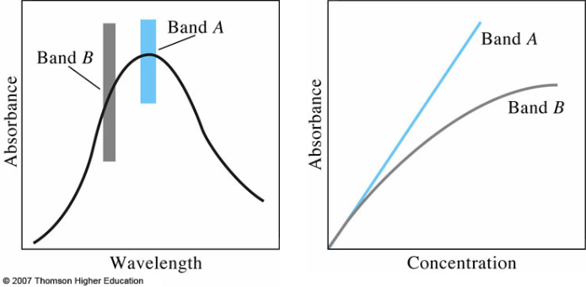
Why is it critical to use λ_{max.} for measuring absorbance?
Because at λ_{max.} (Band A in the figure below) measurements show little deviation since ε does not change much throughout the band. On the other hand, using other regions of the spectrum (e.g., band B) gives large deviations due to strong dependence of ε on wavelength.
The effect of polychromatic radiation upon Beer’s Law.

Slide 20
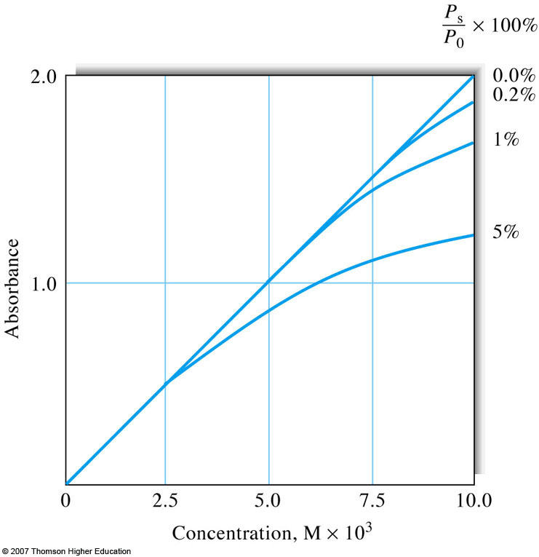
b) Stray (lost) Radiation
Stray radiation resulting from scattering or various reflections in the instrument will reach the detector without passing through the sample.
High concentrations of the analyte would scatter more radiation resulting in higher deviations and lead to negative absorbance errors.
Deviation from Beer’s Law brought about by various amounts of stray radiation.

Slide 21
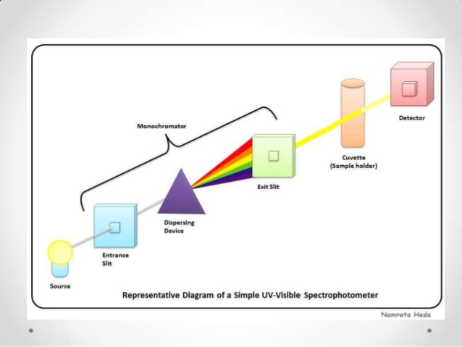
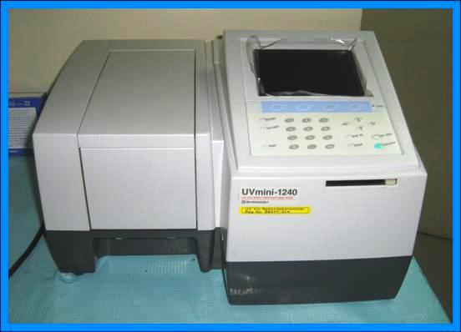
Instrumentation
UV/VIS Molecular Absorption Spectrometers
Source
lamp
Wavelength selector
Sample holder
Detector
Signal processor
UV/VIS Spectrophotometer

Slide 22
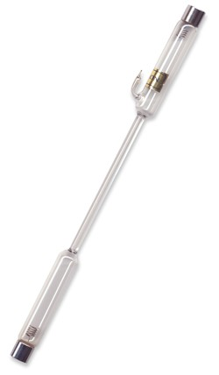
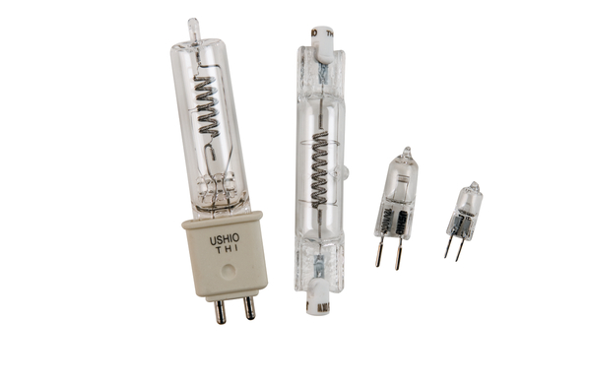
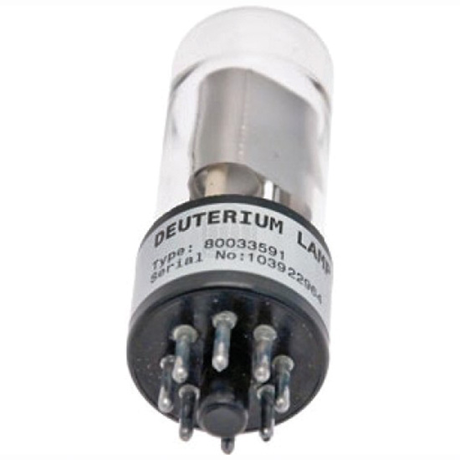
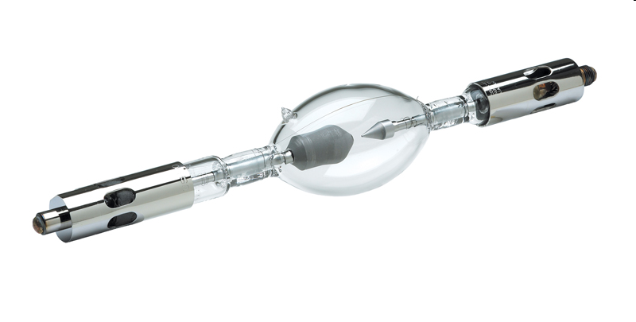
① Sources of radiation in UV/VIS
Continuum light sources are used in commercial UV/VIS spectrophotometers which include:
Deuterium (D₂) or hydrogen (H₂) lamps (UV: 160 – 375 nm),
Tungsten (W) filament lamps (UV-VIS, NIR: 300 – 2500 nm),
Xenon (Xe) arc lamps (UV-VIS: 150 – 800 nm).
D₂ lamp
H₂ lamp
W lamps
Xe arc lamp

Slide 23
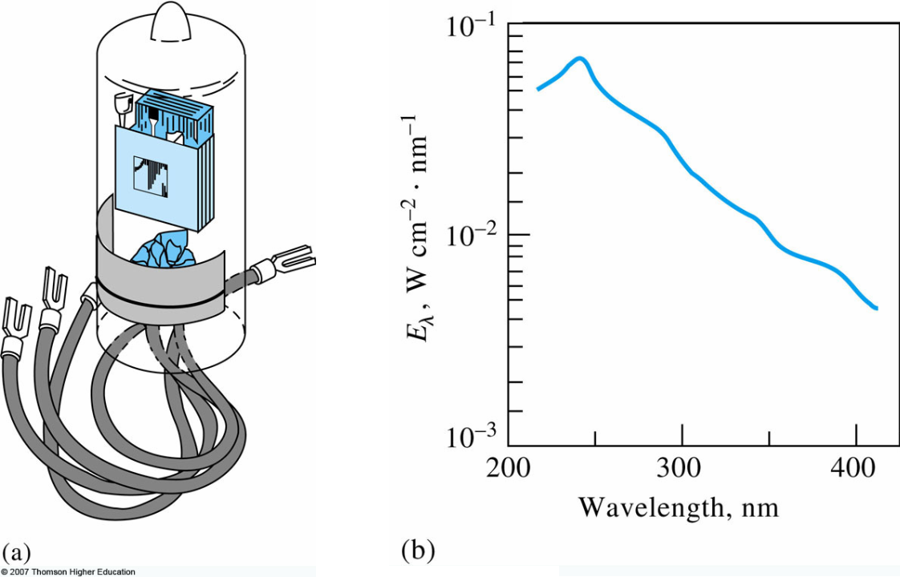
D₂ Lamp
D₂ lamp for the UV region
(a) A deuterium lamp of the type used in spectrophotometers and (b) its spectrum. The plot is of irradiance E_{λ} (proportional to radiant power) versus wavelength. Note that the maximum intensity occurs at about 225 nm. Typically, instruments switch from deuterium to tungsten at about 350 nm.

Slide 24
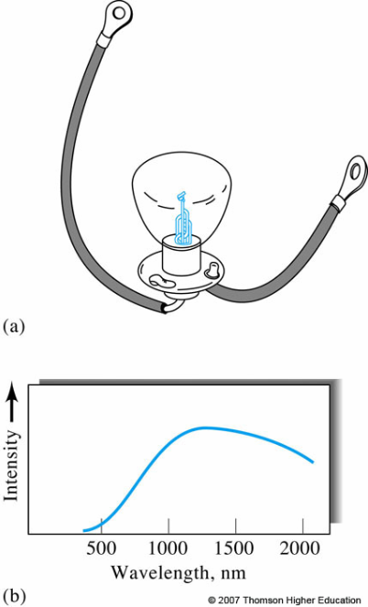
W lamp
(a) A tungsten lamp of the type used in UV/VIS spectrophotometers and its spectrum (b) Intensity of the tungsten source is usually quite low at wavelengths shorter than about 350 nm. Note that the intensity reaches a maximum in the near-IR region of the spectrum (~1200 nm in this case).
W lamp for the VIS and near-IR regions

Slide 25
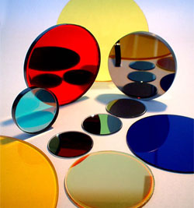
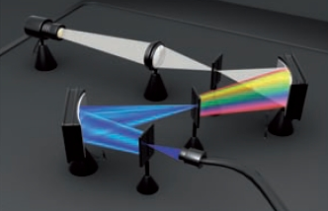
② Wavelength selectors
Wavelength Selectors
Filters
Monochromators
Prism
Grating
Absorption
Interference

Slide 26
② Sample holders
Sample holders must be made of a material that is transparent to radiation in the spectral region of interest.
UV-VIS cuvettes must not absorb in the UV-VIS region.
The most common cell length is 1.0 cm, though 0.1-10 cm are present.
Sample holders for UV/VIS
Glass
Fused silica
Plastic

Slide 27
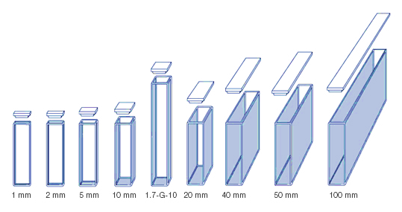
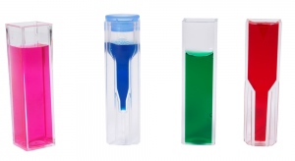
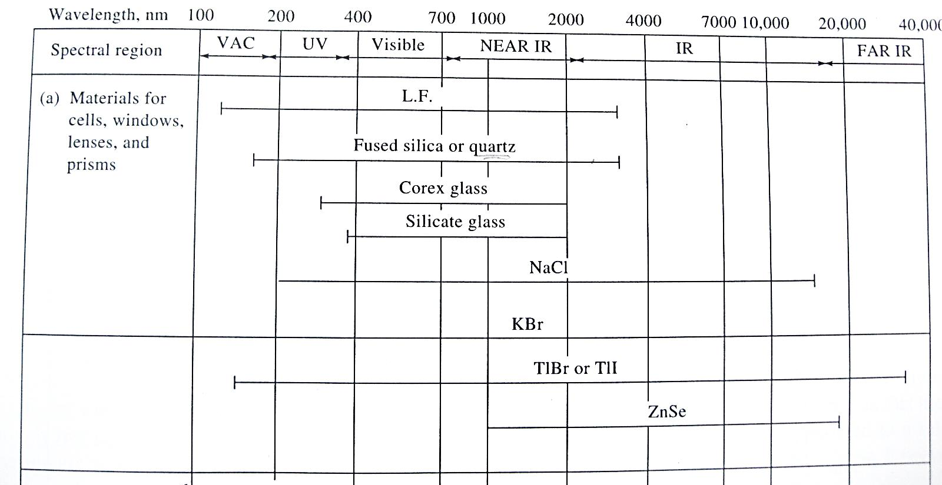
Cuvettes for UV/VIS with different path lengths and shapes
Materials for spectroscopic instruments

Slide 28
Location of Sample Cell
In all photometers and scanning spectrophotpmeters described above, the cell has been positioned after the monochromators. This is important to decrease the possibility of sample photodecomposition due to prolonged exposure to all frequencies coming from the continuum source.
However, the sample is positioned before the monochromator in multichannel instruments like a photodiode array spectrophotometers. This can be done without fear of photodecomposition since the sample exposure time is usually less than 1 s. Therefore, it is now clear that in UV-VIS where photodecomposition of samples can take place, the sample is placed after the monochromators in scanning instruments while positioning of the sample before the monochromators is advised in multichannel instruments.

Slide 29
④ Detectors
Detectors for UV/VIS
Photodiodes
Photomultiplier tubes (PMT)
A photodiode is a semiconductor device that converts light into current. The current is generated when photons are absorbed in the photodiode. Photodiodes may contain optical filters, built-in lenses, and may have large or small surface areas. Photodiodes usually have a slow response time as their surface area increases. The common, traditional solar cell used to generate electric solar power is a large area photodiode.
Photomultiplier tubes, members of the class of vacuum tubes, are extremely sensitive detectors of light in the ultraviolet, visible, and near-infrared ranges of the electromagnetic spectrum. These detectors multiply the current produced by incident light by as much as 100 million times in multiple dynode stages, enabling (for example) individual photons to be detected when the incident flux of light is very low.

Slide 30
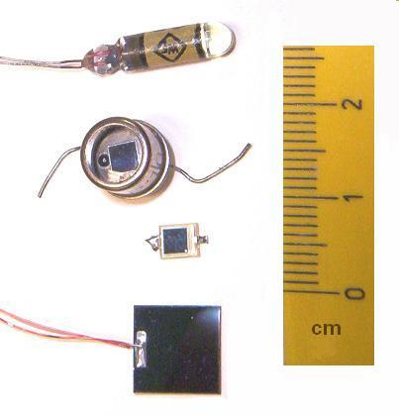
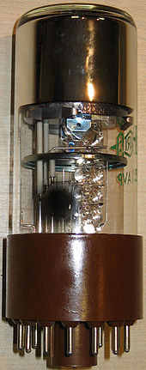
Three Si and one Ge (top)
photodiodes.
Photomultiplier tube
(PMT)

Slide 31
Types of UV/VIS Instruments
UV/VIS Instruments
Single-Beam
Double-Beam
Multichannel
Double-beam-in-space
Double-beam-in-time

Slide 32
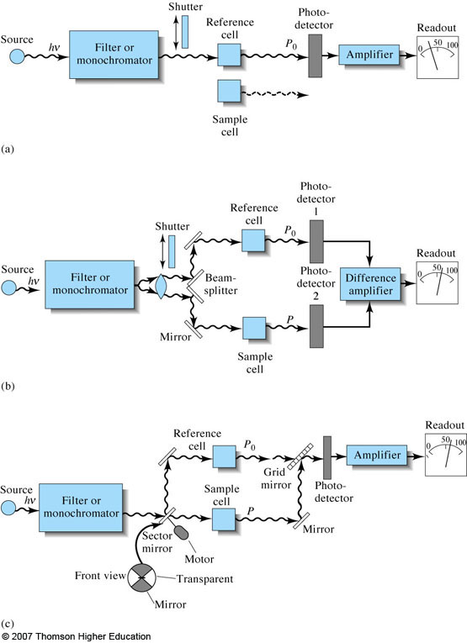
❶ Single-Beam Instruments
The cuvette with a blank (i.e., the solvent) is placed in the instrument and a reading is taken and is considered as 100% T.
The cuvette is replaced with the sample containing the analyte and a reading is taken. The observed % T is for the analyte (from which absorbance can be calculated).

Slide 33
❷ Double-Beam Instruments
(a) Double-beam-in-space
Light is split by a V-shaped mirror and directed towards both reference cell (blank) and sample cell at the same time.
Two detectors are used that subtract the blank from sample.
Advantages over single-beam:
Compensates for fluctuations in source intensity and drift in detector,
Better design for continuous recording of spectra.

Slide 34
❷ Double-Beam Instruments
(b) Double-beam-in-time
Light is split in-time by a sector mirror and directed towards both reference cell (blank) and sample cell one after the other but very rapidly.
One detector is used that subtracts the blank from sample.
Offers the same advantages as for the double-beam-in-space.

Slide 35
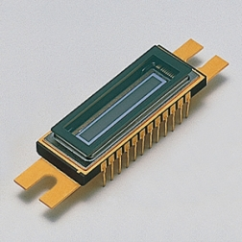
❸ Multichannel Instruments
Photodiode array detectors (DAD) are used (multichannel detectors can measure all wavelengths dispersed by grating simultaneously).
Advantage: scan spectrum very quickly “snapshot” < 1 s.
Powerful tool for studies of transient intermediates in moderately fast reactions.
Useful for kinetic studies.
Useful for qualitative and quantitative determination of the components exiting from a liquid chromatographic column.
DAD

Slide 36
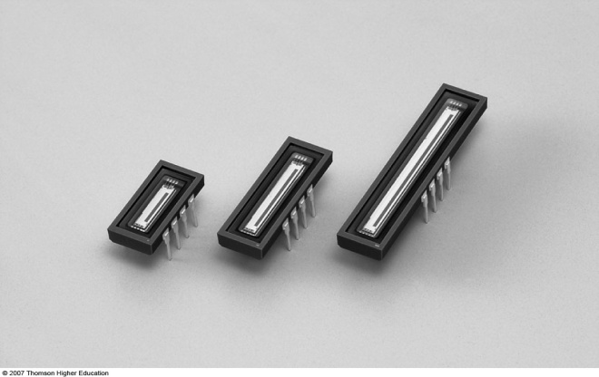
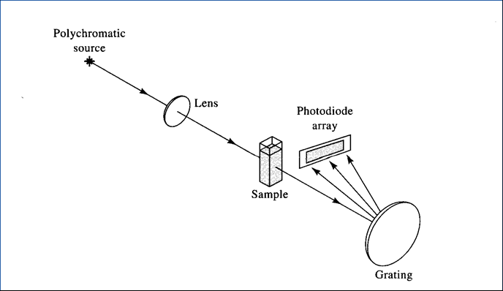
Diagram of a multichannel spectrophotometer based on a grating monochromator and a photodiode array detector (DAD).

